Slide 1



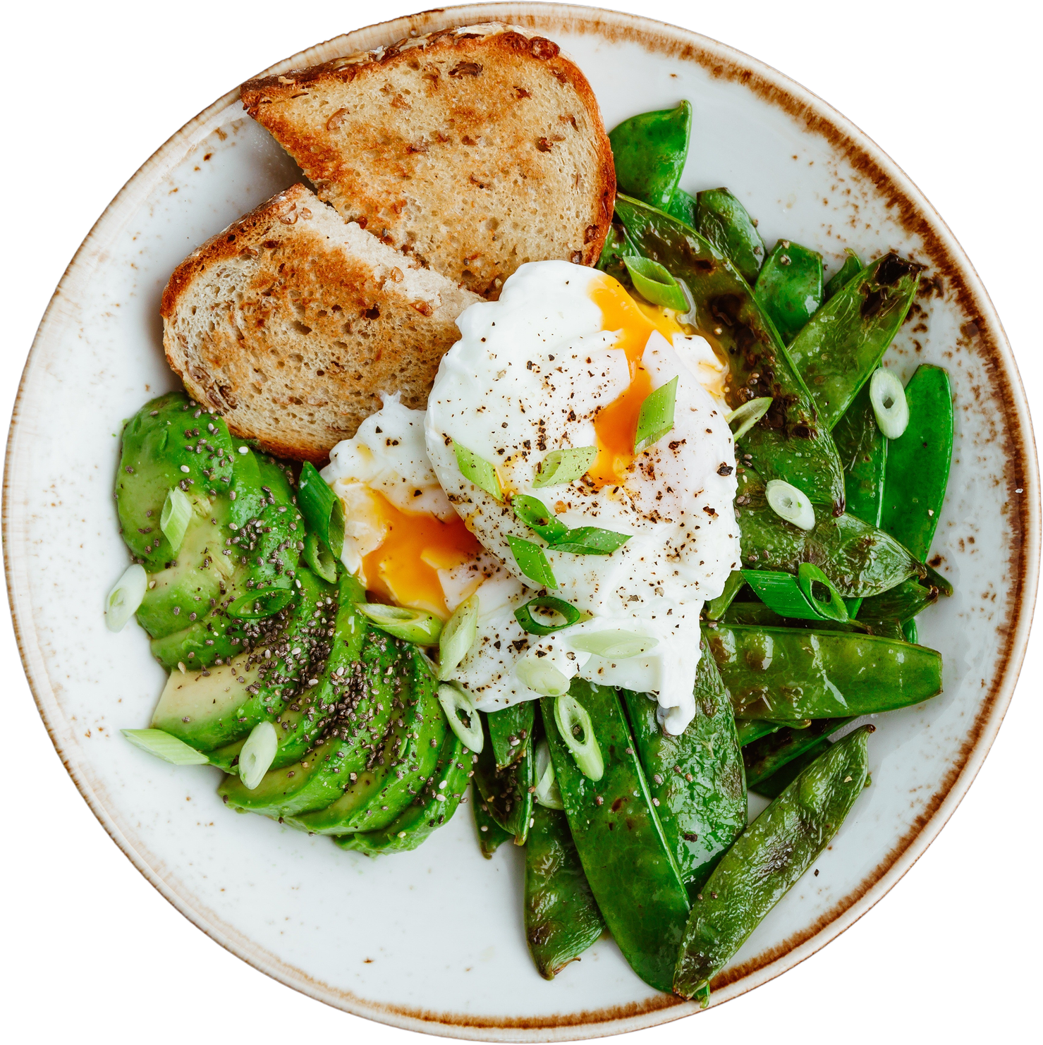
Food Wars:
Battling Big Soda & Ultra-Processed Food
Jan Mould, RN, BSN, MEd

Slide 2
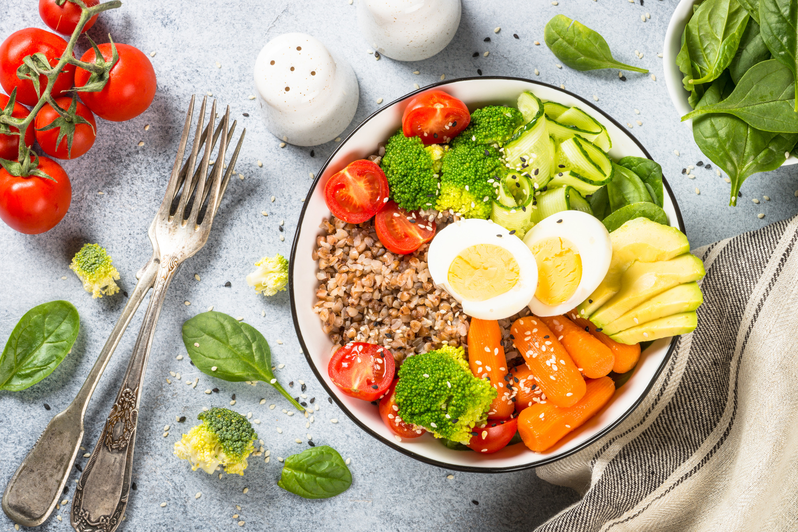
Real Food Wins
Changes have occurred in the nutrition recommendations.

Slide 3
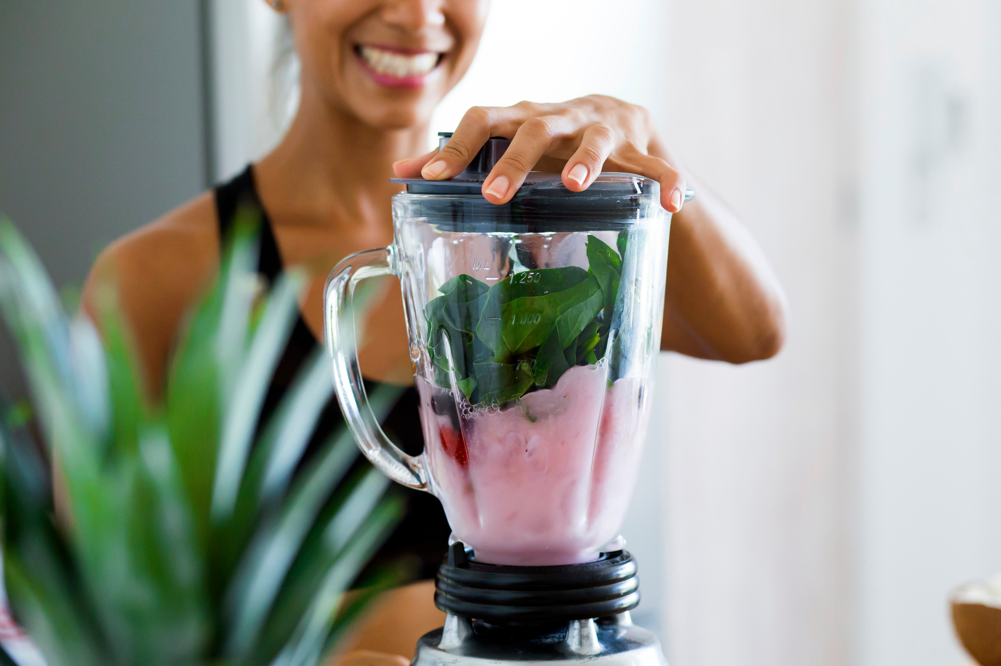
Most of the Foods We Eat are Ultra-Processed. Are They All Unhealthy?

Slide 4

Share the information
PUBLIC HEALTH GUIDELINES

