Slide 1
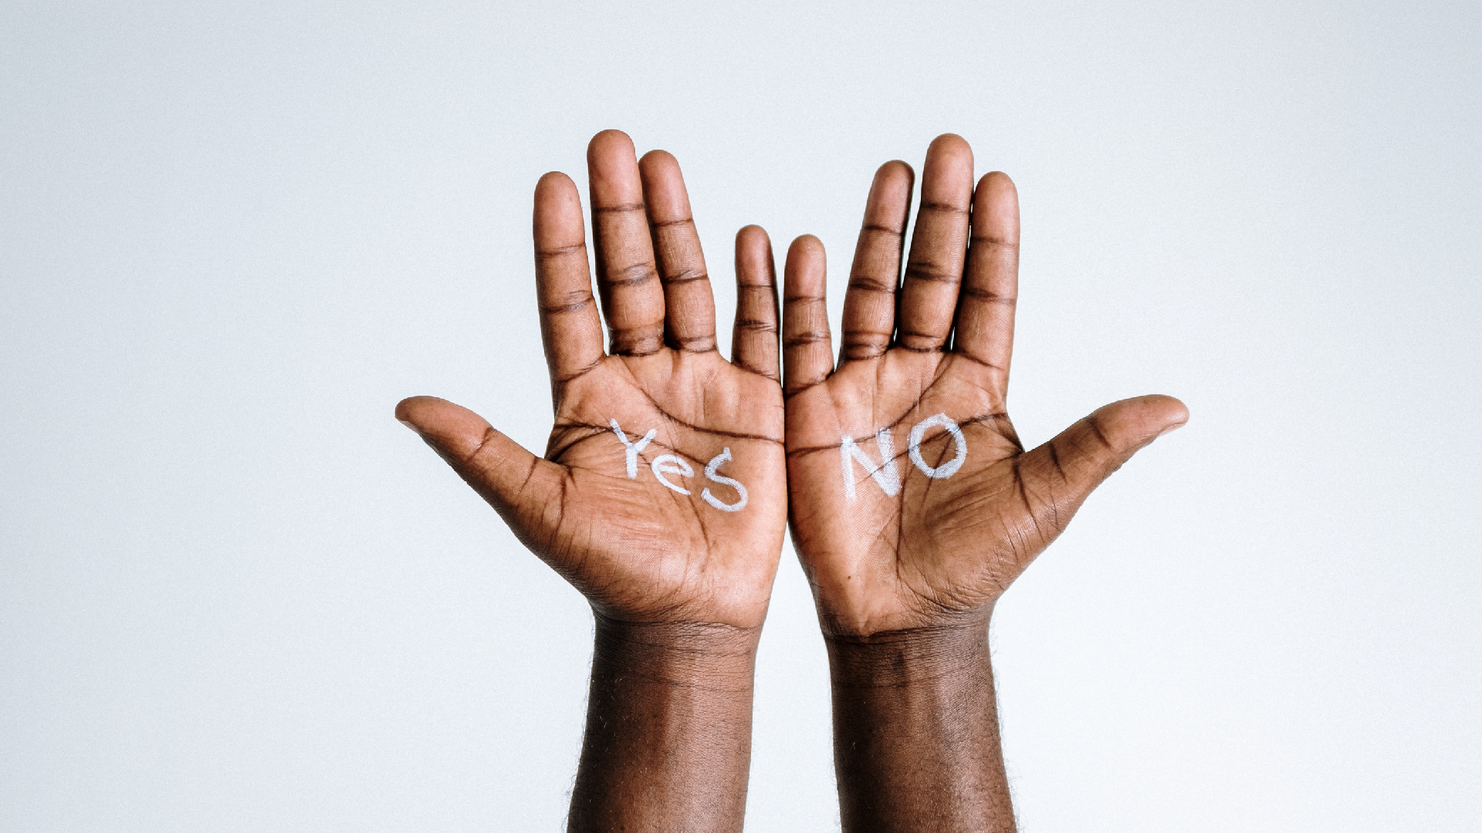


Social Media Influencers - You Make the Call
HOSA
FUTURE HEALTH PROFESSIONALS

Slide 2
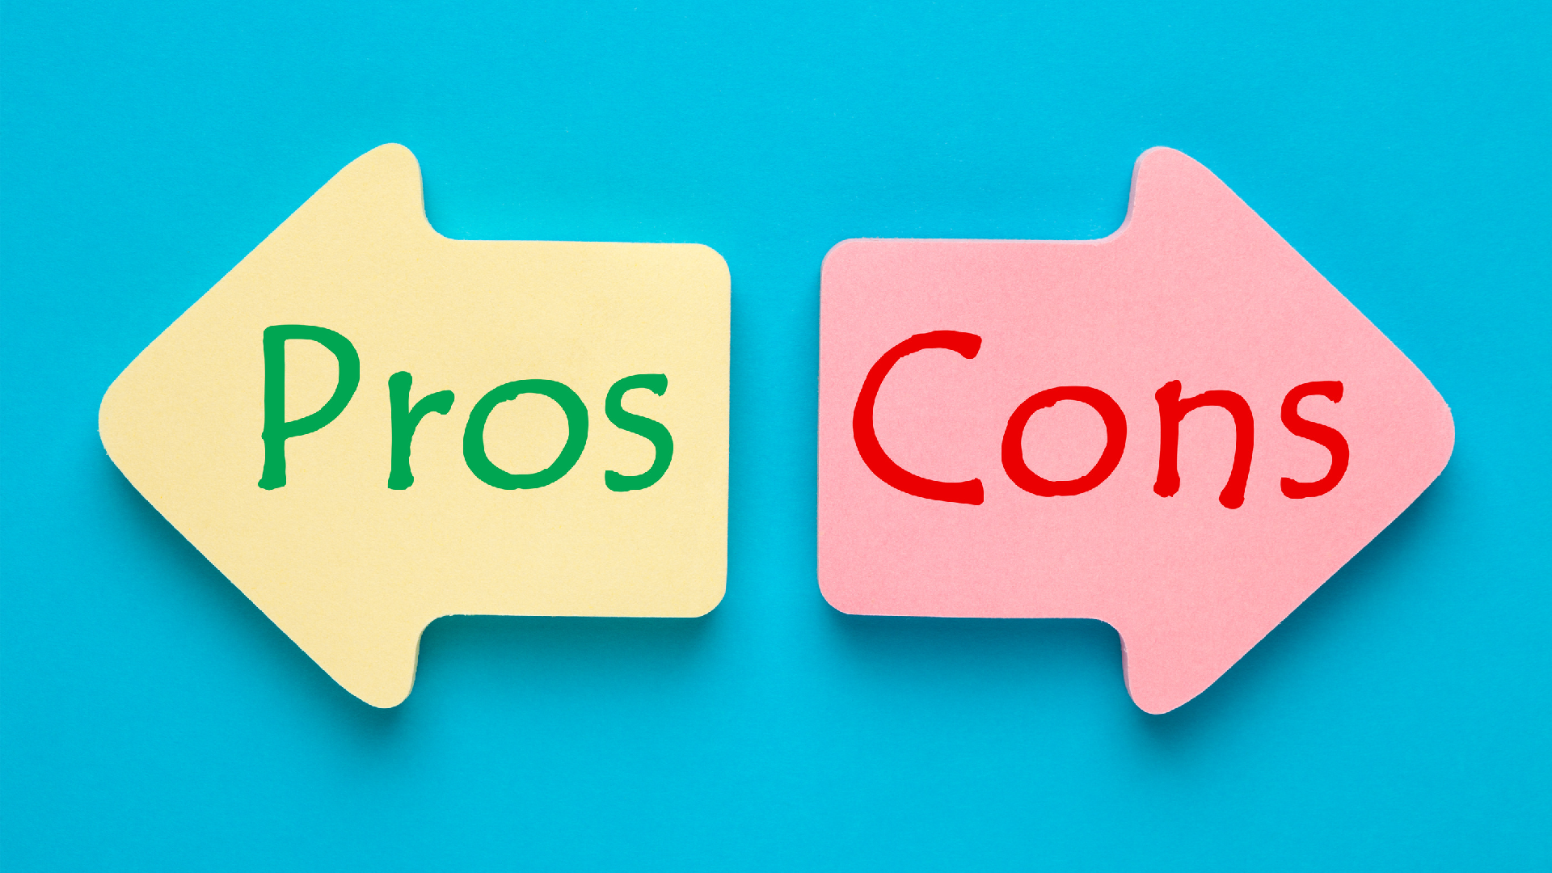

HOSA-FUTURE HEALTH PROFESSIONALS
HOSA.ORG

Slide 3

PROS
Engage the community
Raise awareness
Improvement in health & food literacy Potential to support healthier behaviors
HOSA-FUTURE HEALTH PROFESSIONALS
HOSA.ORG

Slide 4
NEGATIVES
Possible Health Misinformation
Lack consideration of individual health needs Questionable motivation for involvement Advice based on personal experience
HOSA-FUTURE HEALTH PROFESSIONALS
HOSA.ORG

Slide 5

BIOMEDICAL DEBATE

