Slide 2
What’s Wrong With Taking a Pic? HIPAA –Know the Rules Jan Mould, RN, BSN, MEd

Slide 3
CASE I
Last day of clinical rotation for CNA students- how about a selfie of all of us in uniform here at the nurse’s station?

Slide 4
Case I (cont)
The Longterm Care Administrator walks by as the picture is taken and asked, “Did you realize a patient was in the background of the picture you just took?”
Notes:
content used in previous years may not be used again

Slide 5
HIPAA
YOU NEED TO KNOW IT

Slide 6
Case II
Queen of England Calling

Slide 7
Most common violations
Snooping on health care records
UCLA Hospitals fined $865,000
Records of Brittney Spears & Maria Shriver accessed
NEED TO KNOW – NOT WANT TO KNOW

Slide 8
Most common violations
Disclosures of PHI
Filming without patient’s consent New York Presbyterian Hospital $2.2 million penalty
Fax disclosure of HIV status to employer by Luke’s-Roosevelt Hospital Center - $387,000

Slide 9
Most common violations
Improper disposal of PHI
Parkview Health - $800,000 penalty for not disposing of paper records securely

Slide 10
You Make the Call
nurse posted on facebook “ for the first time in my career I saw Measles this week. Actually most of my coworkers and the ER docs saw measles for the first time as well. And honestly, it was rough. The kid was super sick. Sick enough to be admitted to the ICU and he looked miserable

Slide 11
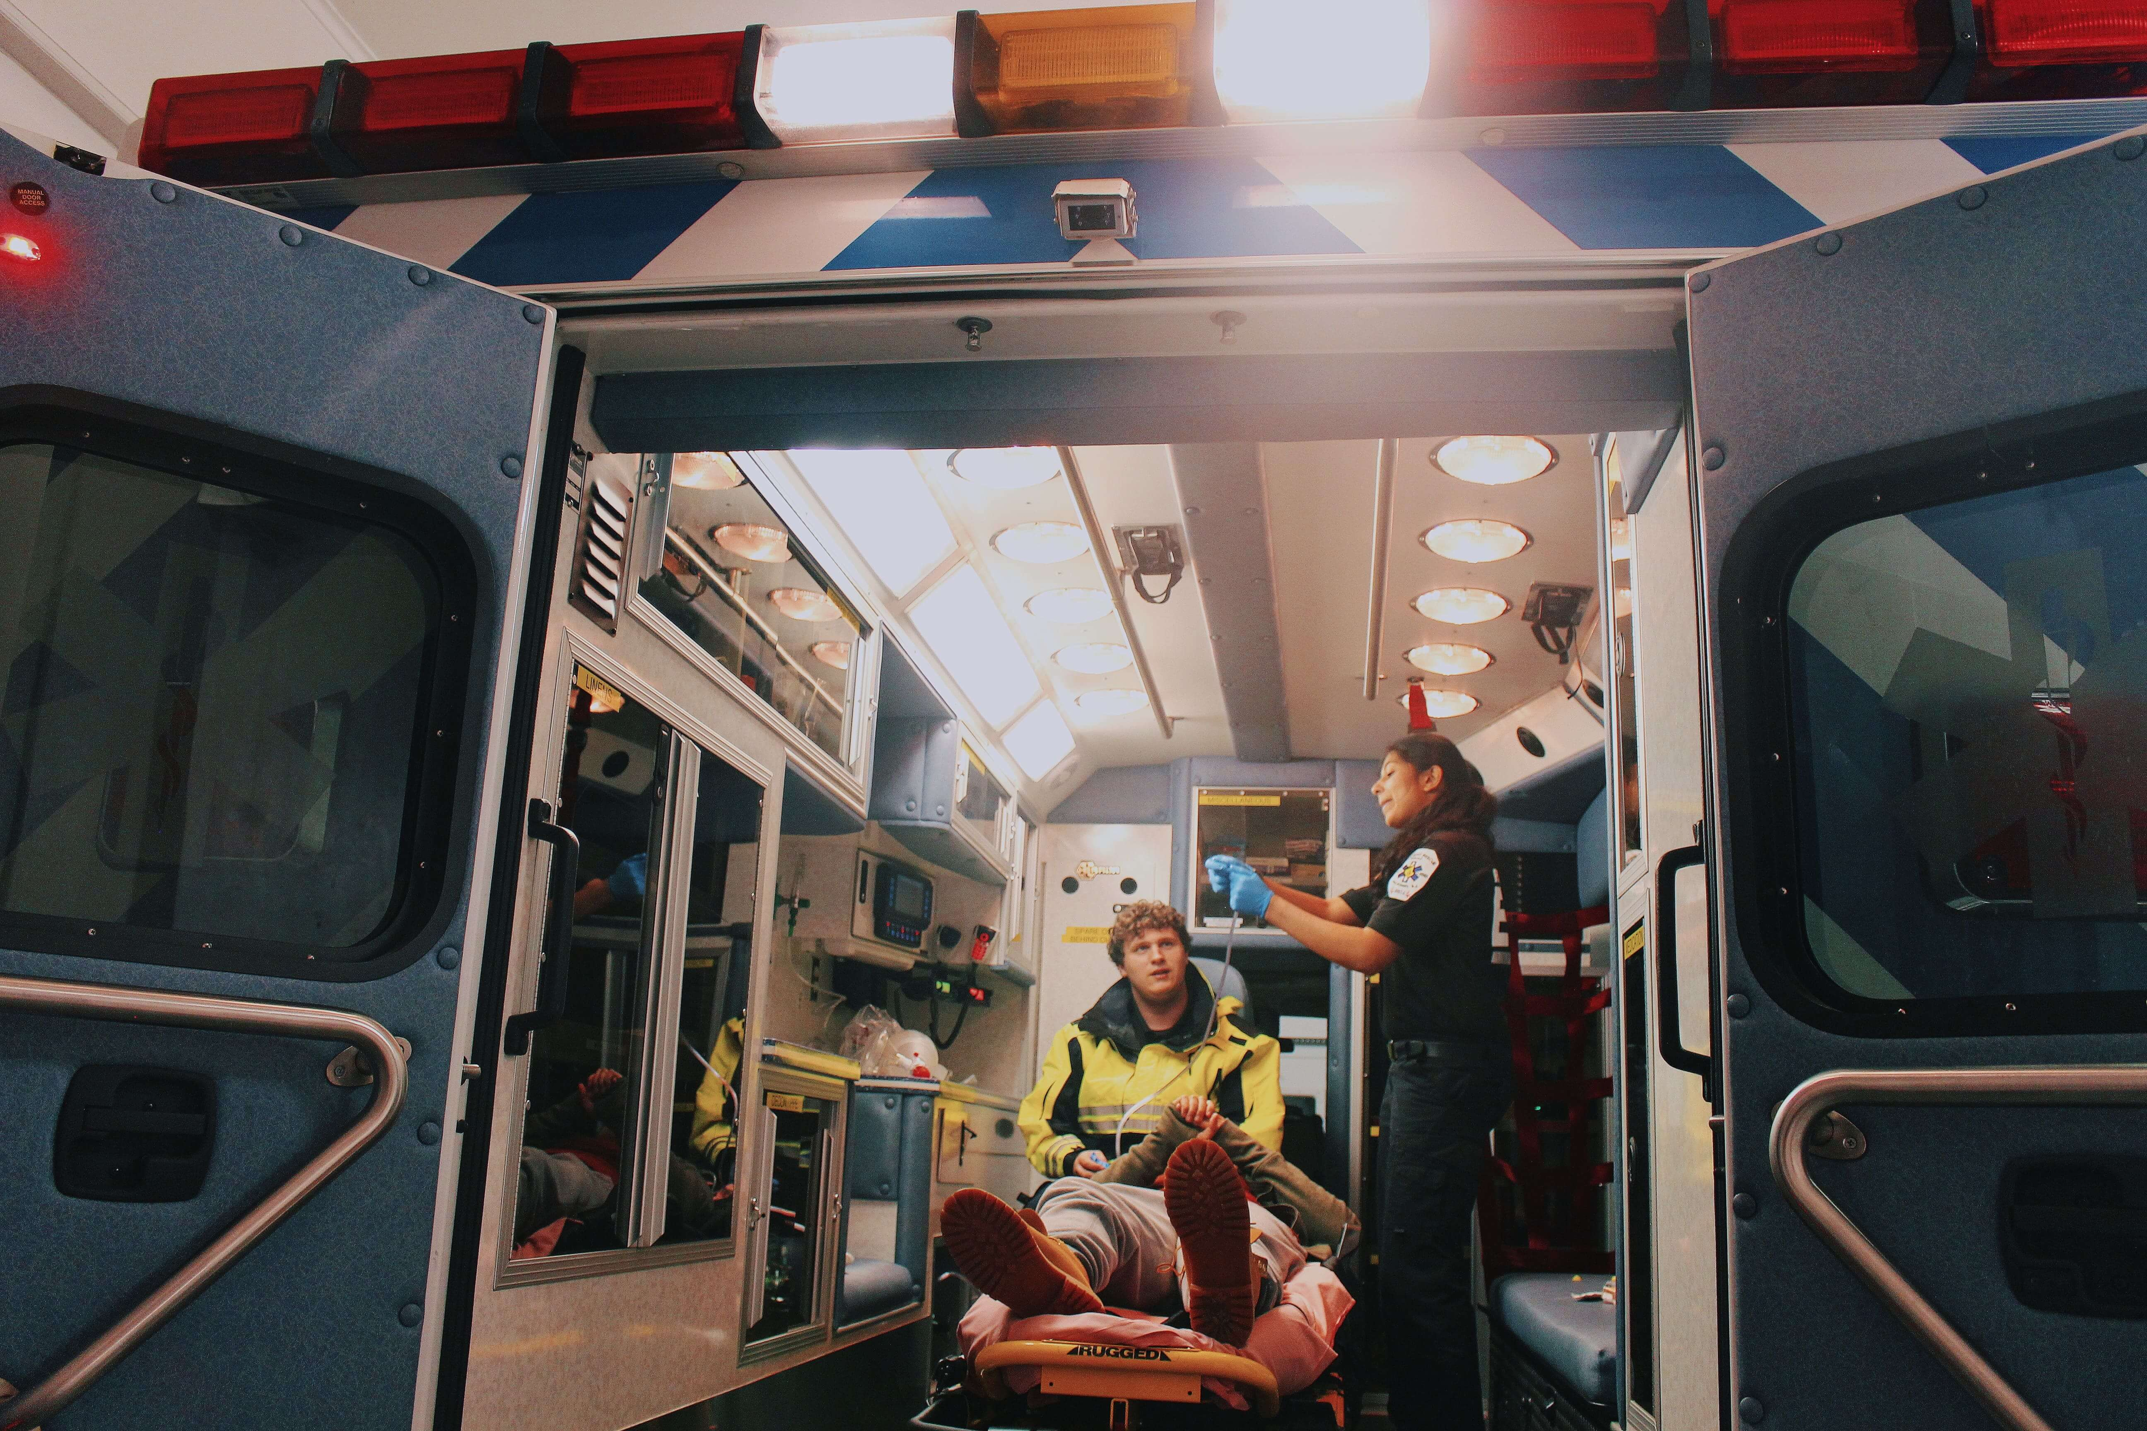
Health Career Photography
Release forms are included in HOSA’s Health Career Photography event to make sure HIPAA rules are followed.

Slide 12
Got it?
Take the quiz

