Slide 1




CELEBRATING FIFTY YEARS OF HOSA
HOSA
FUTURE HEALTH PROFESSIONALS
HOSA.ORG
CELEBRATING
FIFTY YEARS
FUTURE HEALTH PROFESSIONALS

Slide 2

Since its inception in 1976, HOSA has grown steadily reaching over 350,000 members through 55 chartered HOSA Associations, American Samoa, Canada, China, District of Columbia, Korea, Puerto Rico and Vietnam.
HOSA FUTURE HEALTH PROFESSIONALS
HOSA.ORG

Slide 3


A MESSAGE FROM
OUR INTERNATIONAL
PRESIDENT
RIA MOHAN
HOSA is not a club to which a few students in school join. Rather, HOSA is a powerful instructional tool that works best when it is integrated into the HSE and health science related curriculum and classroom. HSE instructors are committed to the development of the total person. Those who join the HSE-HOSA Partnership recognize the importance of providing students with training far beyond the basic technical skills needed for entry into the health care field. The rapidly changing health care system needs dedicated workers who, in addition to their technical skills, are people-oriented and capable of playing a leadership role as a member of a health care team.
HOSA FUTURE HEALTH PROFESSIONALS
HOSA.ORG

Slide 4
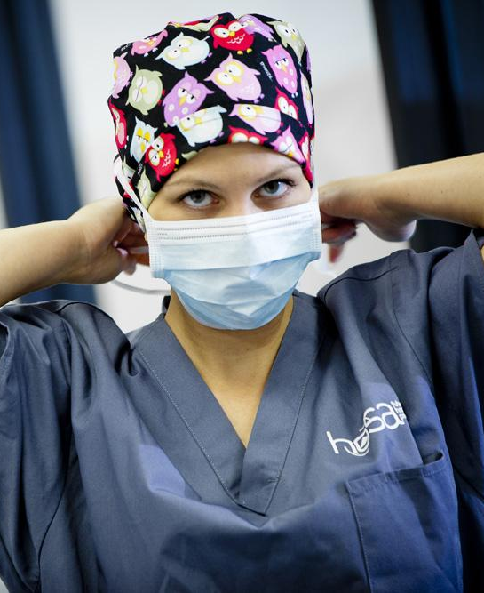

We are Future Health Professionals
HOSA Provides the Health Industry with a Pipeline of Qualified Leaders & Professionals
HOSA's mission is especially critical when considering the acute shortage of qualified workers for the healthcare industry. This shortage has been amplified by the COVID-19 pandemic. In the Spring of 2020 countless doctors and nurses returned to the frontline out of retirement and medical school allowed students to graduate early to fight the pandemic. HOSA is a viable solution to health industry shortages. HOSA Advisors globally are promoting the health professions and ensuring that future health professionals are prepared for college and their health profession of choice!
HOSA FUTURE HEALTH PROFESSIONALS
HOSA.ORG

Slide 5
HOSA: A LEGACY
OF EXCELLENCE
HOSA’S EARLY HISTORY
In 1957 the then United States Office of Education realized that educational programs in health occupations were growing throughout the nation at such a pace that the first Health Occupations Program Specialist, Helen K. Powers, was appointed to supervise the field. As programs expanded, needs for a student organization for health occupations students began to emerge for students enrolled in these programs.
In 1960, early student organizational needs were met through Future Nurses Clubs and Vocational Industrial Clubs of America (VICA). The demand grew for a group that would provide the specialized programs of Health Occupations students. An organization called the Health Careers Clubs gained national strength, especially in states such as Texas, New Jersey, North Carolina, Alabama, New York, New Mexico and others. These clubs focused especially on health programs operating in academic high schools.
Health programming continued to grow and diversify. Health occupations programs were established in vocational and technical schools in many states. Health occupations educators began to see a need for an organized and united effort to consider common and unique concerns of health occupations. The American Vocational Association (AVA) emerged as a logical locus for such a group.
HOSA FUTURE HEALTH PROFESSIONALS
HOSA.ORG

Slide 6
VITAL STATISTICS
HOSA IS FOR FUTURE HEALTH PROFESSIONALS
55 States, Territories, and Country Associations
6,200 HOSA Chapters
350,000 HOSA Members
15,000 International Leadership Conference Attendees
$10 National Affiliation Fee
HOSA FUTURE HEALTH PROFESSIONALS
HOSA.ORG

Slide 7
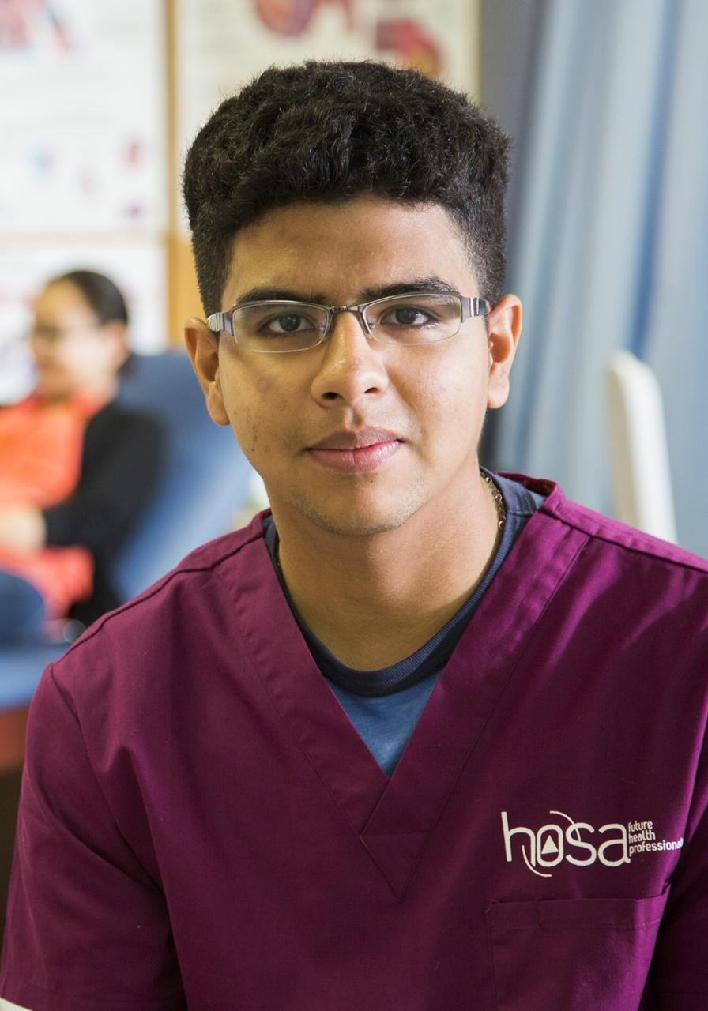
WE ARE
FUTURE HEALTH
PROFESSIONALS
LEARN. LEAD. SERVE. INNOVATE.
HOSA is not a club to which a few students in school join. Rather, HOSA is a powerful instructional tool that works best when it is integrated into the HSE and health science related curriculum and classroom. HSE instructors are committed to the development of the total person. Those who join the HSE-HOSA Partnership recognize the importance of providing students with training far beyond the basic technical skills needed for entry into the healthcare field. The rapidly changing health care system needs dedicated workers who, in addition to their technical skills, are people-oriented and capable of playing a leadership role as a member of a healthcare team.
HOSA FUTURE HEALTH PROFESSIONALS
HOSA.ORG

Slide 8
We are Future Health Professionals
HOSA Provides the Health Industry with a Pipeline of Qualified Leaders & Professionals
HOSA's mission is especially critical when considering the acute shortage of qualified workers for the healthcare industry. This shortage has been amplified by the COVID-19 pandemic. In the Spring of 2020 countless doctors and nurses returned to the frontline out of retirement and medical school allowed students to graduate early to fight the pandemic. HOSA is a viable solution to health industry shortages. HOSA Advisors globally are promoting the health professions and ensuring that future health professionals are prepared for college and their health profession of choice!
HOSA FUTURE HEALTH PROFESSIONALS
HOSA.ORG

Slide 9
HOSA: A LEGACY
OF EXCELLENCE
HOSA’S EARLY HISTORY
In 1957 the then United States Office of Education realized that educational programs in health occupations were growing throughout the nation at such a pace that the first Health Occupations Program Specialist, Helen K. Powers, was appointed to supervise the field. As programs expanded, needs for a student organization for health occupations students began to emerge for students enrolled in these programs.
In 1960, early student organizational needs were met through Future Nurses Clubs and Vocational Industrial Clubs of America (VICA). The demand grew for a group that would provide the specialized programs of Health Occupations students. An organization called the Health Careers Clubs gained national strength, especially in states such as Texas, New Jersey, North Carolina, Alabama, New York, New Mexico and others. These clubs focused especially on health programs operating in academic high schools.
Health programming continued to grow and diversify. Health occupations programs were established in vocational and technical schools in many states. Health occupations educators began to see a need for an organized and united effort to consider common and unique concerns of health occupations. The American Vocational Association (AVA) emerged as a logical locus for such a group.
HOSA FUTURE HEALTH PROFESSIONALS
HOSA.ORG

Slide 10
VITAL STATISTICS
HOSA IS FOR FUTURE HEALTH PROFESSIONALS
55 States, Territories, and Country Associations
6,200 HOSA Chapters
350,000 HOSA Members
15,000 International Leadership Conference Attendees
$10 National Affiliation Fee
HOSA FUTURE HEALTH PROFESSIONALS
HOSA.ORG

Slide 11
WE ARE
FUTURE HEALTH
PROFESSIONALS
LEARN. LEAD. SERVE. INNOVATE.
HOSA is not a club to which a few students in school join. Rather, HOSA is a powerful instructional tool that works best when it is integrated into the HSE and health science related curriculum and classroom. HSE instructors are committed to the development of the total person. Those who join the HSE-HOSA Partnership recognize the importance of providing students with training far beyond the basic technical skills needed for entry into the health care field. The rapidly changing health care system needs dedicated workers who, in addition to their technical skills, are people-oriented and capable of playing a leadership role as a member of a health care team.
HOSA FUTURE HEALTH PROFESSIONALS
HOSA.ORG

Slide 12
HOSA: A LEGACY
OF EXCELLENCE
HOSA’S EARLY HISTORY
In 1957 the then United States Office of Education realized that educational programs in health occupations were growing throughout the nation at such a pace that the first Health Occupations Program Specialist, Helen K. Powers, was appointed to supervise the field. As programs expanded, needs for a student organization for health occupations students began to emerge for students enrolled in these programs.
In 1960, early student organizational needs were met through Future Nurses Clubs and Vocational Industrial Clubs of America (VICA). The demand grew for a group that would provide the specialized programs of Health Occupations students. An organization called the Health Careers Clubs gained national strength, especially in states such as Texas, New Jersey, North Carolina, Alabama, New York, New Mexico and others. These clubs focused especially on health programs operating in academic high schools.
Health programming continued to grow and diversify. Health occupations programs were established in vocational and technical schools in many states. Health occupations educators began to see a need for an organized and united effort to consider common and unique concerns of health occupations. The American Vocational Association (AVA) emerged as a logical locus for such a group.
HOSA FUTURE HEALTH PROFESSIONALS
HOSA.ORG

Slide 13
A MESSAGE FROM
OUR INTERNATIONAL
PRESIDENT
RIA MOHAN
HOSA is not a club to which a few students in school join. Rather, HOSA is a powerful instructional tool that works best when it is integrated into the HSE and health science related curriculum and classroom. HSE instructors are committed to the development of the total person. Those who join the HSE-HOSA Partnership recognize the importance of providing students with training far beyond the basic technical skills needed for entry into the healthcare field. The rapidly changing health care system needs dedicated workers who, in addition to their technical skills, are people-oriented and capable of playing a leadership role as a member of a healthcare team.
HOSA FUTURE HEALTH PROFESSIONALS
HOSA.ORG

Slide 14
HOSA
FUTURE HEALTH PROFESSIONALS
HOSA.ORG
CELEBRATING
FIFTY YEARS

