Slide 1



HOSA’s BEST KEPT SECRETS -
HOW TO MAKE IT EASIER IN YOUR CLASSROOM
Jan Mould, RN, BSN, MEd
Dana Chandler, RN, BSN, MEd
Sam Pohl, BA
Notes:
Jan - introductions

Slide 2

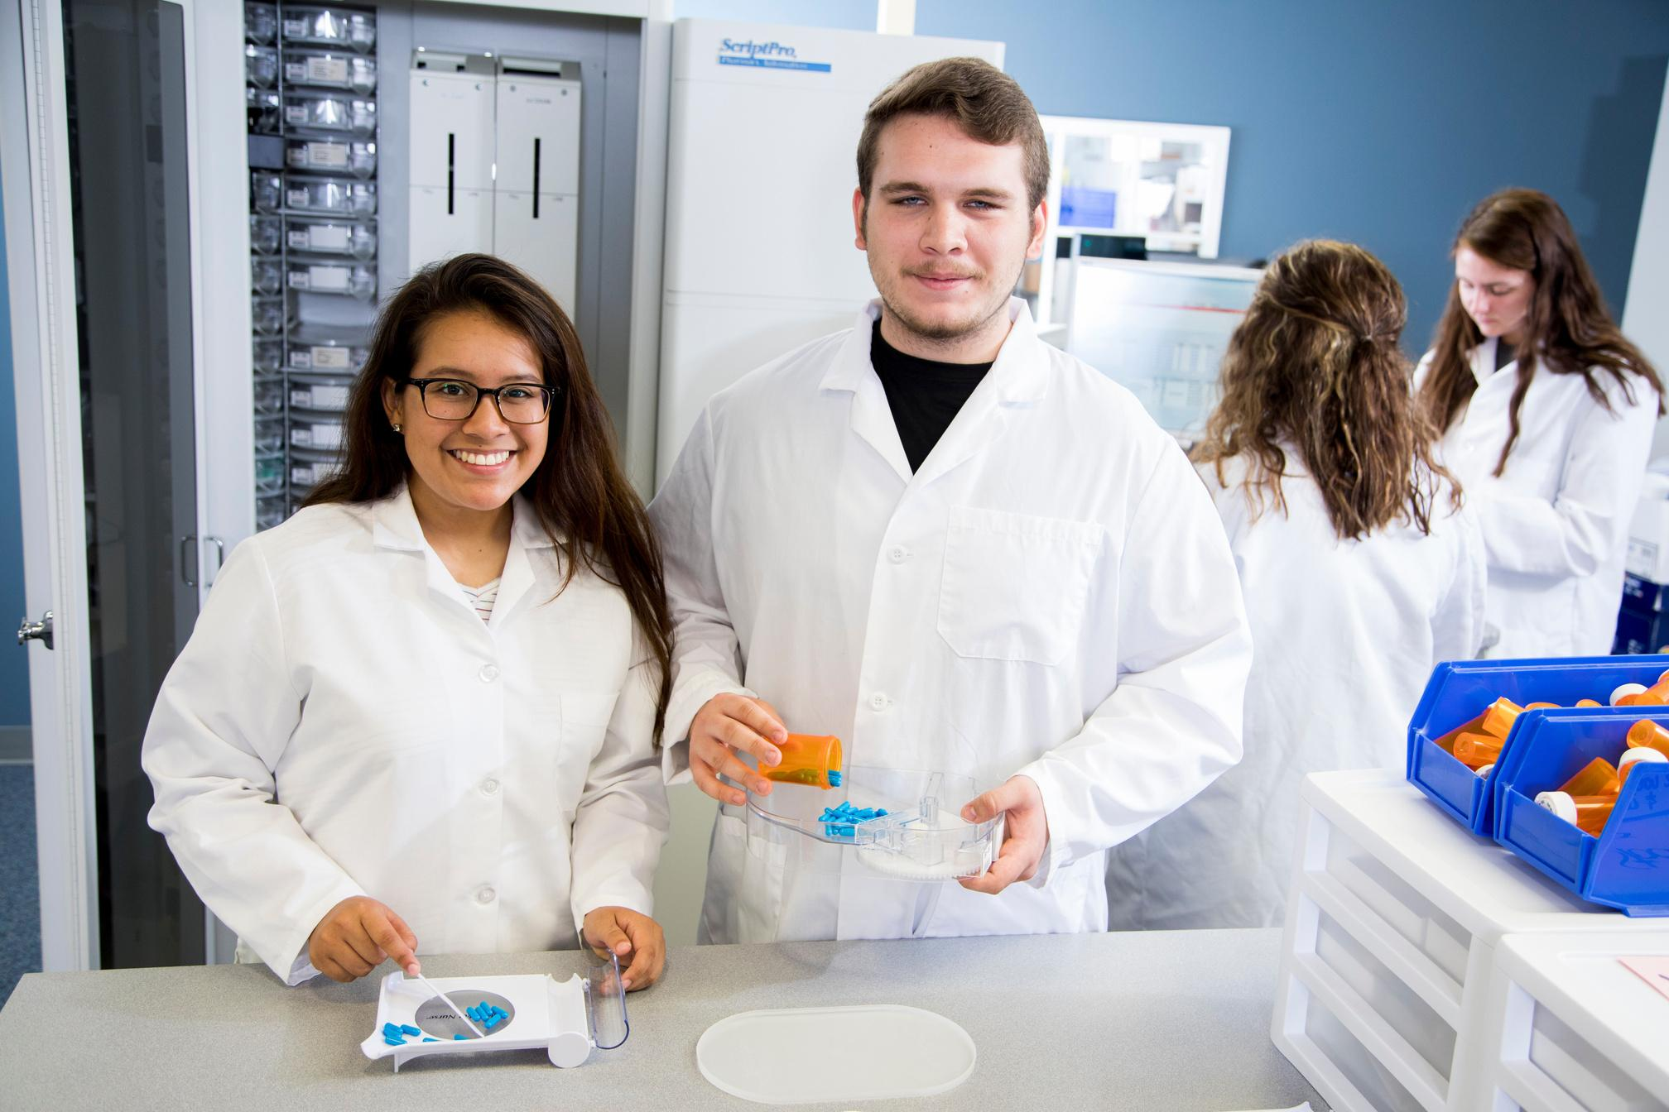
WHY Competitive Events?
helps build programs
pushes members
What Event is Right for
You
Notes:
SAM

Slide 3


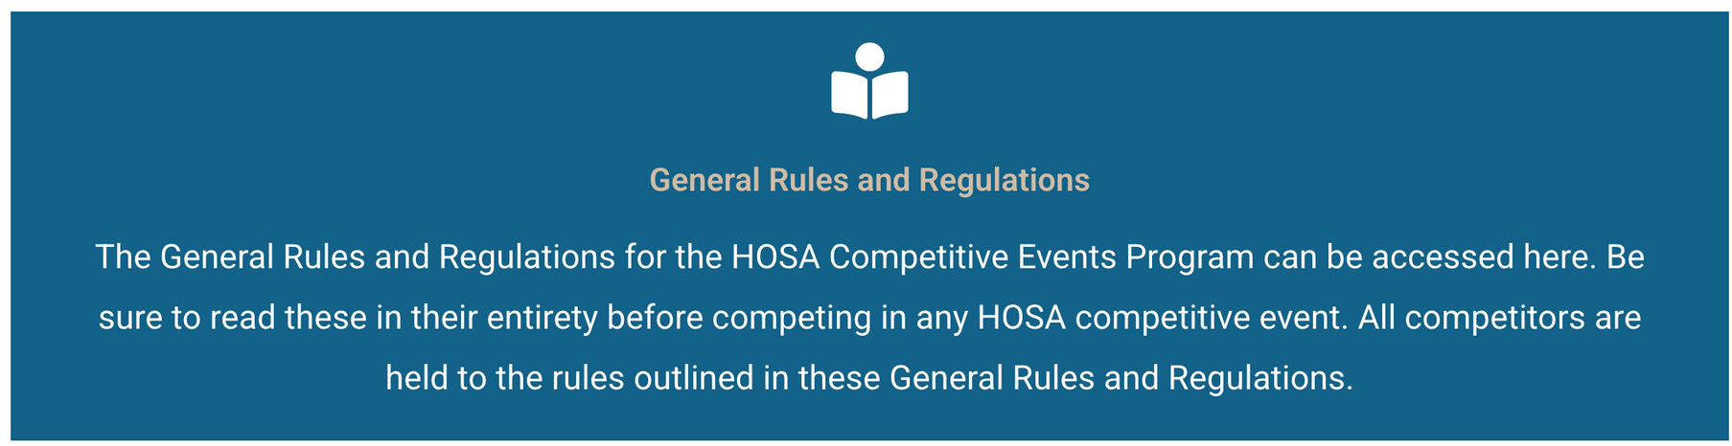
General Rules & Regulations
Notes:
SAM

Slide 4
Your Turn - How Well Do You Know the GRRs
h
Notes:
SAM

Slide 5
CE Useful Tools
CE Updates
Digital Uploads
Event Preparation & Resources
Judge Feedback
Member Activities Tracking Instructions
Competitive Event Samples
Notes:
SAM

Slide 6

CE Useful Tools
Curriculum Resources
Event History
Seeding Charts
Notes:
DANA Review additional resources….
Curriculum resources: review the crosswalks, how it relates to classroom curriculum, verifying the intra curriculum pieces.

Slide 7
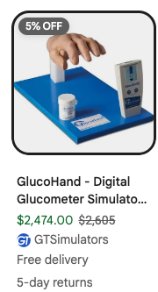
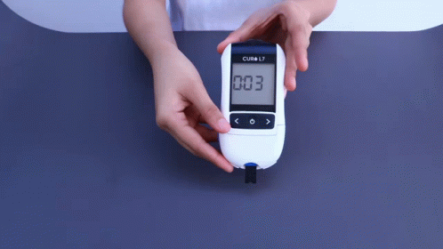
PCT New Skill - Glucometer
easy one
only use simulated body fluids
cheapest I could find - $593.67
Full kit - $2,474.00
Notes:
DANA - NHA (National Hospital Association) suggested the change from EKG interpretation to demonstrating fingerstick and use of glucometer and we thought it
would be easy to implement.
What we discovered was $$$$. Jan began to research and found a great solution which is also being utilized in many simulation labs.

Slide 8
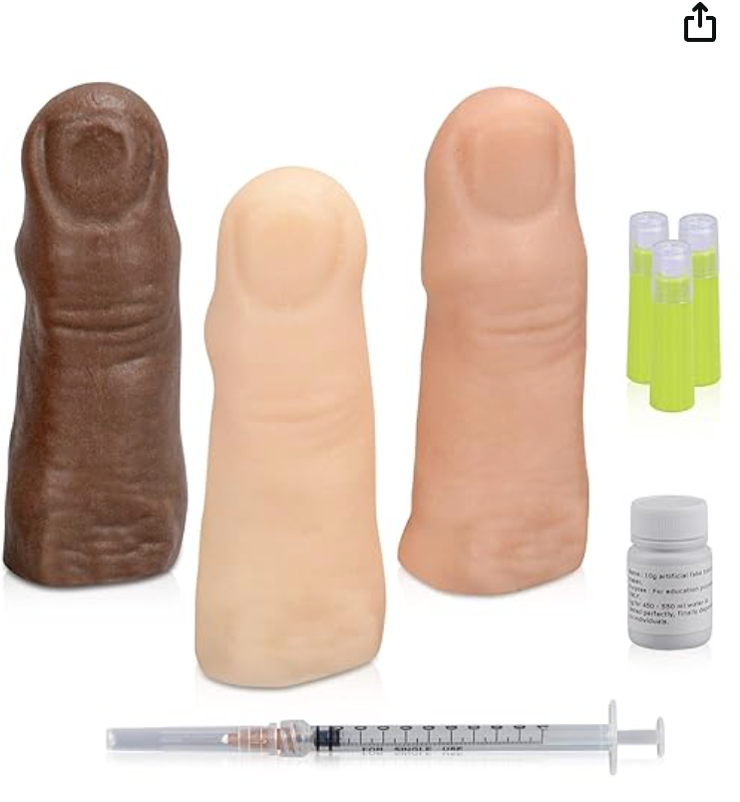
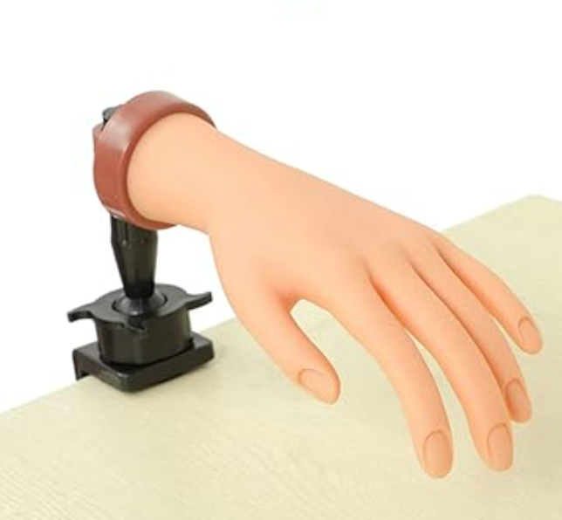
A Possible Solution
Notes:
DANA show the video how the kit works- really cool. The hand is flexible and will work well for the skill. Always use simulated blood.
Demonstrate skill.

Slide 9
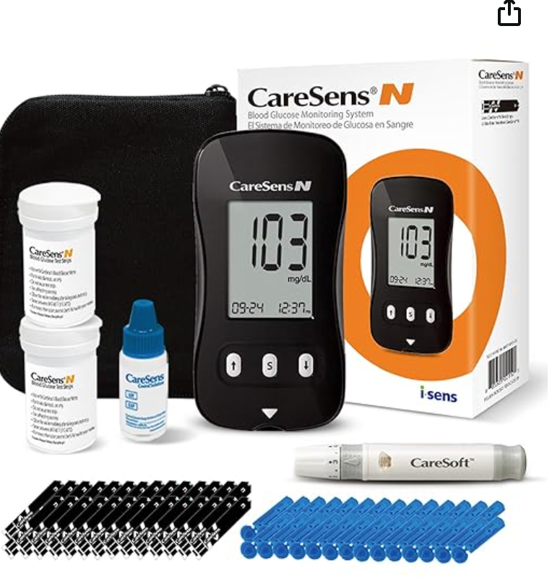
A Possible Solution
Nail practice hand - $13.99
Blood glucose trainer - $39.99
Glucometer - $19.99
Total: $73.97
Notes:
DANA have the student perform the skill; can use the control and will get a reading / comes with 100 lancets and 50 strips.
The student can perform the skill using the control and will get a reading. The total of $73.97 includes 100 lancets and 50 strips.

Slide 10
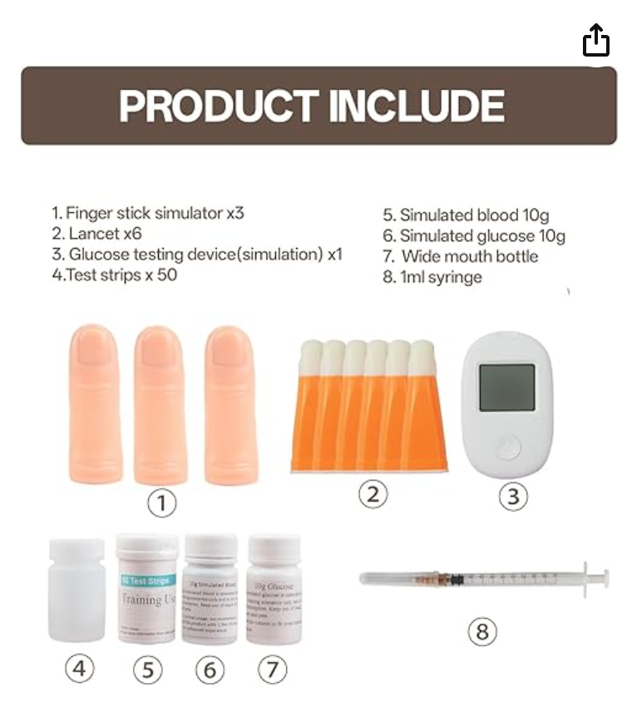
A Possible Solution
Found this one last night – entire kit for $48.99
Blood Glucose Test Trainer Kit
Notes:
DANA have the student perform the skill; can use the control and will get a reading / comes with 100 lancets and 50 strips.
The student can perform the skill using the control and will get a reading. The total of $73.97 includes 100 lancets and 50 strips.

Slide 11

On Demand
Learning Opportunities
Notes:
JAN

Slide 12
On Demand
Learning Opportunities
Mini Lesson: Student Self-Assessment & Other Tools for CE Prep
Notes:
JAN

Slide 13
On Demand
Learning Opportunities
HOSA SCAVENGER HUNT
COMING SOON - GRR WORKSHEET
Notes:
JAN Maybe add QR code here so the audience can scan it.

Slide 14
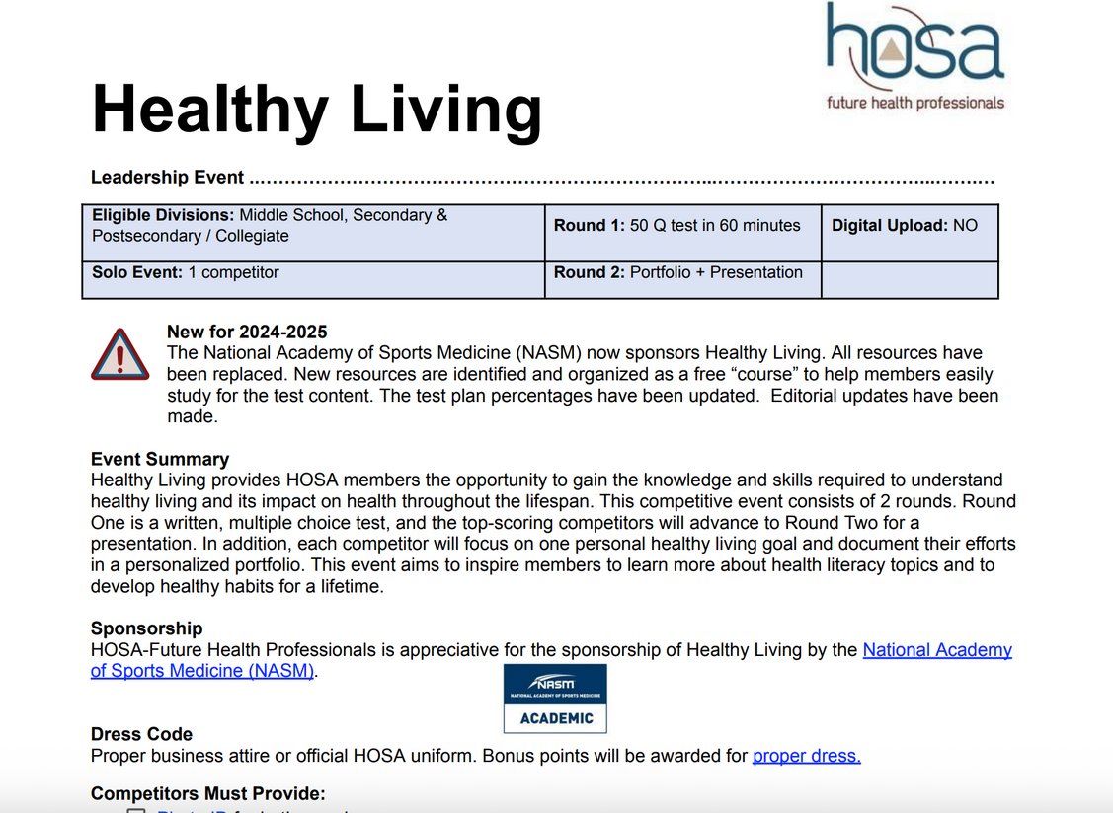
Guidelines
Notes:
JAN

Slide 15
T
Guidelines for use in the classroom
Researched Persuasive Writing & Speaking
Health Education
Biomedical Debate
Medical Innovation - used legos
CERT Skills
Notes:
JAN

Slide 16
Substitute Lessons
FIrFirst
First Step Career Skills
pdf or curriculum
Healthy Living
courses
Notes:
JAN

Slide 17

Competitive Event Winners
Mrs. Mould’s Wall of Fame
Notes:
JAN Wall of Fame - student story

Slide 18

Questions

Slide 19
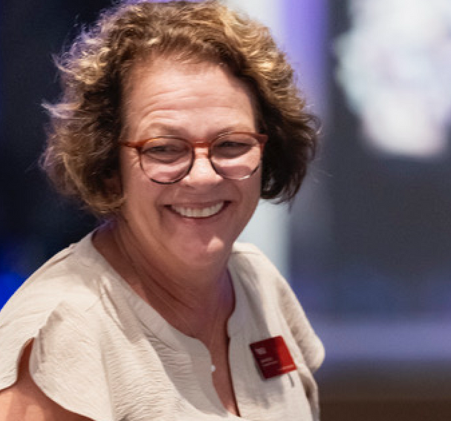

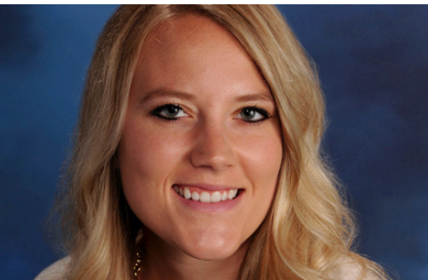
Thank You
Jan Mould
Director, Competitive Events
jan.mould@hosa.org
423.791.2356
Dana Chandler
Deputy Director, Competitive Events
dana.chandler@hosa.org
Sam Pohl
Director CE Operations
sam.pohl@hosa.org

