Slide 1
Competitive Events (CE) Preview for 2025 - 2026
HOSA International Leadership Conference
August, 2025
Notes:
JAN - Jan Mould & Dana Chandler (RNs + HOSA Advisors + CE Team Members)

Slide 2
The best kept secret…
Notes:
JAN

Slide 3
GRR UPDATES
Additional wording regarding presentations in English
Responsible Use AI
Testing ethical statement will be updated
Notes:
JAN

Slide 4
GRR UPDATES (con’t)
Updating human subject use in projects language in Research Poster Guideline
Team members testing at same time
Clarifying language re: participation in ILC after graduation
Notes:
JAN

Slide 5
TEST ITEM CHANGES
THERE WILL BE CHANGES IN THE NUMBER OF TEST ITEMS FOR 2025-2026
ANTICIPATE RIGOR & RELEVANCE TO INCREASE
Notes:
JAN consistency

Slide 6
Health Science Events
Notes:
JAN

Slide 7

Medical Spelling
Rounds 2– 5 will move from 100 terms to 50 terms.
Notes:
JAN - not used

Slide 8

Pharmacology
Dean Vaughn Pharmacy will be added to the resources.
Notes:
JAN

Slide 9
Recognition Events
Notes:
JAN

Slide 10
Healthcare Issues Exam
CNN will be retired as a resource
The registration cap of 25% of previous year’s ILC attendance will be removed
Notes:
JAN

Slide 11
All recognition events have been updated to better align

Slide 12
Health Professions Events
Notes:
DANA

Slide 13

Veterinary Science & Foundations of Veterinary Science
The number of dogs used for identification will be decreased to 50 for both events. The guidelines will include a list of selected breeds.
Notes:
DANA

Slide 14

Occupational Therapy
The event will move to a Round 1 written test and Round 2 skill assessment.
The test plan will not change.
Notes:
DANA

Slide 15
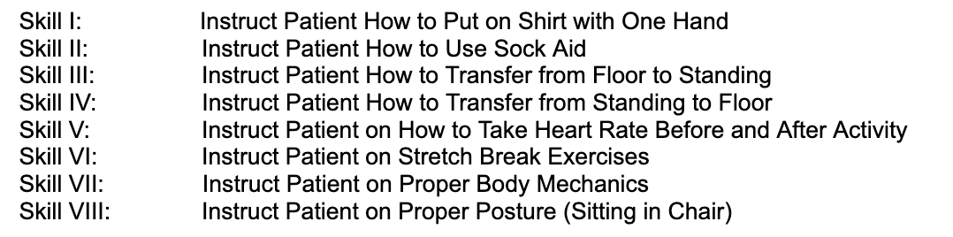
Occupational Therapy Skills
Notes:
DANA

Slide 16

Respiratory Therapy
The round one presentation will be retired and replaced with a round one written examination - 50 multiple choice ?s Test plan with guideline release
Notes:
DANA

Slide 17
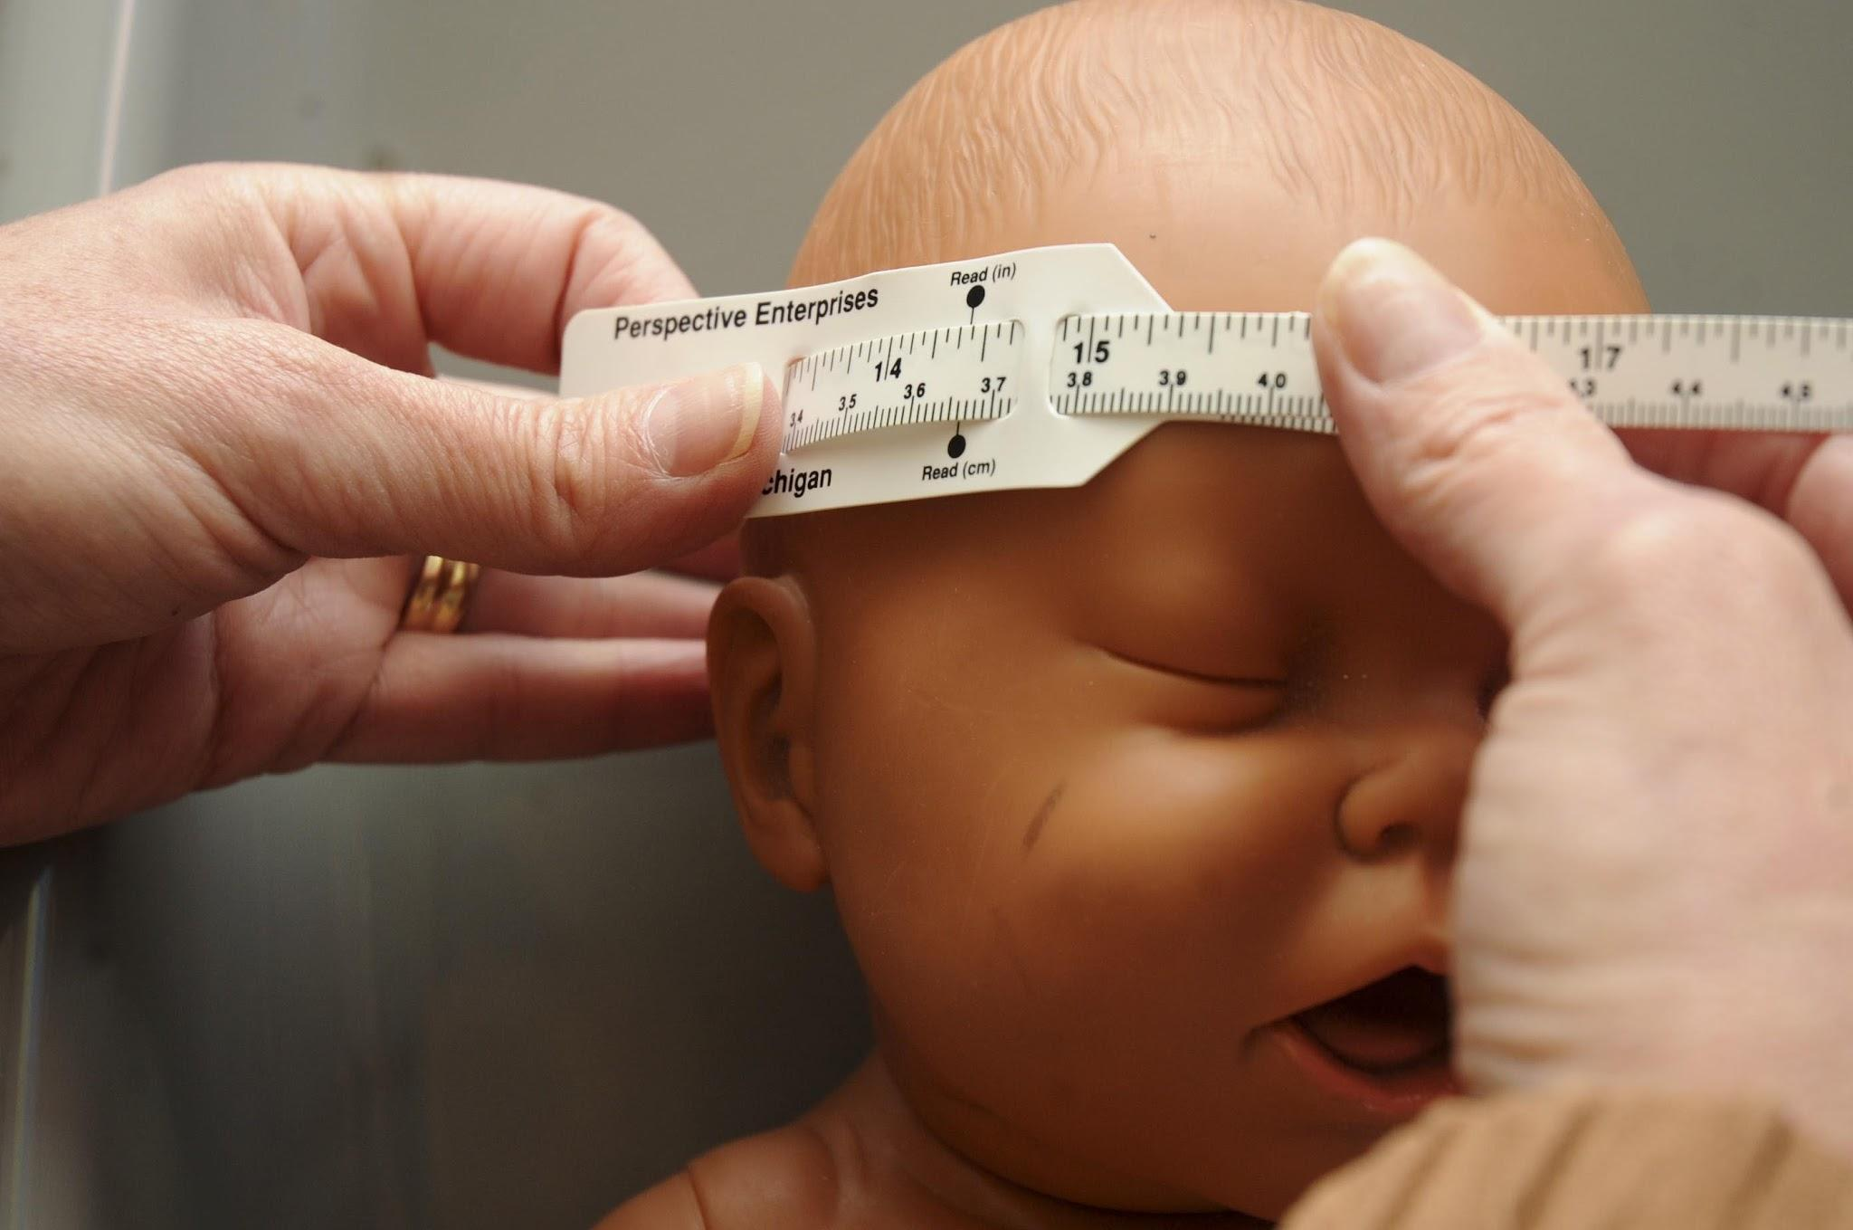
PCT
Skills & Resources updated
MA - one skill update

Slide 18
Emergency Preparedness
Notes:
DANA

Slide 19
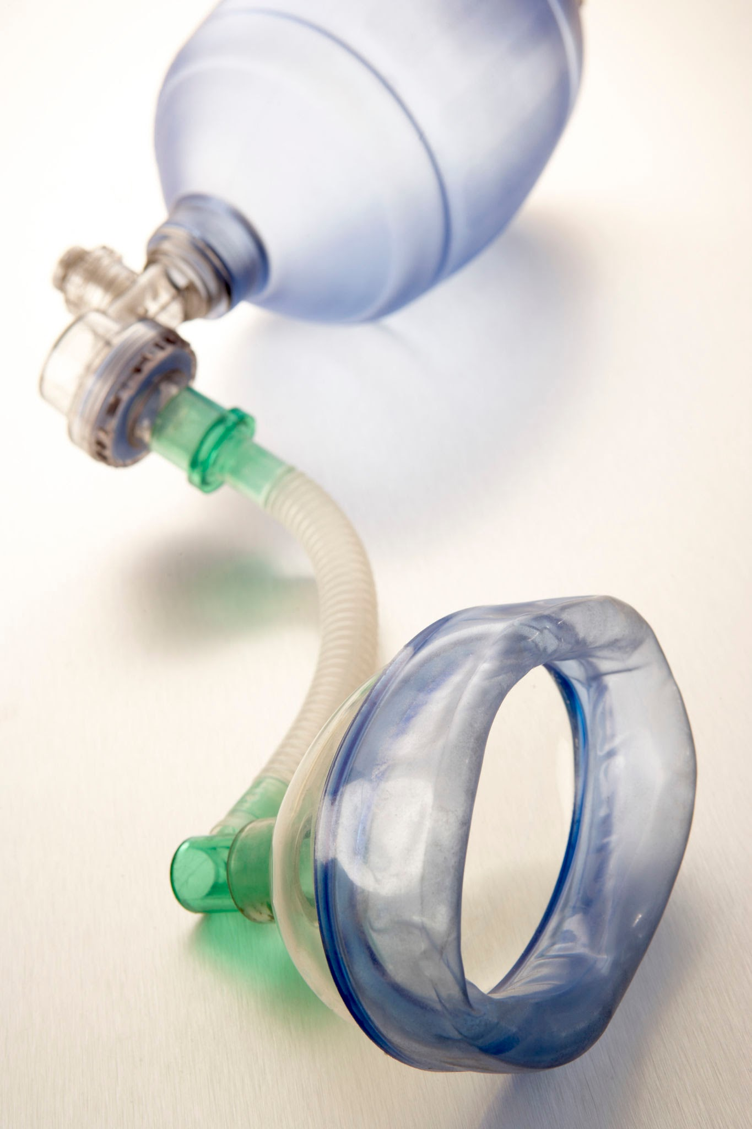
All Events with CPR
Following ARC and AHA – breathing will no longer be simulated
Notes:
DANA

Slide 20

CPR/First Aid, LSS & EMT
Change order of 911 call in those skills requiring immediate action
Notes:
DANA

Slide 21


MENTAL HEALTH PROMOTION
One location for all
social media
access is required
Notes:
DANA

Slide 22
Epidemiology
Some of the websites will be retired.
New digital resource will be added
ActivEPI
Test plan will be updated
Notes:
DANA

Slide 23
Leadership Events
Notes:
DANA

Slide 24


Prepared Speaking & Speaking Skills
A resource from the new sponsor will be added.

Slide 25
Research Poster
Event moves to Rd 1 & Rd 2
Top posters and abstracts may be featured in HOSA e-Magazine Fall edition
Notes:
DANA

Slide 26
Middle School Events
Notes:
DANA

Slide 27
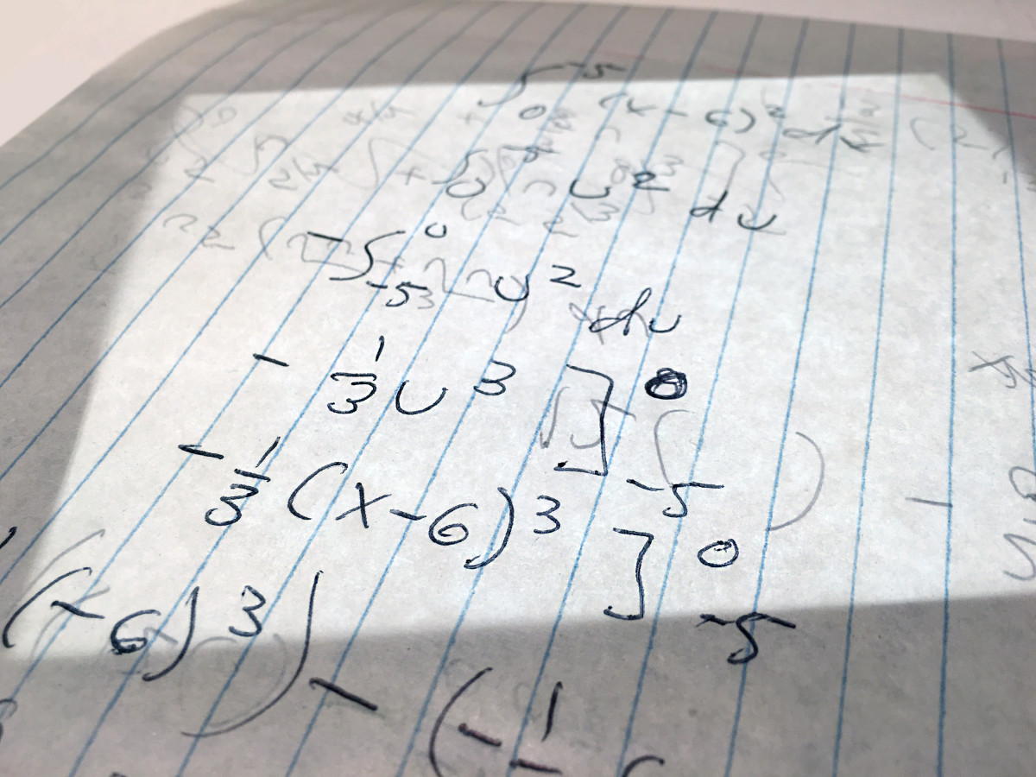
Math for Health Careers
multiple choice to fill in the blank to align with other math events
Notes:
DANA

Slide 28
Health Career Preparation
Statement of Interest will be a digital upload to align with interview & job seeking skills
Notes:
DANA

Slide 29
Teamwork Events
Notes:
DANA

Slide 30
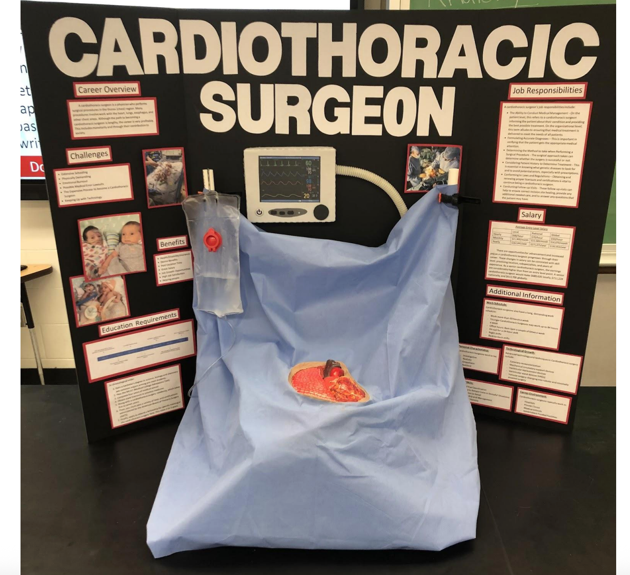
Health Career Display
Teams will be required to include one picture of their board in addition to ”the plan” in their digital upload
Notes:
DANA - Found that for Round 1 this was an important piece for the event

Slide 31
Health Education & Community Awareness
The guidelines will reflect a definition of health to include the following aspects:
physical, mental, environmental and societal
Notes:
DANA

Slide 32
NEW Events
Notes:
JAN NEW EVENTS - for all, remember it is up to state to run at SLC

Slide 33
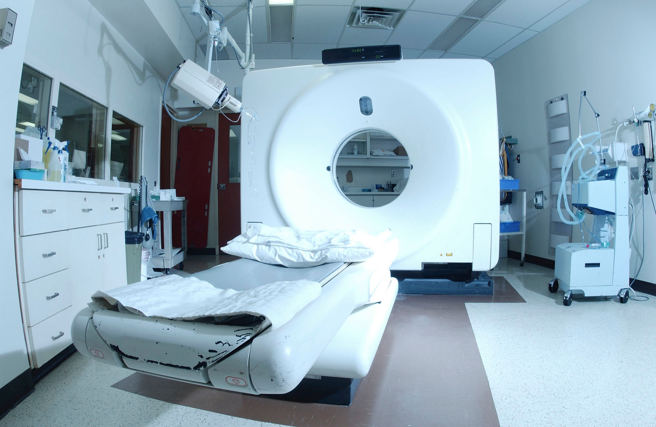

NEW EVENTS!
Biomedical Equipment Technician
The event will consist of a 50 question multiple-choice test.
Notes:
Jan - new Health Professions event
test only this year

Slide 34
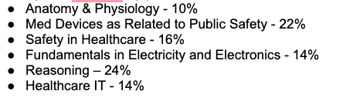
Biomedical Equipment Technician
Test Plan
E
Notes:
JAN

Slide 35

First Step Career Skills
MIDDLE SCHOOL ONLY EVENT
Research of AAMC First Step Career Skills and develop a role playing video that demonstrates a selected career skill
Sponsored by AAMC

Slide 36

Foundations of Healthy Living
Test will be designed for Middle School with less NASM Modules included in test plan
Presentation @ ILC for the judges will be on one of the covered modules
New Event for Middle School Only

Slide 37

Healthcare Administration
Written test – 50 multiple-choice test with a tiebreaker
NEW EVENTS!
Notes:
JAN
this will be the 15th ATC

Slide 38
Healthcare Administration Test Plan
Globalization of Health Care Delivery Systems and Challenges - 10%
Leadership & Management Framework - 10%
Organization Design & Coordination - 10%
Motivating People and Conflict Management - 10%
Teams & Team Effectiveness -10%
Communication - 10%
Improving Quality - 10%
Strategy & Achieving Mission - 10%
Health Policy & Regulation - 10%
Consumerism & Ethics - 10%
Notes:
JAN

Slide 39
Health Administration Resources
Shortell & Kaluzny’s Health Care Management: Organization Design and Behavior by Burns, Bradley, Weiner
Introduction to Health Care Management by Sharon B. Buchbinder
Notes:
JAN

Slide 40


NEW EVENTS!
Moving from pilot status to regular events - watch for guidelines
Rd 1 Test & Rd 2 Skills
Surgical Technologist
Notes:
JAN sponsored by AST; piloted in 2024-2025
resources listed
round 1 50 Q MC - test plan for this listed on slide
round 2 , 7 skills
combinated of nursing patient care skills, plus EKG and phlebotomy skills

Slide 41
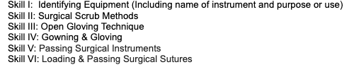

Surgical Technologist Skills
Notes:
JAN

Slide 42

HOSA HISTORY EXAM
Recognition Opportunity for the
HOSA - Future Health Professionals
One year only in celebration of the 50 anniversary!
Open to all Divisions, Alumni, and Local Advisors

Slide 43
Annual Books and Topics

Slide 44

Medical Reading Books
Through the Decades
Notes:
JAN Books were selected from the decades since the event was released

Slide 45

Notes:
JAN - Gifted Hands - 80’s/ FIrst Do No Harm - 90s/ Tuesdays with Morri - 2000s/ Being Mortal + Wonder -2010s/Ultra-Processed People + The Unseen Body - 2020s

Slide 46
Postsecondary/Collegiate and Secondary Divisions
Gifted Hands by Dr. Ben Carson
First Do No Harm by Lisa Belkin
Tuesdays with Morrie by Mitch Albom
Being Mortal by Atul Gawande
Ultra Processed People by Dr. Chris Van Tullekan
Notes:
JAN

Slide 47
Gifted Hands by Dr. Ben Carson
Wonder by RJ Paladcio
Chasing My Cure: A Doctor’s Race to Turn Hope into Action by David Fajgenbaum
Middle School Division - UPDATED 6.30.25
Notes:
JAN

Slide 48
ANNUAL TOPIC!
Biomedical Debate:
Social Media Health Influencers Should be Monitored
Notes:
JAN

Slide 49
ANNUAL TOPIC!
Researched Persuasive Writing and Speaking:
Is the Smartphone Responsible for the Current Youth Mental Health Crisis?
Notes:
JAN

Slide 50
ANNUAL TOPIC!
Public Health:
Food Wars: Battling Big Soda and Ultra-Processed Food
Notes:
JAN

Slide 51

ANNUAL TOPIC!
Public Service Announcement:
Brain Health is Public Health
Notes:
JAN

Slide 52

ANNUAL TOPIC!
Speaking Skills and Prepared Speaking:
Champions of Change: 50 Years of HOSA -
Future Health Professionals
Notes:
JAN SS and PS – topic is the 25-26 theme:
Champions of Change: 50 Years of HOSA

Slide 53

QUESTIONS
JAN MOULD, RN, BSN, MEd
jan.mould@hosa.org
DANA CHANDLER RN, BSN, MEd dana..chandler@hosa.org
Notes:
JAN

Slide 54
Thank you!
We hope you all have had wonderful ILC!
We hope to see your for the 50th in Indianapolis!
Notes:
JAN

