Slide 1
Jan Mould, RN, BSN, MEd Deputy Director of Competitive Events HOSA – Future Health Professionals
Occupational Therapy Resources

Slide 2

Occupational Therapy

Slide 3

Awesome resource

Slide 4
OCCUPATIONAL THERAPY EVENT
2025 - 2026 – The event will consist of a Round 1 test and Round 2 skills

Slide 5
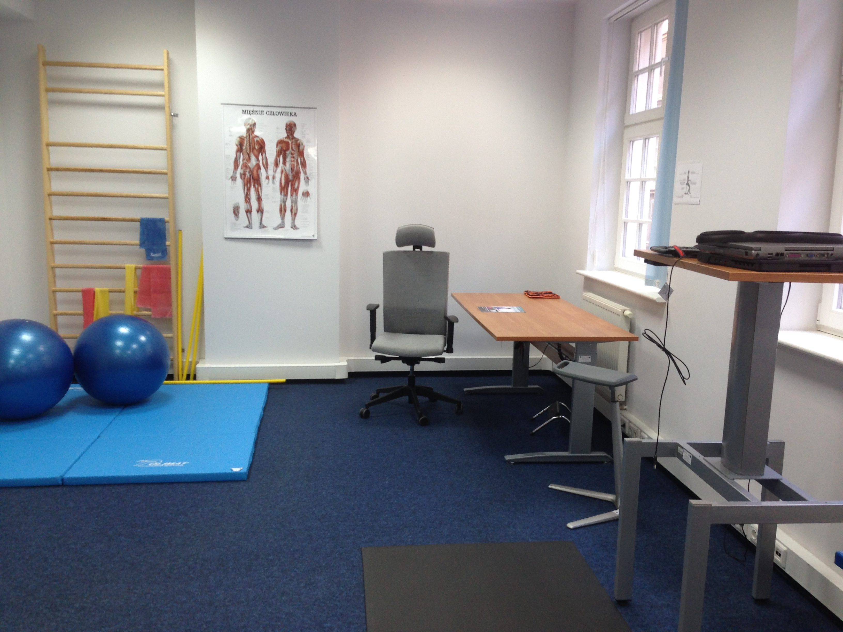
BE READY!

