Slide 1



Mind Your Way ​
A Train-the-Trainer for Behavioral Health Career Pathways
Morgan Seiler, M.Ed., Ed.S.
Regional Behavioral Health Advisor, Region 8
Substance Abuse and Mental Health Services Administration
U.S. Department of Health and Human Services
Notes:
Welcome, everyone! Today’s session is titled 'Mind Your Way: A Train-the-Trainer for Behavioral Health Career Pathways.' I'm Morgan Seiler (joined by..other SAMHSA folks on the line) and I’m here to guide you through the diverse and impactful careers in behavioral health. We know your students are energized about mental health and this presentation will provide you with tools and knowledge to share with your students to explore these pathways, ensuring they understand the many ways they can show up in this space!

Slide 2


We have no financial disclosures for this presentation.
The views expressed in this presentation are those of the speakers and do not reflect the official policy or position of the US Department of Health and Human Services (HHS) or the U.S. Government. Non-federal sources included do not constitute an endorsement by HHS or any of its employees of the sponsors, information, or products presented on the site. The linked content may not comply with all U.S. government guidance for websites.
Notes:
Morgan:
As a federal government agency it's important we say we aren't funded by anyone to do this presentation, and that the content of this slide deck is not the official position of the department of health and human services.

Slide 3


Discover SAMHSA
Explore Behavioral Health and Traverse the Continuum of Care
Scout Behavioral Health Career Pathways
Wander Through Resources for Continued Learning
Notes:
So, during our time together (you'll sense a theme) we will..read bullet points.

Slide 4


Discovering SAMHSA
Notes:
So let's start by laying a bit of a foundation for who SAMHSA is and what we do as a federal agency.

Slide 5







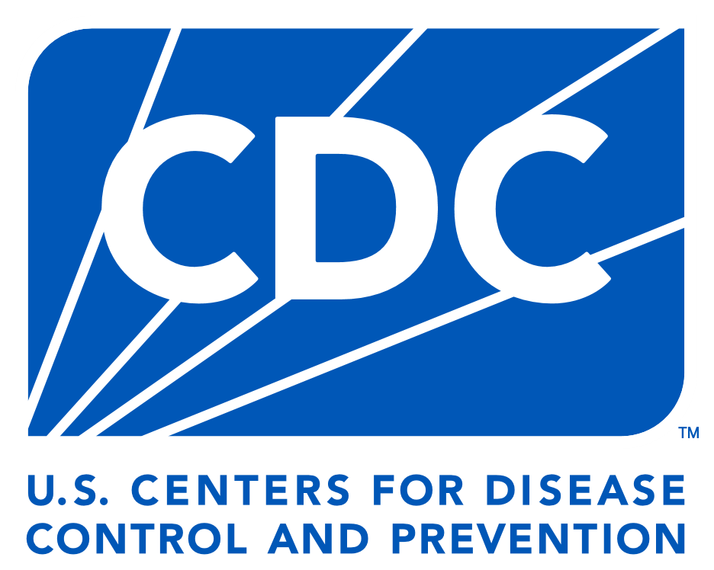



is SAMHSA?
11 TOTAL Operating Divisons!
Notes:
The Substance Abuse and Mental Health Services Administration (SAMHSA) is the agency within the U.S. Department of Health and Human Services that leads public health efforts to advance the behavioral health of the nation. It sits under the umbrella of the larger department of health and human services along with some of the agencies listed you may have heard of before like the
-FDA or food and drug administration
-Centers for medicaid and medicare
-national institutes of health
-CDC or centers for disease control and prevention
-Indian health service
-administration for children and families
-HRSA or Health resources and Services Administration
With 11 total operating divisions!

Slide 6







Enhancing access to suicide prevention and mental health services
Promoting resilience and emotional health for children, youth, and families
Preventing substance use and overdose
SAMHSA Priorities
Do They Do?
Strengthening the behavioral health workforce
Integrating behavioral and physical healthcare
Notes:
What do we do? We are the lead public health agency for mental health and substance use, and here are our strategic priority areas. We enhance access to suicide prevention and mental health services

Slide 7





Grants
Do They Do It?
Resources
Training
Notes:
SAMHSA plays a vital role in mental health and substance use through grants or money to states, tribal nations, community organizations, and local government agencies, training for grantees or people who receive funding from SAMHSA and the public, and resources for people who work in mental health and substance use and the population at large.

Slide 8

Exploring Behavioral Health + Traversing The Continuum of Care

Slide 9




Behavioral Health
Mental Health
Substance Use
Notes:
Behavioral health refers to the connection between behavior and well-being, encompassing mental health, substance use, and prevention.

Slide 10



Continuum of Care
Promotion/Prevention
+ Early Intervention
Recovery Support
Primary
Care
Specialty
Care-Inpatient
Crisis
Care
Specialty
Care-Outpatient
Notes:
Behavioral health spans the continuum of care from prevention to recovery. This continuum includes promotion and prevention, primary care, crisis care, specialty outpatient and inpatient care, and recovery support. Understanding this framework helps us recognize the various roles and entry points into behavioral health careers.

Slide 11

Scouting Behavioral Health Career Pathways

Slide 12

Three Main Pathways to Work in Behavioral Health
Primary Care
Crisis Care
Treatment
Recovery
Lived Experience
Wellbeing
Public Health
Promotion
Prevention
Notes:
As we explore the diverse opportunities within behavioral health, it’s helpful to organize careers into three main pathways. Each pathway represents a unique approach to supporting mental health and substance use recovery, offering students a variety of roles to consider based on their interests and strengths.
Pathway 1: Public Health, Promotion, and Prevention The first pathway focuses on public health, promotion, and prevention. This area emphasizes proactive strategies to prevent mental health and substance use challenges before they arise. Professionals in this pathway work to educate communities, implement evidence-based programs, and advocate for policies that promote health equity. Careers here include public health specialists, prevention coordinators, and community health workers. It’s ideal for students who want to make a broad impact at the population level.
Pathway 2: Recovery and Lived Experience The second pathway centers on recovery and lived experience. This area is built on the power of personal stories and peer support. Roles like peer recovery specialists and recovery coaches allow individuals with lived experience in mental health or substance use challenges to guide and mentor others. These professionals offer emotional support, share coping strategies, and help individuals build meaningful lives in recovery. It’s a deeply personal and rewarding career path for those who want to inspire hope and resilience.
Pathway 3: Primary Care, Crisis Care, and Treatment The third pathway includes primary care, crisis care, and treatment. This is where students could work directly with individuals addressing immediate mental health or substance use challenges. Careers in this pathway include crisis intervention specialists, counselors, therapists, and psychiatrists. These professionals provide assessment, therapy, medication management, and critical support during times of crisis. It’s an excellent option for students who want to work hands-on with individuals and families to make a direct impact on their well-being.

Slide 13


Multidisciplinary Teams
Public Health campaigns reduce stigma and improve literacy
Mental health promotion and psychoeducation improves coping skills and resilience
Prevention raises awareness of risk and protective factors
Primary care screens for signs and symptoms
Crisis care is there when you need it
Outpatient therapy and inpatient therapy provide appropriate levels of care
Medication management is there if clinically necessary
Community supports wrap around to improve outcomes for someone experiencing a mental health or substance use challenge
Peers with lived experience provide additional protective layers of support, connectedness, and belonging
Notes:
One of the most critical aspects of behavioral health is the collaboration among multidisciplinary teams. These teams bring together professionals from various disciplines, each playing a unique role to ensure comprehensive care. Let’s walk through how these professionals work together to support individuals and communities.
We begin with public health campaigns, which play a foundational role in reducing stigma and improving mental health literacy. By educating the public about mental health and substance use, these campaigns create an environment where individuals feel empowered to seek help without fear or shame
Mental health promotion and psychoeducation focus on building coping skills and resilience. This work is often done in schools, workplaces, and community settings to ensure people have the tools they need to manage stress and thrive in their environments.
Prevention professionals raise awareness of risk and protective factors. They help communities understand how to reduce the likelihood of mental health or substance use challenges while promoting factors that protect against them, like strong social connections and access to support services.
In primary care settings, healthcare providers screen for early signs and symptoms of mental health or substance use concerns. Early detection is key to connecting individuals with the right level of support before issues escalate
When someone is in immediate distress, crisis care steps in to provide urgent support. Whether it’s a hotline like 988, a mobile crisis unit, or an emergency room, this care is there when it’s needed most to stabilize the situation and connect individuals to longer-term resources
Therapy services, whether outpatient or inpatient, provide appropriate levels of care tailored to the individual’s needs. Outpatient therapy offers ongoing support while individuals live in their communities, and inpatient therapy provides intensive care for those who need a more structured environment.
Medication management is available when clinically necessary. Psychiatrists, primary care providers, and other trained professionals help individuals find the right medications to support their mental health or substance use recovery as part of a broader treatment plan
Community supports wrap around individuals to improve outcomes. This could include housing assistance, vocational training, or support groups. These services address the social determinants of health that play a significant role in recovery. Finally, peers with lived experience bring a deeply personal and relatable element to care. They provide protective layers of support, connectedness, and belonging, showing others that recovery is possible and offering hope through shared understanding
By combining their expertise, these multidisciplinary teams ensure individuals receive the right care, at the right time, and in the right setting. This collaborative approach is essential for improving mental health and substance use outcomes, supporting both individuals and the broader community

Slide 14
Public Health
Mental Health Promotion
+ Prevention
Notes:
So let's jump in to roles in our first pathway

Slide 15

What they do...
Bridge gaps between healthcare systems and underserved populations.
Promote health literacy and cultural competence.
Address social determinants of health (e.g., housing, nutrition).
How they do it...
Community Health Workers
Educate communities on health topics.
Connect individuals to resources, such as healthcare providers or social services.
Conduct health screenings and assessments.
Trusted members of the community who provide health education, outreach, and support.
How you can get there...
Educational requirements:
Typically requires a high school diploma or equivalent.
Some states require CHW certification or specialized training.
Training opportunities:
Programs offered through community colleges, health departments, and online platforms.
Certification programs endorsed by organizations like the National Association of Community Health Workers (NACHW).
Resources
Practical Guide for Expanding the Community-Based Behavioral Health Workforce
National Association of Community Health Workers
Notes:
Community Health Workers, or CHWs, are trusted community members who bridge gaps in healthcare systems. They provide health education, connect individuals to resources, and address social determinants of health like housing and nutrition. This career path is accessible with a high school diploma and certification, making it a great starting point in behavioral health.
Each slide highlighting a role or career pathway is organized in this way with a brief description of who they person is under the title, then you'll find what they do, how they do it or the primary responsibilities, how you can get there including educational and training or licensure information, and finally we wrap every slide with specific resources to learn more about the role or field of practice.

Slide 16
What they do...
Promote protective factors and reducing risk factors.
Implement evidence-based strategies to prevent behavioral health challenges.
How they do it...
Prevention Specialists
Plan and deliver prevention programs targeting youth, families, and communities.
Collect and analyze data to assess community needs and program effectiveness.
Conduct training sessions to build community capacity for prevention efforts.
How you can get there...
Professionals dedicated to reducing substance use, mental health challenges, and related risks through education, community engagement, and policy advocacy.
Educational requirements:
Bachelor’s degree in public health, psychology, sociology, or related fields is common.
Relevant experience in community or health-based settings.
Certifications:
Certified Prevention Specialist (CPS) credential offered by many states.
Prevention Specialist Certification Board resources.
Training programs:
Offered through regional Prevention Technology Transfer Centers (PTTCs).
Resources
The International Certification and Reciprocity Consortium (IC&RC)
Core Trainings for Prevention Specialist Certification
Notes:
Our next role in Public health, mental health promotion, and prevention is Prevention Specialists who focus on reducing risks related to mental health and substance use. They implement evidence-based strategies, conduct community education, and build resilience through targeted programs. A bachelor’s degree in fields like public health or psychology is typically required, along with certifications like the Certified Prevention Specialist credential. Inspire your students to explore the role of a prevention specialist, where they can proactively build healthier communities by addressing risks and promoting resilience

Slide 17
What they do...
Address public health challenges like mental health, substance use, infectious diseases, and health disparities.
Promote policies that foster health equity.
Public Health Professionals
How they do it...
Design and implement public health programs and campaigns.
Conduct research and analyze data to identify health trends.
Develop health policies and advocating for systemic change.
Specialists dedicated to protecting and improving the health of populations through education, policy, research, and prevention programs.
How you can get there...
Educational requirements:
Bachelor’s degree in public health, health education, or related fields.
Advanced roles typically require a Master of Public Health (MPH) or similar graduate degree.
Certifications:
Certified Health Education Specialist (CHES).
Certification in Public Health (CPH).
Career entry points:
Internships with public health agencies.
Roles in health education, program coordination, or epidemiology.
Resources
APHA (American Public Health Association)
CDC’s Public Health Training Opportunities
SOPHE (Society for Public Health Education)
Notes:
The final role in this pathway we want to highlight is public health professionals. Public health professionals work to improve population health through education, policy, and prevention programs. They address challenges like mental health disparities and substance use while promoting health equity. These roles often require a bachelor’s or master’s degree in public health and certifications such as CHES or CPH. Students interested in community-wide impact should consider this path. As an FYI, roles in state and federal government are often included in this pathway as well.

Slide 18
Recovery
Lived Experience
Wellbeing

Slide 19

What they do...
Provide guidance, mentorship, and resources to promote long-term recovery.
Empower individuals to achieve personal goals and maintain wellness.
Peer Recovery Support Specialists
How they do it...
Offer peer-based support and mentorship grounded in lived experience.
Help individuals develop recovery plans and connect to resources (e.g., housing, employment, healthcare).
Facilitate support groups and recovery meetings.
Professionals with lived/living experience who support individuals navigating recovery from substance use, mental health conditions, or both.
How you can get there...
Educational and experiential requirements:
High school diploma or equivalent; some roles may require postsecondary education in social work or counseling.
Lived experience and stable recovery are often prerequisites.
Certifications:
Certified Recovery Specialist (CRS) or equivalent, often state-specific.
Training through organizations like NAADAC or state recovery boards.
Training topics:
Ethics, motivational interviewing, and trauma-informed care.
Resources
Core Competencies for Peer Workers
National Association of Peer Supporters
National Peer Recovery Alliance
National Certified Peer Recovery Support Specialist
Notes:
Since this is an emerging pathway we have one role to share, but this field is growing and likely to see additional job titles and descriptions coming on line in the next few years. Peer Recovery Support Specialists use their lived experience with mental health or substance use recovery to mentor and support others. They provide emotional support, guide individuals in developing recovery plans, and connect them to resources. Training and certification programs ensure peer specialists are equipped to make a lasting impact. In this role students can use their compassion and shared experiences to guide others toward recovery and wellness.

Slide 20
Primary Care
Crisis Care
Treatment
Notes:
Now we come to our final pathway for working in behavioral health including primary care, crisis care, and treatment.

Slide 21

What they do...
Guide students through academic and career planning.
Address personal and social issues that may affect their educational success.
How they do it...
Conduct individual and group counseling to help students with academic, social, and emotional challenges.
Assist students in developing social-emotional skills, coping strategies, and conflict resolution.
Coordinate and deliver school-wide programs to promote mental health awareness, bullying prevention, and positive behavior support.
School Counselor
School counselors are trained professionals who support students’ academic, personal, and social development. They work with students, teachers, and families to create an environment conducive to learning and emotional well-being.
How you can get there...
Educational requirements:
A Master’s degree in School Counseling or a related field is required.
Coursework includes counseling techniques, ethics, child development, and career counseling.
Licensure:
State licensure is required for school counselors, often involving exams, supervised practice, and continuing education.
Some states offer certifications specifically for school counselors (e.g., National Certified School Counselor, NCC).
Training:
Clinical experience through internships or supervised practice in schools.
Resources
ASCA (American School Counselor Association) for professional development, advocacy, and standards for school counseling.
Notes:
We will start with where you are – at school!! School counselors, social workers, and psychologists are essential in supporting student mental health. They provide counseling, implement mental health programs, and collaborate with educators to foster safe and supportive environments. These roles typically require advanced degrees and licensure tailored to educational settings – I'll highlight the differences as we move through the 3 roles:
School Counselors focus on academic and career planning, along with personal development, work directly with students on academic and personal growth, and requires a Master’s in School Counseling.

Slide 22
What they do...
Help students cope with challenges related to mental health, family issues, and life stressors.
Collaborate with families, teachers, and administrators to create a positive and supportive school environment.
How they do it...
Conduct individual and group counseling to address issues like bullying, anxiety, depression, and family challenges.
Connect students and families to community resources such as food assistance, mental health services, or housing support.
Develop and implement school-wide programs for conflict resolution, peer relationships, social-emotional learning (SEL), and crisis support.
School Social Worker
How you can get there...
Licensed professionals who work in educational settings to address students' social, emotional, and behavioral needs, supporting academic success and personal growth.
Educational requirements:
A Master’s degree in Social Work (MSW) is required for clinical positions in schools.
Some states may offer alternative pathways for certification or licensure specific to school social work.
Licensure:
State licensure as a social worker (LCSW, LMSW) is typically required.
National certification (e.g., School Social Work Specialist – SSWS) may be available.
Training:
Focus on social work practice in schools, including counseling, crisis intervention, and working with students with special needs.
Resource
NASW (National Association of Social Workers) for professional development, certification, and advocacy.
Notes:
School social workers address social and family dynamics, connecting students to community resources, they collaborate with families and external resources to address barriers, and need a Master's in Social Work.

Slide 23
What they do...
Address psychological issues that impact students' learning and social functioning.
Collaborate with educators, parents, and other professionals to create supportive school environments.
How they do it...
Conduct psychological assessments to identify learning disabilities, behavioral issues, or mental health concerns.
Consult with teachers, parents, and administrators on strategies to support students’ mental health and educational outcomes.
Provide crisis intervention and support during school emergencies or tragedies.
School Psychologist
How you can get there...
Licensed professionals who work within educational settings to support students' mental health, emotional well-being, and academic development.
Educational requirements:
Master’s or specialist degree (Ed.S.) in school psychology is typically required.
Some states may require a doctoral degree (Ph.D. or Psy.D.) for certain positions.
Licensure:
State licensure or certification is required, typically involving exams and supervised practice.
Nationally certified school psychologist (NCSP) credential is available through the National Association of School Psychologists (NASP).
Training:
Focus on child development, learning theories, counseling, assessment, and school systems.
Resource
National Association of School Psychologists
Notes:
School psychologists specialize in assessments and interventions for learning and psychological needs, they focus on evaluations, behavior plans, and mental health strategies, and typically need a Specialist or Doctoral degree in School Psychology.

Slide 24
What they do...
Empower clients to improve their well-being and navigate complex systems.
Address societal challenges through advocacy and systemic change.
How they do it...
Provide case management and linking clients to resources such as housing, healthcare, and employment.
Offer counseling and therapeutic interventions to address emotional and behavioral needs.
Advocate for policies and practices that support vulnerable populations.
Collaborating with interdisciplinary teams to provide holistic care.
Social Worker
How you can get there...
Professionals who support individuals, families, and communities by addressing challenges related to mental health, substance use, and social determinants of health.
Educational requirements:
Bachelor’s degree in Social Work (BSW) for entry-level positions.
Master’s degree in Social Work (MSW) required for clinical roles and licensure.
Licensure:
Varies by state; common credentials include Licensed Clinical Social Worker (LCSW) or Licensed Master Social Worker (LMSW).
Requires supervised clinical hours and a state licensure exam.
Specializations:
Options include school social work, healthcare, mental health, and substance use.
Resources
The National Association of Social Workers
Clinical Social Work Association
National Association of Black Social Workers
School Social Work Association of America
Notes:
Community-based Social workers provide case management and connect clients to essential resources such as housing, healthcare, and employment. They also offer counseling and therapeutic interventions to address emotional and behavioral needs, helping individuals navigate personal challenges like mental health issues, family conflicts, or substance use disorders. Social work is an incredibly rewarding career path for those who are passionate about helping others and advocating for social justice. Encourage your students to consider this role if they want to make a meaningful difference in both individual lives and society as a whole.

Slide 25
What they do...
Help clients understand and overcome substance use challenges.
Promote recovery and healthy lifestyle changes.
How they do it...
Conduct assessments to evaluate the severity of substance use and its impact.
Lead individual and group therapy sessions focused on recovery.
Educating clients and families on addiction.
Collaborating with healthcare providers, peer support specialists, and recovery resources.
Substance Use Counselors
How you can get there...
Professionals who support individuals struggling with substance use disorders (SUDs) through assessment, counseling, and treatment planning.
Educational requirements:
Entry-level roles may require an associate’s degree; advanced positions often require a bachelor’s or master’s degree in counseling, social work, or psychology.
Licensure and certification:
Credential options include Certified Addiction Counselor (CAC) or Licensed Alcohol and Drug Counselor (LADC).
Requirements vary by state and may include supervised practice and exams.
Training:
Specialized training in motivational interviewing, cognitive-behavioral therapy, or trauma-informed care.
Resources
The Association for Addiction Professionals (NAADAC)
The Association of Lesbian, Gay, Bisexual, Transgender Addiction Professionals and Their Allies (NALGAP)
The International Certification and Reciprocity Consortium (IC&RC)
Notes:
Substance Use Counselors assist individuals in overcoming addiction through therapy and treatment planning. They work in clinics, hospitals, and community programs. Students can start this path with a bachelor’s degree and pursue certifications like CAC or LADC to advance their careers.

Slide 26
What they do...
Address mental health concerns in family systems.
Support couples, individuals, and families in resolving interpersonal conflict.
Help families navigate life transitions such as divorce.
How they do it...
Conduct individual, couple, and family therapy to address a wide range of emotional and psychological issues such as anxiety, depression, trauma, substance use, and family dysfunction.
Use diagnostic tools to assess mental health conditions, relationship dynamics, and family communication patterns.
Offer immediate support to families experiencing acute stress or crises, such as family violence, suicidal ideation, or sudden life changes.
Marriage and Family Therapist
How you can get there...
Licensed clinicians who specialize in diagnosing and treating mental health issues and relationship problems within the context of families and couples.
Educational Requirements:
A Master’s or Doctoral degree in Marriage and Family Therapy, or a related field like psychology or social work.
Coursework typically covers family systems theory, therapeutic techniques, and ethical and legal issues in therapy.
Most programs require completing a significant number of hours of supervised clinical work with clients.
Licensing:
After completing the required education and clinical hours, MFTs must pass a state licensure exam to become licensed practitioners.
Each state has specific requirements, but licensure generally includes supervised practice and continuing education.
Resource
American Association for Marriage and Family Therapy
Notes:
Marriage and Family Therapists focus on relationships and family dynamics, addressing challenges like conflict, trauma, and communication. They provide therapy to couples, families, and individuals, requiring a master’s degree and licensure. This career is ideal for those passionate about helping people strengthen their relationships.

Slide 27
What they do...
Help clients develop coping strategies and achieve personal growth.
Address issues like anxiety, depression, trauma, relationships, and more.
How they do it...
Conduct assessments and developing personalized treatment plans.
Provide individual, family, or group therapy sessions.
Collaborate with other healthcare providers for comprehensive care.
Document progress and adjusting treatment approaches as needed.
Mental Health Counselor
How you can get there...
Educational requirements:
Bachelor’s degree in psychology, counseling, or a related field.
Master’s degree in counseling or clinical social work (required for licensure).
Licensure:
Common credentials include Licensed Professional Counselor (LPC) or Licensed Clinical Social Worker (LCSW), depending on the state.
Supervised clinical hours and a state licensure exam are typically required.
Specialized certifications:
Options include trauma-focused therapy, marriage and family therapy, or substance use counseling.
Licensed clinicians who provide therapeutic support to individuals, families, and groups experiencing mental health challenges.
Resources
American Counseling Association
American Mental Health Counselors Association
National Board for Certified Counselors
Notes:
Mental Health Counselors work directly with individuals, families, and groups to address issues like anxiety, depression, and trauma. They require a master’s degree and licensure, making them pivotal in outpatient settings, schools, and community health centers. This career offers opportunities to specialize and make a profound difference in people’s lives.

Slide 28
What they do...
Promote mental health and emotional well-being.
Use evidence-based approaches to help individuals manage life’s challenges.
How they do it...
Conduct psychological assessments and diagnostic evaluations.
Provide therapy to individuals, families, and groups.
Conduct research to advance the understanding of human behavior and mental health interventions.
Consult with organizations, schools, or healthcare teams on mental health strategies.
Psychologist
How you can get there...
Professionals who study human behavior and mental processes to assess, diagnose, and treat psychological disorders.
Educational requirements:
Bachelor’s degree in psychology or a related field.
Doctoral degree (Ph.D. or Psy.D.) in psychology for clinical practice, research, or specialized areas.
Licensure:
State licensure is required for practice, involving supervised clinical hours and passing a national exam (e.g., EPPP).
Specializations:
Clinical psychology, school psychology, industrial-organizational psychology, forensic psychology, and more.
Resources
American Psychological Association
National Association of School Psychologists
Society of Clinical Psychology
Psychology Careers Guide
Notes:
Psychologists specialize in understanding human behavior and mental health. They assess, diagnose, and treat psychological disorders, often conducting research to improve interventions. This role requires a doctoral degree and licensure, with opportunities to specialize in areas like clinical or forensic psychology

Slide 29
What they do...
Integrate medical knowledge with therapeutic interventions to support mental wellness.
Prescribe and manage medications alongside other treatments.
How they do it...
Conduct psychiatric evaluations and diagnostic assessments.
Prescribe and monitoring psychotropic medications.
Provide psychotherapy or collaborating with other mental health professionals.
Manage care for individuals with complex or co-occurring disorders.
Conduct research or teaching in academic settings.
Psychiatrist
How you can get there...
Medical doctors specializing in the diagnosis, treatment, and prevention of mental health disorders.
Educational requirements:
Bachelor’s degree with a pre-med focus.
Medical degree (MD or DO) from an accredited program.
Training:
Completion of a 4-year psychiatry residency program, with options to subspecialize (e.g., child psychiatry, addiction psychiatry, forensic psychiatry).
Licensure and certification:
Passing the USMLE or COMLEX for medical licensing.
Certification by the American Board of Psychiatry and Neurology (ABPN).
Resources
American Psychiatric Association
Developing Your Career in Addiction Medicine
Notes:
Psychiatrists are medical doctors who diagnose and treat mental health disorders, often through medication management. After completing medical school and a psychiatry residency, they may choose to specialize further, such as in child psychiatry or addiction psychiatry. This career offers both medical and therapeutic approaches to behavioral health

Slide 30
What they do...
Physicians in Medication Management for Behavioral Health
Address mental health and substance use diagnoses through primary care, family medicine, or other specialties.
Bridge gaps in behavioral health care, especially in underserved areas.
How they do it...
Evaluate and diagnose behavioral health conditions in patients.
Prescribe and manage medications such as antidepressants, anxiolytics, or medications for substance use disorders.
Monitor side effects and adjusting treatment plans based on patient response.
Coordinate care with mental health professionals, such as counselors, social workers, or psychiatrists.
Non-psychiatrist physicians who provide medication management for behavioral health conditions, often as part of integrated care teams.
How you can get there...
Educational requirements:
Medical degree (MD or DO) with training in primary care, family medicine, internal medicine, or pediatrics.
Training:
Behavioral health rotations during residency.
Optional certifications or additional training in addiction medicine, mental health integration, or psychopharmacology.
Licensure:
State medical license required to practice.
Resource
AAFP (American Academy of Family Physicians) Behavioral Health Resources
Notes:
Non-psychiatrist physicians, such as primary care doctors, also play a role in behavioral health by managing medications for conditions like depression or anxiety. These professionals integrate behavioral health into general practice, improving accessibility for patients. Additional training in mental health integration is valuable in this role.

Slide 31
What they do...
Address mental health and substance use diagnoses through primary care, intensive outpatient, and inpatient settings.
How they do it...
Nursing in Behavioral Health Settings
Monitor side effects and provide care to patients receiving treatments for mental health and/or substance use disorders.
Coordinate care with mental health professionals, such as counselors, social workers, or psychiatrists.
How you can get there...
Educational requirements:
Entry-Level: Associate Degree in Nursing (ADN) or Bachelor of Science in Nursing (BSN).
Advanced Roles: Master of Science in Nursing (MSN) or Doctor of Nursing Practice (DNP) for advanced practice roles such as Psychiatric-Mental Health Nurse Practitioner (PMHNP)..
Training:
Behavioral health rotations during clinical rotations during their nursing program.
Licensure:
State nursing license required to practice.
Board certification in Psychiatric-Mental Health through organizations like the American Nurses Credentialing Center (ANCC)
Nurses providing care to individuals facing mental health and substance use challenges. They combine medical knowledge with therapeutic support to improve patient outcomes and promote recovery
Resources
American Psychiatric Nurses Association (APNA)
American Nurses Association (ANA)
Behavioral Health Workforce Education and Training Program (BHWET)
Notes:
And finally nurses play a critical role in behavioral health care and is an option for HOSA students interested in nursing who have a passion for mental health or substance use treatment and recovery services. Nursing students interested in working in behavioral health care settings should seek out rotation opportunities in their nursing program in in-patient and intensive outpatient clinical settings.

Slide 32

Wandering Through Resources for Continued Learning

Slide 33
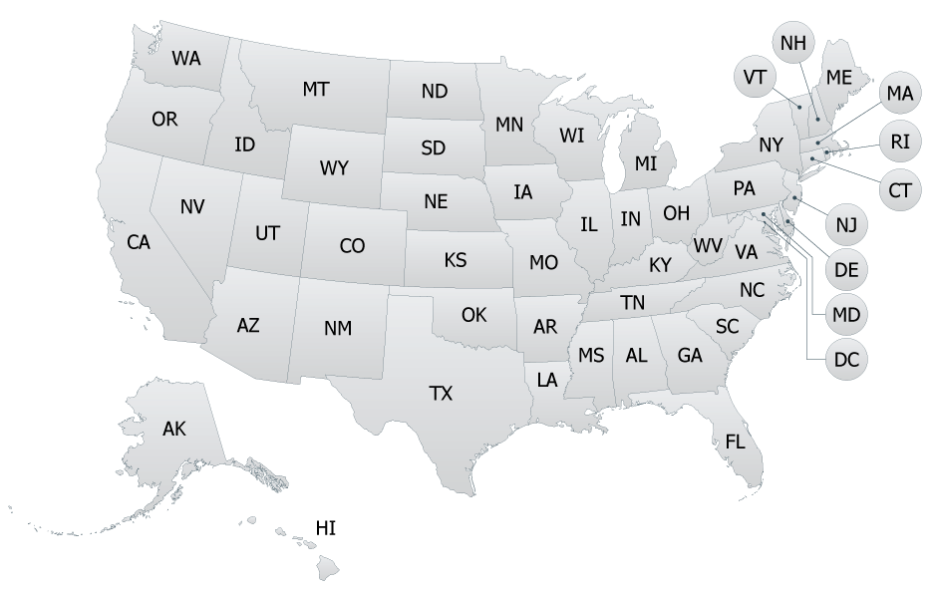

NEW! Behavioral Health Career Navigator
This tool will help you understand the basic requirements to enter the field in each state!
samhsa.gov/behavioral-health-careers
Notes:
SAMHSA’s new Behavioral Health Career Navigator is an invaluable tool for students interested in exploring careers in mental health and substance use. Designed with aspiring professionals in mind, this interactive resource provides comprehensive information about the wide variety of career pathways in behavioral health."
Key Features: This tool helps students discover roles that align with their interests and skills. It offers:
Detailed descriptions of career options, from prevention specialists to peer support workers and clinical roles like counselors and psychiatrists.
Educational requirements and training pathways for each career, helping students understand what steps to take to reach their goals.
Information on certifications and licensure, ensuring students know the credentials required for their chosen field.
Resources on workforce demand and growth trends, helping students align their ambitions with market needs.
How It Benefits Students: The Career Navigator empowers students to make informed decisions about their futures by providing clarity and actionable guidance. It’s also a great resource for identifying entry points into behavioral health careers, whether through education, training, or certification programs. It even includes links to additional resources like scholarships, internships, and mentorship opportunities.
Encourage your students to explore this tool as they consider a career in behavioral health. You can find the Career Navigator on SAMHSA’s website and share it with your students today!

Slide 34
Federal Support for Your Journey
SAMHSA’s Minority Fellowship Program (MFP)
Open to people pursuing graduate degrees in various fields of behavioral health, and around 400 educational scholarships are awarded each year
National Health Service Corps
Supports more than 17,000 primary care medical, dental, and behavioral health providers through scholarships and loan repayment programs.
CDC-Public Health Associates Program for Recent Graduates
The Public Health Associate Program for Recent Graduates (PHAP) trains early-career professionals who have a recent college degree and are interested in public health and service.
Commissioned Corps of the U.S. Public Health Service
Elite paid fellowships, residencies, and training programs for Public Health Service officers and graduate and undergraduate students on America's front lines.
Notes:
The Minority Fellowship Program addresses critical disparities in behavioral health by increasing the number of culturally competent professionals. Its goal is to ensure that underserved and minority populations receive effective and sensitive care from providers who understand their unique cultural and social contexts. The MFP provides financial assistance, including tuition support and stipends, to graduate-level students pursuing advanced degrees in behavioral health disciplines. It also offers access to mentorship, professional development opportunities, and specialized training to enhance cultural competence. Eligible students include those pursuing master’s or doctoral degrees in fields like psychiatry, psychology, counseling, social work, marriage and family therapy, and addiction studies. The program emphasizes the importance of serving communities with high behavioral health disparities, empowering fellows to make a meaningful impact where it’s needed most. Students can explore SAMHSA’s Minority Fellowship Program if they are pursuing advanced education in behavioral health fields. This program not only provides invaluable financial and professional support but also empowers students to become leaders in addressing health disparities and advancing equity in care

Slide 35


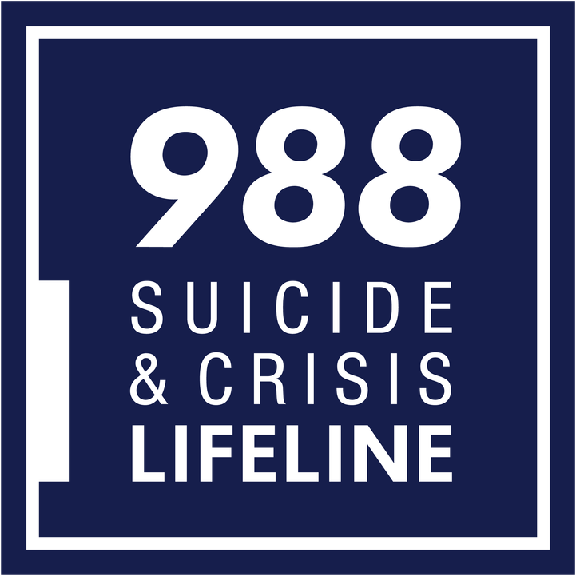

SAMHSA Resources
Find Support for issues with mental health, drugs, or alcohol
Millions of Americans have mental and substance use disorders. Find treatment here.
samhsa.gov/find-support
National HelpLine: 1-800-662-HELP (4357)
findtreatment.gov
988 serves as a universal entry point so that no matter where you live in the United States, you can reach a trained crisis counselor who can help.​
Call, text, or chat 988 for 24/7 access to trained crisis counselors who can help people experiencing mental health-related distress which could include, thoughts of suicide​, mental health or substance use crises​, and/or emotional distress.
Access the 988 partner toolkit and much more by visiting: samhsa.gov/find-help/988
Notes:
SAMHSA provides three critical resources to help individuals access behavioral health care and support: FindSupport, FindTreatment.gov, and the 988 Suicide & Crisis Lifeline. These tools are designed to connect people with the help they need, when and where they need it.
FindSupport: FindSupport is a user-friendly resource for anyone seeking information about mental health and substance use. It offers guidance on identifying challenges, exploring treatment options, and learning how to support yourself or a loved one on the path to wellness.
FindTreatment.gov: FindTreatment.gov is a comprehensive directory of treatment facilities for mental health and substance use across the United States. It allows users to search for providers by location, type of care, and accepted payment options, making it easier than ever to find accessible, quality care.
988 Suicide & Crisis Lifeline: The 988 Lifeline is a 24/7, free, and confidential service that connects individuals in crisis with trained counselors. Whether it’s a mental health emergency, a substance use challenge, or a need for emotional support, 988 ensures that help is just a phone call, text, or chat away.
By spreading awareness of FindSupport, FindTreatment.gov, and 988, you can help ensure that no one feels alone when navigating their behavioral health journey.

Slide 36






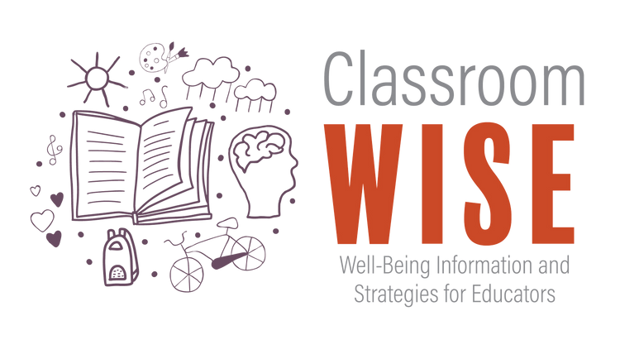



SAMHSA Training + Technical Assistance
SAMHSA-Funded Technical Assistance and Training Centers provide FREE training and technical assistance. You do not have to be a grant-recipient to access the services, supports, and resources from these centers. Click the logo buttons below to access a some of the currently funded school-aged youth focused centers.
In addition to the topic-focused technical assistance and training centers, SAMHSA also funds centers of excellence focused on advancing best practices and behavioral health equity for currently and historically underserved populations. These centers include but aren’t limited to:
FREE
Self-Paced
Co-Created with Educators
NEW Modules
Implementation Guidance
African American Behavioral Health Center of Excellence
American Indian and Alaska Native Behavioral Health Center of Excellence
Asian American, Native Hawaiian, and Pacific Islander Behavioral Health Center of Excellence
Hispanic/Latino Behavioral Health Center of Excellence
LGBTQ+ Behavioral Health Equity Center of Excellence
Classroom WISE is a FREE 3-part training package that assists K-12 educators and school staff in supporting the mental health of students in the classroom. Developed by the Mental Health Technology Transfer Center (MHTTC) Network in partnership with the National Center for School Mental Health, this package offers evidence-based strategies and skills to engage and support students experiencing adversity and distress.
For a complete list and up-to-date links visit:
samhsa.gov/practitioner-training
Notes:
Training & Technical Assistance Centers:
SAMHSA supports nearly 50 centers covering topics like suicide prevention, social media impacts, and mental health literacy.
Highlights:
MHTTC – now sunsetted but Classroom WISE remains alive and well – self-paced (low barrier training)
• Suicide Prevention Resource Center: Tailored resources for schools and communities.
A QR code links to a full catalog of resources and upcoming search features (launching 2025).

Slide 37
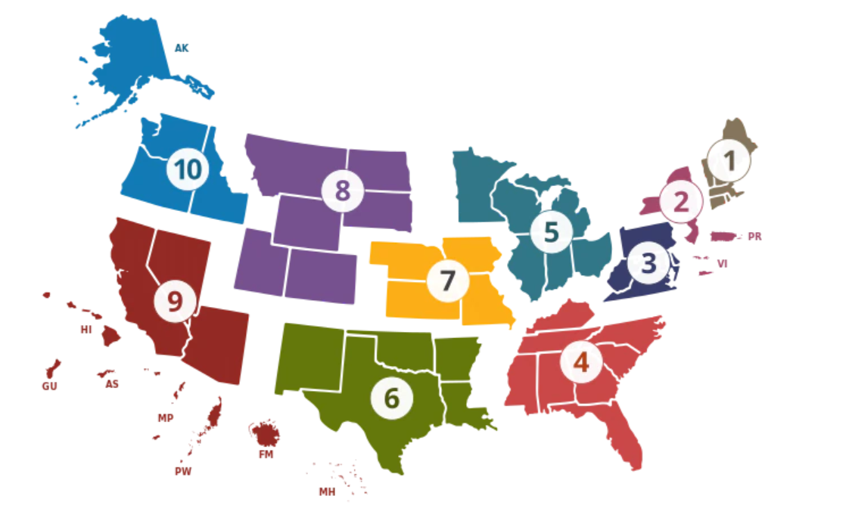
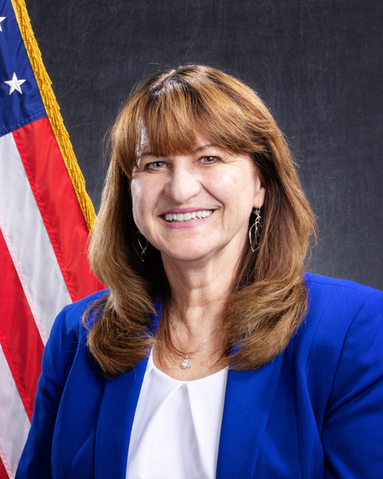
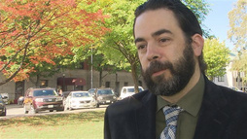

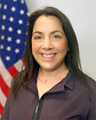

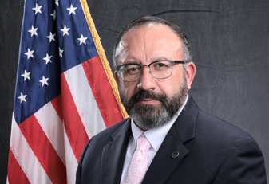
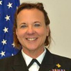


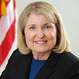
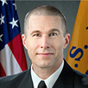
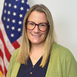
SAMHSA Regional Offices
Region V: Chicago IL, IN, MI, MN, OH, WI
and 34 Tribal Nations
Lynda Zeller
202-897-5646
Lynda.Zeller@samhsa.hhs.gov
RBHA: Jesse.Hefferman@samhsa.hhs.gov
To explore the regional offices scan here
Region I: Boston?CT, MA, ME, NH, RI, VT
and 10 Tribal Nations
Scott Gagnon, MPP, PS-C
240.276.2304
Scott.Gagnon@samhsa.hhs.gov
RBHA: Rachel.Brase@samhsa.hhs.gov
RBHA: Laura.Grubb@samhsa.hhs.gov
Region X: Seattle AK, ID, OR, WA
and 272 Tribal Nations
Nathan Billy, MEd, LPC
240-276-0766
Nathan.Billy@samhsa.hhs.gov
ARD:Lois.Gillmore@samhsa.hhs.gov
Region VIII: Denver CO, MT, ND, SD, UT, WY
and 28 Tribal Nations
Senior Regional Advisor: Traci Pole, MSW
303-844-1205
Traci.Pole@samhsa.hhs.gov
RBHA: Morgan.Seiler@samhsa.hhs.gov
Region II: New York NJ, NY, PR, VI
and 8 Tribal Nations
Dennis O. Romero, MA
212-264-8097
Dennis.Romero@samhsa.hhs.gov
ARD: Karina.Aguilar@samhsa.hhs.gov
Region IX: San Francisco AZ, CA, HI, GU, NV, AS, CNMI, FSM, MH, PW
and 156 Tribal Nations
CAPT Emily Williams, LCSW
415-437-7600
Emily.Williams@samhsa.hhs.gov
ARD: Hal.Zawacki@samhsa.hhs.gov
RBHA: Carly.Blemmel@samhsa.hhs.gov
Region III: Philadelphia DC, DE, MD, PA, VA, WV
and 7 Tribal Nations
Jean Bennett, PhD
215-861-4377
Jean.Bennett@samhsa.hhs.gov
ARD: Jeanne.Tuono@samhsa.hhs.gov
RBHA: Anna Whitney@samhsa.hhs.gov
Region VII: Kansas City IA, KS, NE, MO
and 9 Tribal Nations
Kimberly Freese, MPA,LAC
816-426-5291
Kimberly.Freese@samhsa.hhs.gov
RBHA: Mirna.Herrera@samhsa.hhs.gov
RBHA: Maria.Loconsolo@samhsa.hhs.gov
SAMHSA Regional Offices
Office of Intergovernmental and Public Affairs
Tom Coderre, Acting Director, Tom.Coderre@samhsa.hhs.gov
Jayme Marshall, Deputy Director
Jayme.Marshall@samhsa.hhs.gov
Valerie Kolick, Special Assistant, Valerie.Kolick@samhsa.hhs.gov
Kenyon Cameron, Executive Assistant, Kenyon.Cameron@samhsa.hhs.gov
Region IV: Atlanta AL, FL, GA, KY, MS, NC, SC, TN
and 6 Tribal Nations
CAPT Michael King, PhD, MSW
404-562-4125
Michael.King@samhsa.hhs.gov
RBHA: Marissa.Dancy@samhsa.hhs.gov
RBHA: Oshea.Johnson@samhsa.hhs.gov
Region VI: Dallas AR, LA, NM, OK, TX
and 68 Tribal Nations
Kristie Brooks, MS
240-276-1447
Kristie.Brooks@samhsa.hhs.gov
RBHA: Zayna.Fulton@samhsa.hhs.gov
RBHA: Kristopher.Engdall@samhsa.hhs.gov
Notes:
Regional Support Contacts
Every HHS region has a point of contact to help you navigate resources and connect with federal partners. The QR code provides details for these regional leads who can assist with presentations, grantee connections, and more.

Slide 38

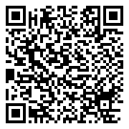



Stay Connected
Interested in substance use and mental health updates?
Subscribe to the SAMHSA Email List:
samhsa.us4.list-manage.com
Also check out HOSA’s Career Information Page:
hosa.org/career-information

Slide 39



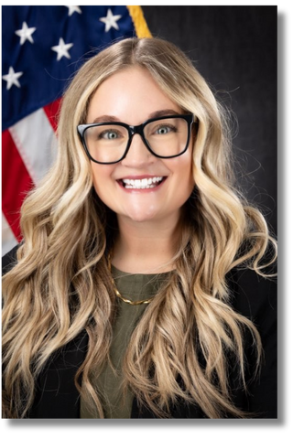
To access the fileshare with the deck + script scan or use the URL below:
COMING SOON!
bit.ly/hosaBHpathways
​
Morgan Seiler, M.Ed., Ed.S. ​
Regional Behavioral Health Advisor - HHS Region 8
morgan.seiler@samhsa.hhs.gov

