Slide 1

Infection Control
Jan Mould, RN, BSN, MEd
HOSA – Future Health Professionals
Updated 9.23.24

Slide 2
Bell Ringer
You enter your science class and are given instructions to use lancet to break skin on your finger for small blood sample. You are then directed to pass the lancet to the person behind you for their use. There are 25 people in your class and two lancets.
How would you respond?

Slide 3
ACTUAL CASE

Slide 4
Partnering to Heal
Click start to begin training
Watch the introduction video
Move to each of the characters and watch their part of the story

Slide 5
Hospital Associated Infections

Slide 6
What does the author want us to know about Healthcare-Associated Infections (HAI’s)? What does the author include as intangible cost of HAI’s?

Slide 7
What does the author infer regarding the cost of HAI’s in relation to other medical conditions?

Slide 8
EPIDEMIOLOGY – HOSA Competitive Event
THE EVENT

Slide 9
Assignment:
Go to hosa.org & click on competitive events and in the dropdown box select guidelines. Under Emergency Preparedness Events select Epidemiology. Scroll down the guidelines to Rules & Procedures #4. Click on the first CDC Website.

Slide 10
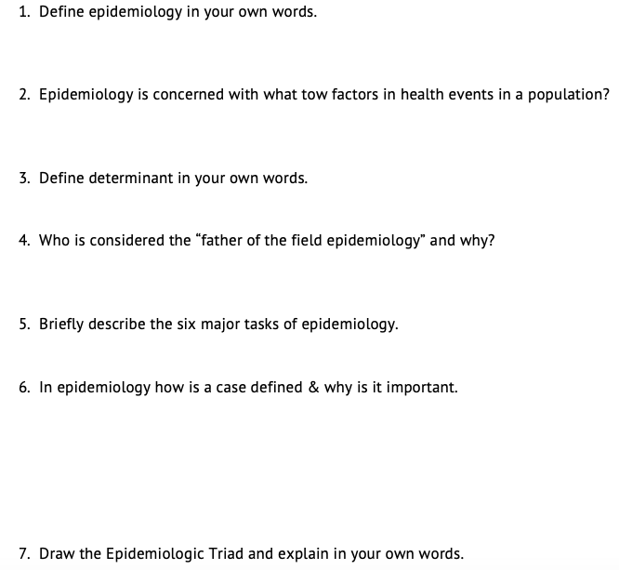
Questions

Slide 11
John Snow
What did the yellow flag indicate?
What tools did John Snow use to determine the cause of cholera?
What is the best defenses for combating for any disease outbreak?
Define in your own words what “public health” means.

Slide 12
The Crows (first video)
Why were the crows dying?
What condition was causing patients to be admitted to Flushing Hospital?
What did the investigators know and not know about the disease outbreak?
Whom did New York City public health workers interview when they began their
investigation?

Slide 13
(cont.)
What questions did they ask?
What did they suspect might be responsible for transmitting disease to the
human population?
How did they come up with this idea?
What did the investigators do next to test their hypothesis?

Slide 14
The Crows (second video)
What evidence led investigators to conclude in mosquito was responsible for transmitting the disease?
What convinced the CDC to reconsider its diagnosis?

