Slide 1

Human Growth & Development
Jan Mould, RN, BSN, MEd
HOSA –Future Health Professionals

Slide 2
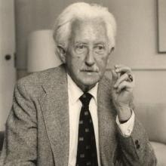
Erik Erikson Psychological Theory of Human Development
Stages of Development
Infancy – Trust vs. Mistrust
Toddler – Autonomy vs. Shame/Doubt
Preschool – Initiative vs. Guilt
School-age – Industry vs. Inferiority
Adolescence – Identity vs. Role Confusion
Young Adulthood – Intimacy vs. Isolation
Middle Adulthood – Generativity vs. Stagnation
Older Adulthood – Ego Integrity vs. Despair
Notes:
Trained with Anna Freud; Harvard Professor

Slide 3
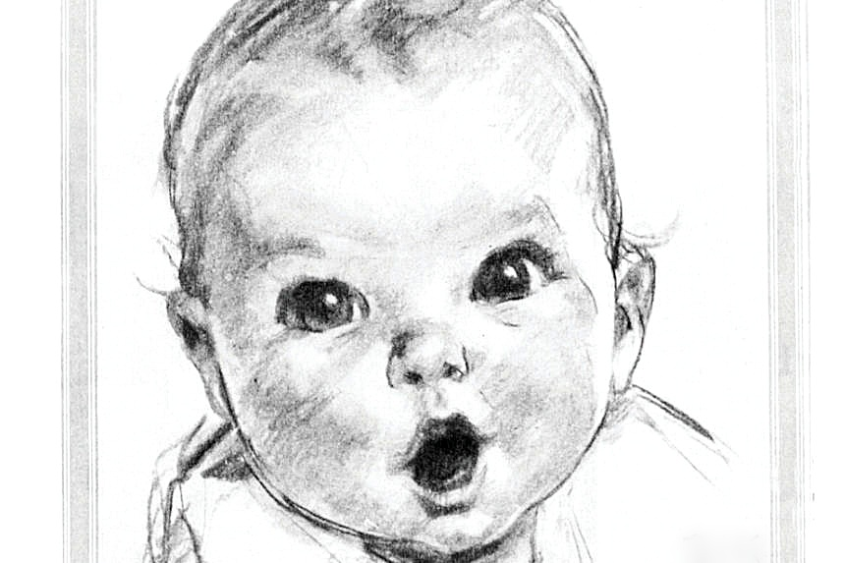
INFANCY
Parents expect to go home with the GERBER Baby.

Slide 4

Physical development is most rapid in the first year of life
Weight usually triples in the first year
Reflexes

Slide 5
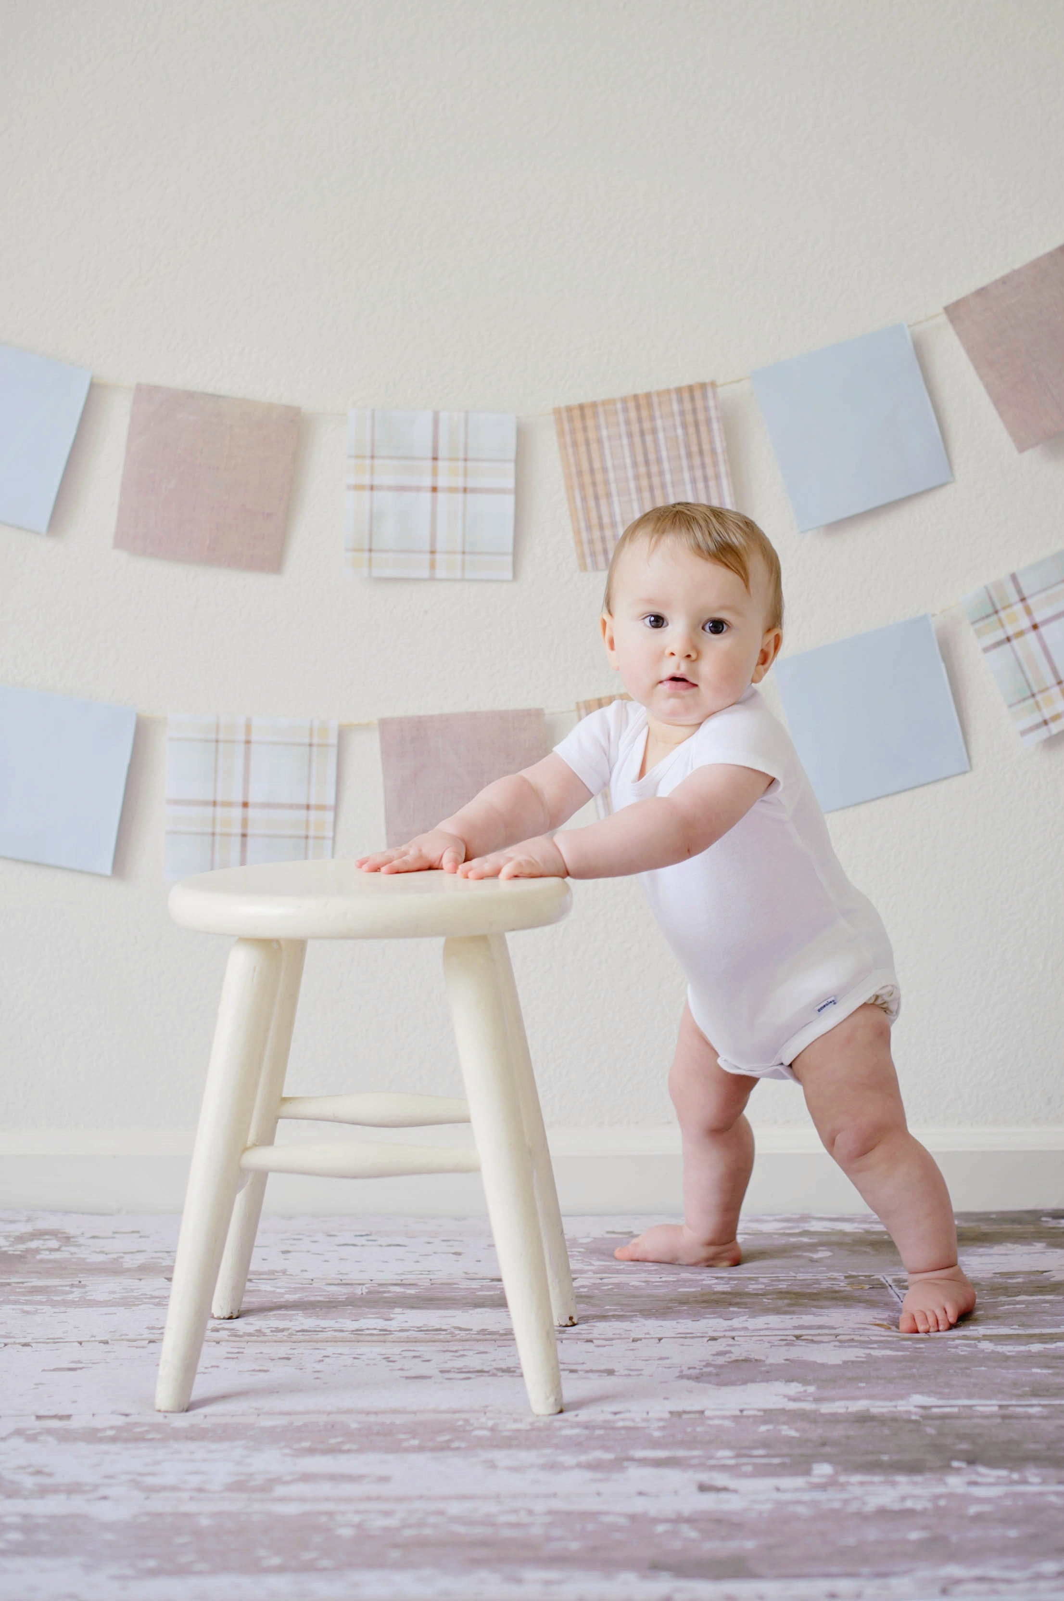

MILESTONES: 2-4 months – roll from side to side 6 -8 months - sit unsupported 8-10 months – crawl 12 months - walk

Slide 6

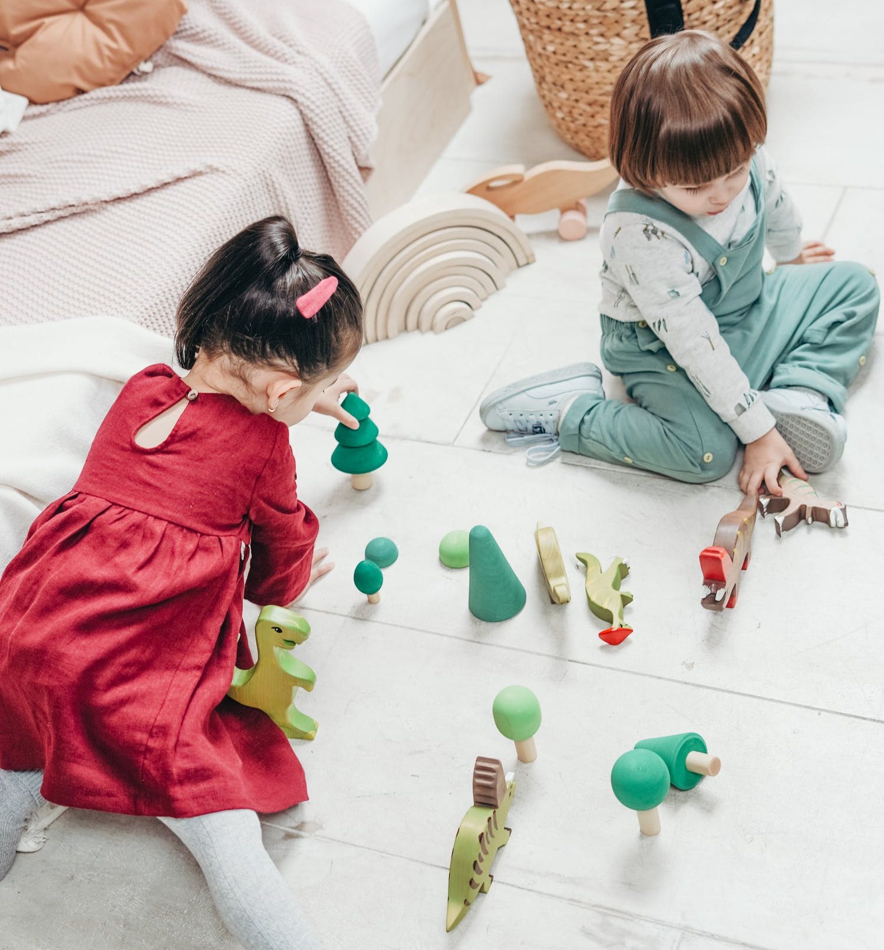
Early Childhood
From a few words at one year to 2,500 words by age 6
Defy limits
Temper tantrums
From self-centered to sociable

Slide 7

Late Childhood
Muscle coordination develops leading to physical activity engagement
Life centers around school
As age become more group oriented and sense of accomplishment should develop

Slide 8


Adolescence
Growth spurt & awkward stage
Development of sexual organs & secondary sexual characteristics
Accept responsibility for their actions
Conflict related to being treated as both child and adult
Less time spent with family & more with peers

Slide 9

Young Adulthood
Most productive life stage
Independence
Career choices
Partner
Moving away from peer group

Slide 10

Middle Adulthood
Physical – hair thins & grays, wrinkles, decrease hearing & visual acuity, weight gain
Understanding life & ability to deal with stressors
Contentment vs. crisis
Empty nest
High divorce rate
Aging parents

Slide 11

Late Adulthood
Physical decline – dry, wrinkled, bones brittle, loss of muscle tone, decreased tolerance for temperature
Retirement
Memory loss
Death of spouse
Physical Disabilities

