Slide 1
Vital Signs
Jan Mould, RN, BSN, MEd

Slide 2
Vital Signs
Temperature
Pulse
Respiration
Blood pressure

Slide 3
Abbreviations
TPR
BP
WNL
BPM

Slide 4
Temperature
Heat is produced in body by exercise & metabolism
Lost through skin, lungs, & waste products

Slide 5
Increased Temperature
Pink/reddish
Warm to touch
Restless
Thirsty

Slide 6
Thermometers:
Oral-place under tongue
Rectal
Axillary- armpit

Slide 7
Tympanic-in ear accurate & easy
Temporal-across forehead

Slide 8
Normal Temperatures
Oral-98.6
Rectal-99.5
Axillary-97.6
Increased temp.-fever or pyrexia

Slide 9
Taking Temperature
Temperature highest at night
Wait 30 minutes after eating, gum, or smoking
Rectal-most accurate
Axillary-least accurate

Slide 10
Temperature Conversion
Fahrenheit (F) to Celsius (C) - subtract 32 from F temp and then multiply by 0.5556
Celsius (C) to Fahrenheit (F) - multiply C temp by 1.8 and then add 32

Slide 11
Pulse
Rate: speed or frequency of the beat in relation to time
Factors that influence: age, infection, exercise, fitness level, fever, hemorrhage, & stress

Slide 12
Pulse
Rhythm: pattern of beats
Volume: strength or quality of the heart beat

Slide 13
Normal Limits
Adults 60-90
Infants 100-140
Bradycardia-less than 60 BPM
Tachycardia-more than 100 BPM

Slide 14
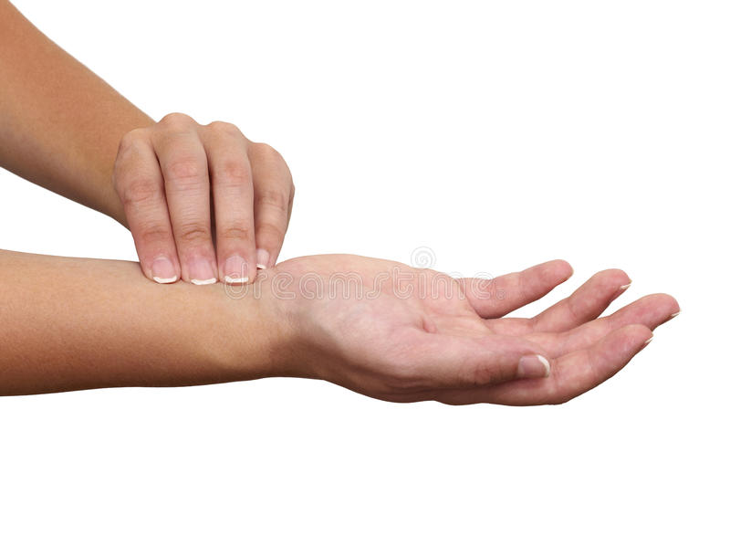
HOW TO TAKE A RADIAL PULSE

Slide 15
Respirations
Process of inspiration & expiration
Normal range for adults 12-20
Note character & rhythm

Slide 16
Respirations
Dyspnea-difficult or labored breathing
Apnea-absence
Cheyne-Stokes-dyspnea followed by apnea
Pt must be unaware

Slide 17
Blood Pressure
Measuring pressure that blood exerts on walls of arteries during contraction & relaxation
Measured in millimeters of mercury
Use a sphygmomanometer

Slide 18
Blood Pressure
Systolic-pressure when contracting
Diastolic-pressure when heart is at rest
Written systolic/diastolic
Normal range 100-140/60-90

Slide 19
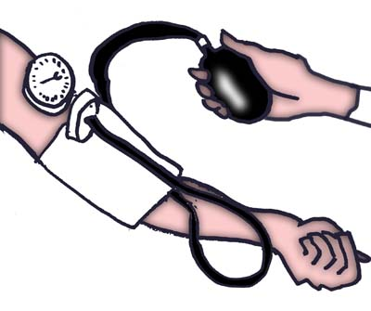
TAKING A BLOOD PRESSURE

Slide 20
PRACTICE –PRACTICE-PRACTICE

