Slide 1

Pregnancy Jan Mould, RN, BSN, MEd HOSA – Future Health Professionals

Slide 2
How Much Do You Know?
1. How many weeks is a human pregnancy?
2. How many stages of labor are there?
3. How are the stages of pregnancy divided?
4. Babies born before the _______ week are considered premature.
5. At what week of pregnancy would you expect the mother to feel movement?
What is a breech presentation?

Slide 3
Normal Pregnancy
Usually lasts 40 weeks
Divided into trimester
First trimester (week 1-12)
Second trimester (week 13-28)
Third trimester (week 29-delivery)

Slide 4
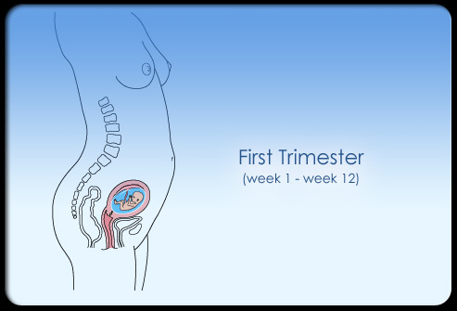
First Trimester
Conception with the fertilized egg (zygote)
Implants in the uterine wall
Cells become the fetus and placenta
Placenta provides nutrients & oxygen

Slide 5
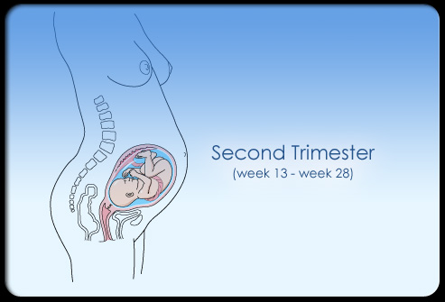
Second Trimester
16 weeks can usually determine sex
20 weeks mother feels movement
Survival rate at 28 weeks gestation is about 92%

Slide 6
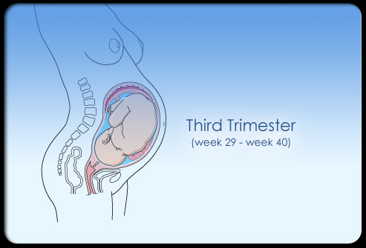
Third Trimester
Born before 37 weeks considered preterm

Slide 7

Stages of Labor
First stage from beginning of contractions to full dilation (10 cm)
Divided in two parts – early labor to active labor

Slide 8
Balloon Activity
Students will need ping pong ball & balloon

Slide 9

Second Stage
Often called “pushing” stage
Ends with birth of baby

Slide 10
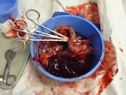
3rd Stage
After baby delivered to placenta delivered

Slide 11
Medical Reasons for C-Section
Fetal distress
Repeat cesarean
Chronic health conditions
Cephalopelvic disporportion

Slide 12
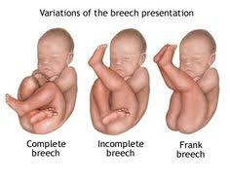
C - Section
Medical Reasons for C- Section:
Abnormal position

Slide 13
Read more about it:
C-section

Slide 14
Now How Much Do You Know?
Post-test
1. How many weeks is a human pregnancy?
2. How many stages of labor are there?
3. How are the stages of pregnancy divided?
4. Babies born before the _______ week are considered premature.
5. At what week of pregnancy would you expect the mother to feel movement?
What is a breech presentation?

