Slide 1


How to get that job, admission, or Scholarship
Jan Mould, rn , BSN, med

Slide 2


Personal statement
a written description of one's achievements, interests, etc., included as part of an application for a job or to an educational program

Slide 3

The HOW To of Personal statements HERE

Slide 4
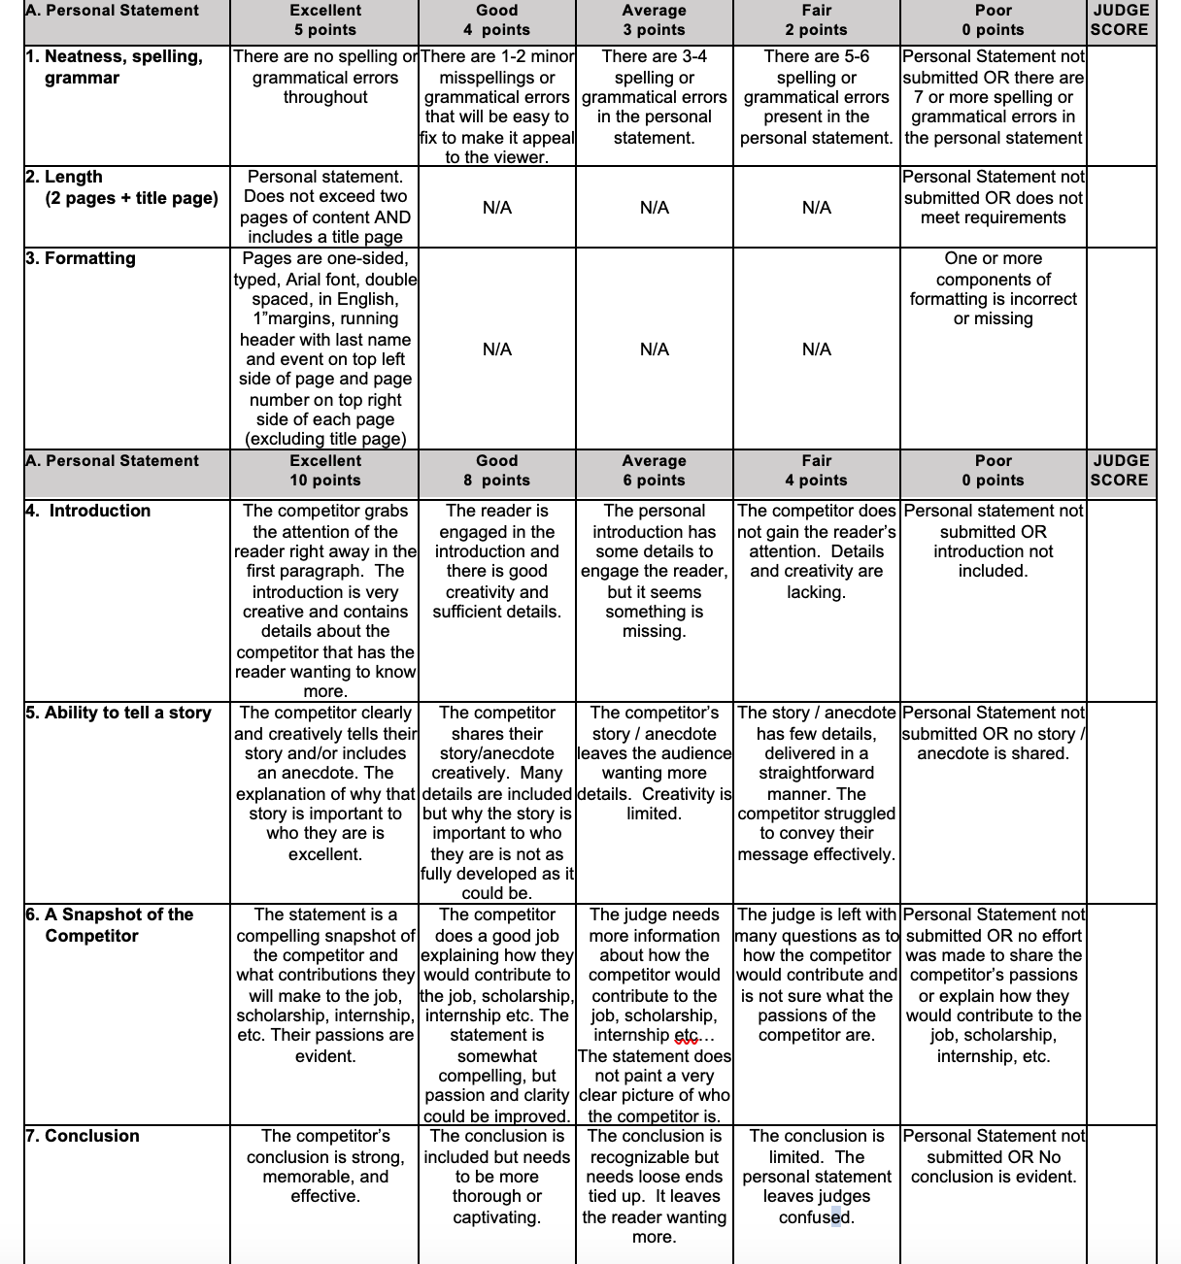
Personal Statement – 55 points

Slide 5
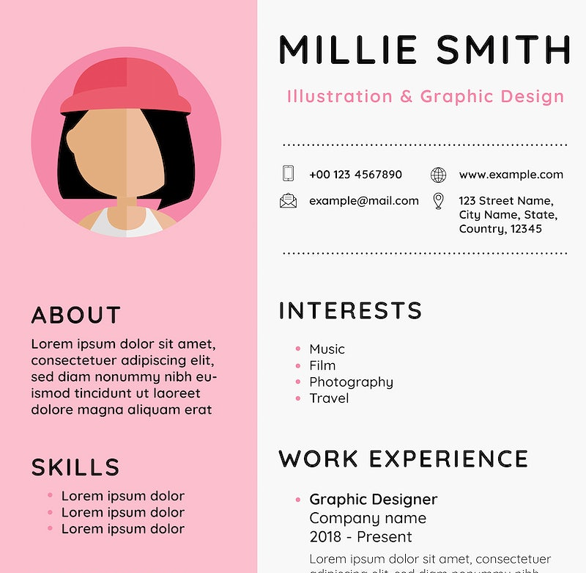
RESUME
A short account of one’s career & Qualifications

Slide 6
Resume suggestions - indeed.com
Cover the basics – few words as possible
Review others from your industry
Professional clean font – arial , 10-12
Active language
Use Keywords from job description
Proofread more than once
Notes:
Basics – work experience, achievements, education & skills relevant to the employer Active language-achieved, earned, completed, accomplished

Slide 7
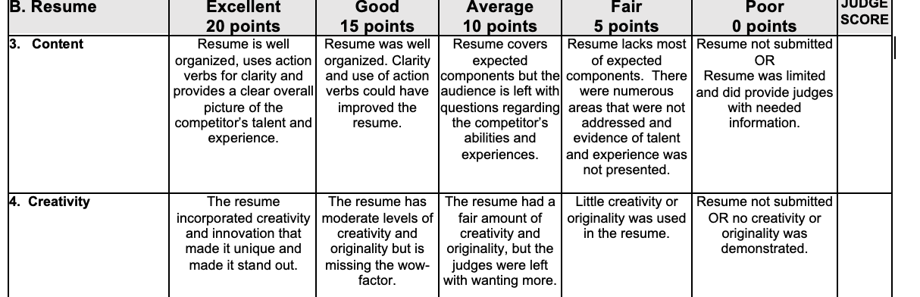
Resume – 40 points

Slide 8

The interview
HERE

Slide 9

Hosa.org
Competitive events
Competitive events Useful tools
Competitive Events Samples
Sample event topics
Job seeking skills

Slide 10
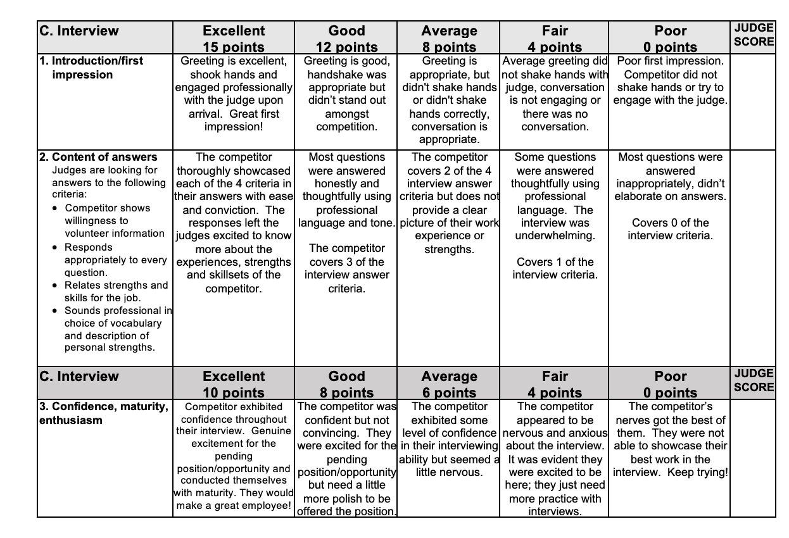
Interview – 80 points
Notes:
First impression within 7 seconds

Slide 11
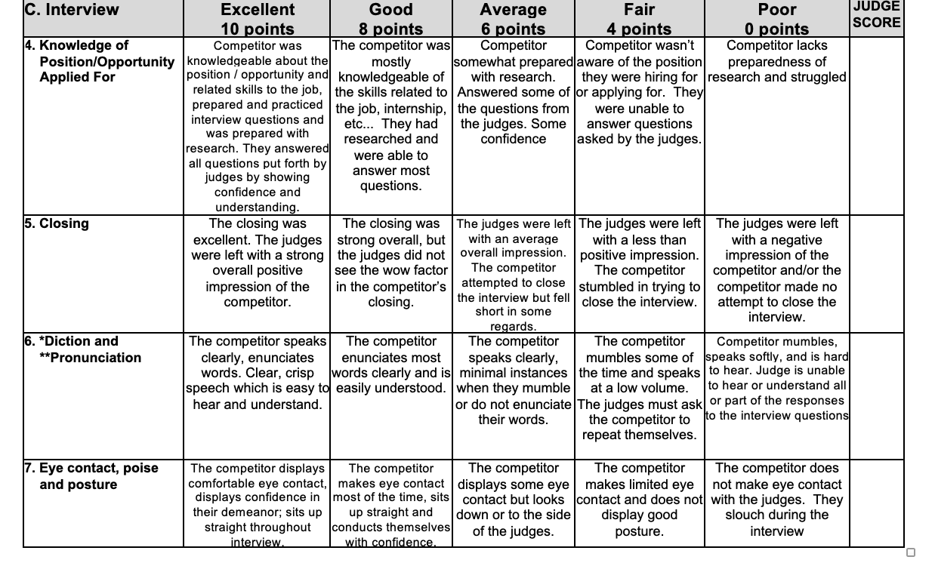
Interview (con’t)

Slide 12


YOU ARE REady
JOB SEEKING SKILLS

