Slide 1

FENTANYL KILLS
Jan Mould, RN, BSN, MEd
Deputy Director of Competitive Events
HOSA – Future Health Professionals

Slide 2
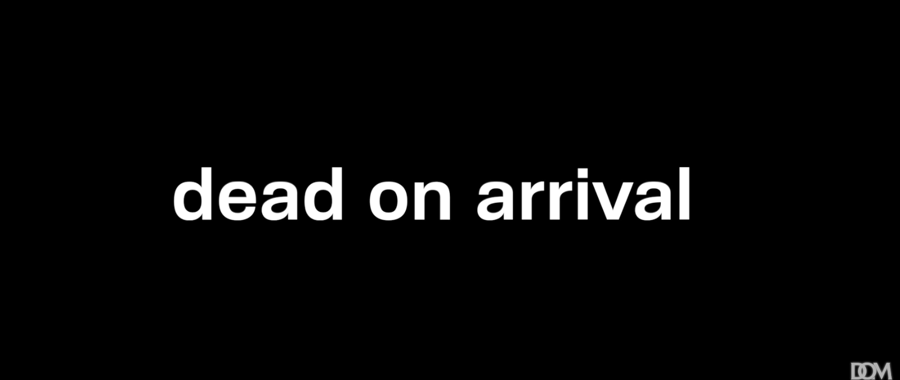
Fentanyl Kills

Slide 3


