Slide 1
Communication Mini Lesson Jan Mould, RN, BSN, MEd HOSA - Future Health Professionals

Slide 2
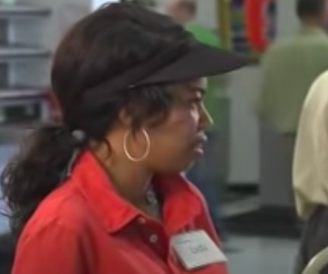
Could this be you?

Slide 3
Communication
From the Latin word communicare – to share
Definition: make common; impart or exchange information
List some appropriate terms you use that your parents would not understand?

Slide 4
Communication Process
Sender
Message
Encode
Channel
Receiver
Decode
Feedback

Slide 5
The Sender

Slide 6
Message

Slide 7
encode
Verbal
Nonverbal
Both

Slide 8
channels
Hearing
Feeling
Seeing

Slide 9
receiver

Slide 10
decode

Slide 11
Feedback
Message back to the sender

Slide 12
Communication Process
Sender
Message
Encode
Channel
Receiver
Decode
Feedback

Slide 13
barriers

Slide 14
Use of jargon
Unfamiliar
Too technical

Slide 15
Emotional barriers
Taboo

Slide 16
Distraction
Uninterested
Lack of attention

Slide 17
Difference in viewpoint

Slide 18
Physical/cognitive issues
Hearing loss
Visual impairment
Speech impairment
Intellectual abilities
Age

Slide 19
Language barriers
Center for Immigration Studies
In 2018 67.3 million in US spoke a language other than English at home

Slide 20
Language barrier example
A health care team misunderstood an 18 years old’s family who said that he was intoxicado.
The interpreter misunderstood the term to mean "intoxicated" rather than “ingested something.”
As a result, the patient was treated for a drug overdose for thirty-six hours before the doctors realized that he had a brain aneurysm.
He ended up being a quadriplegic and his family was awarded $71 million in a malpractice settlement

Slide 21
Cultural differences
WEBSTER defines:
The beliefs, customs and arts of a specific society or group of people

Slide 22
Cultural competency
Increasing knowledge base
Open lines of communication with patient
Experiences with others from different cultures

Slide 23
respect
RESPECT each person as an individual with a right to quality care.

Slide 24
Assignment #1
Using the Prepared Speaking Guidelines, students are to develop a speech that addresses the current HOSA – Future Health Professionals theme: Powered by People.

Slide 25
Assignment #2
Using the Creative Problem Solving Guidelines: groups are to respond to the following:
Your Creative Problem Solving Team is part of a Community Group charged with implementing changes to assist their local Health Department who are seeing increasing numbers of patients who do not speak English. Describe the policies, activities, or programs your team will implement to address the concern of the inability to communicate effectively with those seeking care at the Health Department.

