Slide 1
Connect, Inspire and Engage with Middle and High School Students— The Next Generation of Health Professionals!
Fall 2024

Slide 2
HoSA Provides the Best Prepared people
The mission is to empower
HOSA-Future Health Professionals to become leaders in the global health community through education, collaboration, and experience.

Slide 3



hosa by the numbers vital statistics
54 chartered associations in the U.S., Canada, China, Germany, Korea and American Samoa
6,210 chapters representing middle school, secondary, postsecondary & collegiate divisions
3 million alumni
since 1976
291,458 HOSA Members
80% female, 20% male
59% of HOSA members are racial and ethnic minorities

Slide 4

Chapter Affiliation
www.hosa.org/affiliation
Chapter charter number and password

Slide 5
Available resources www.hosa.org
Guidelines, manuals, photos, posters, publications, tutorials, and videos!

Slide 6
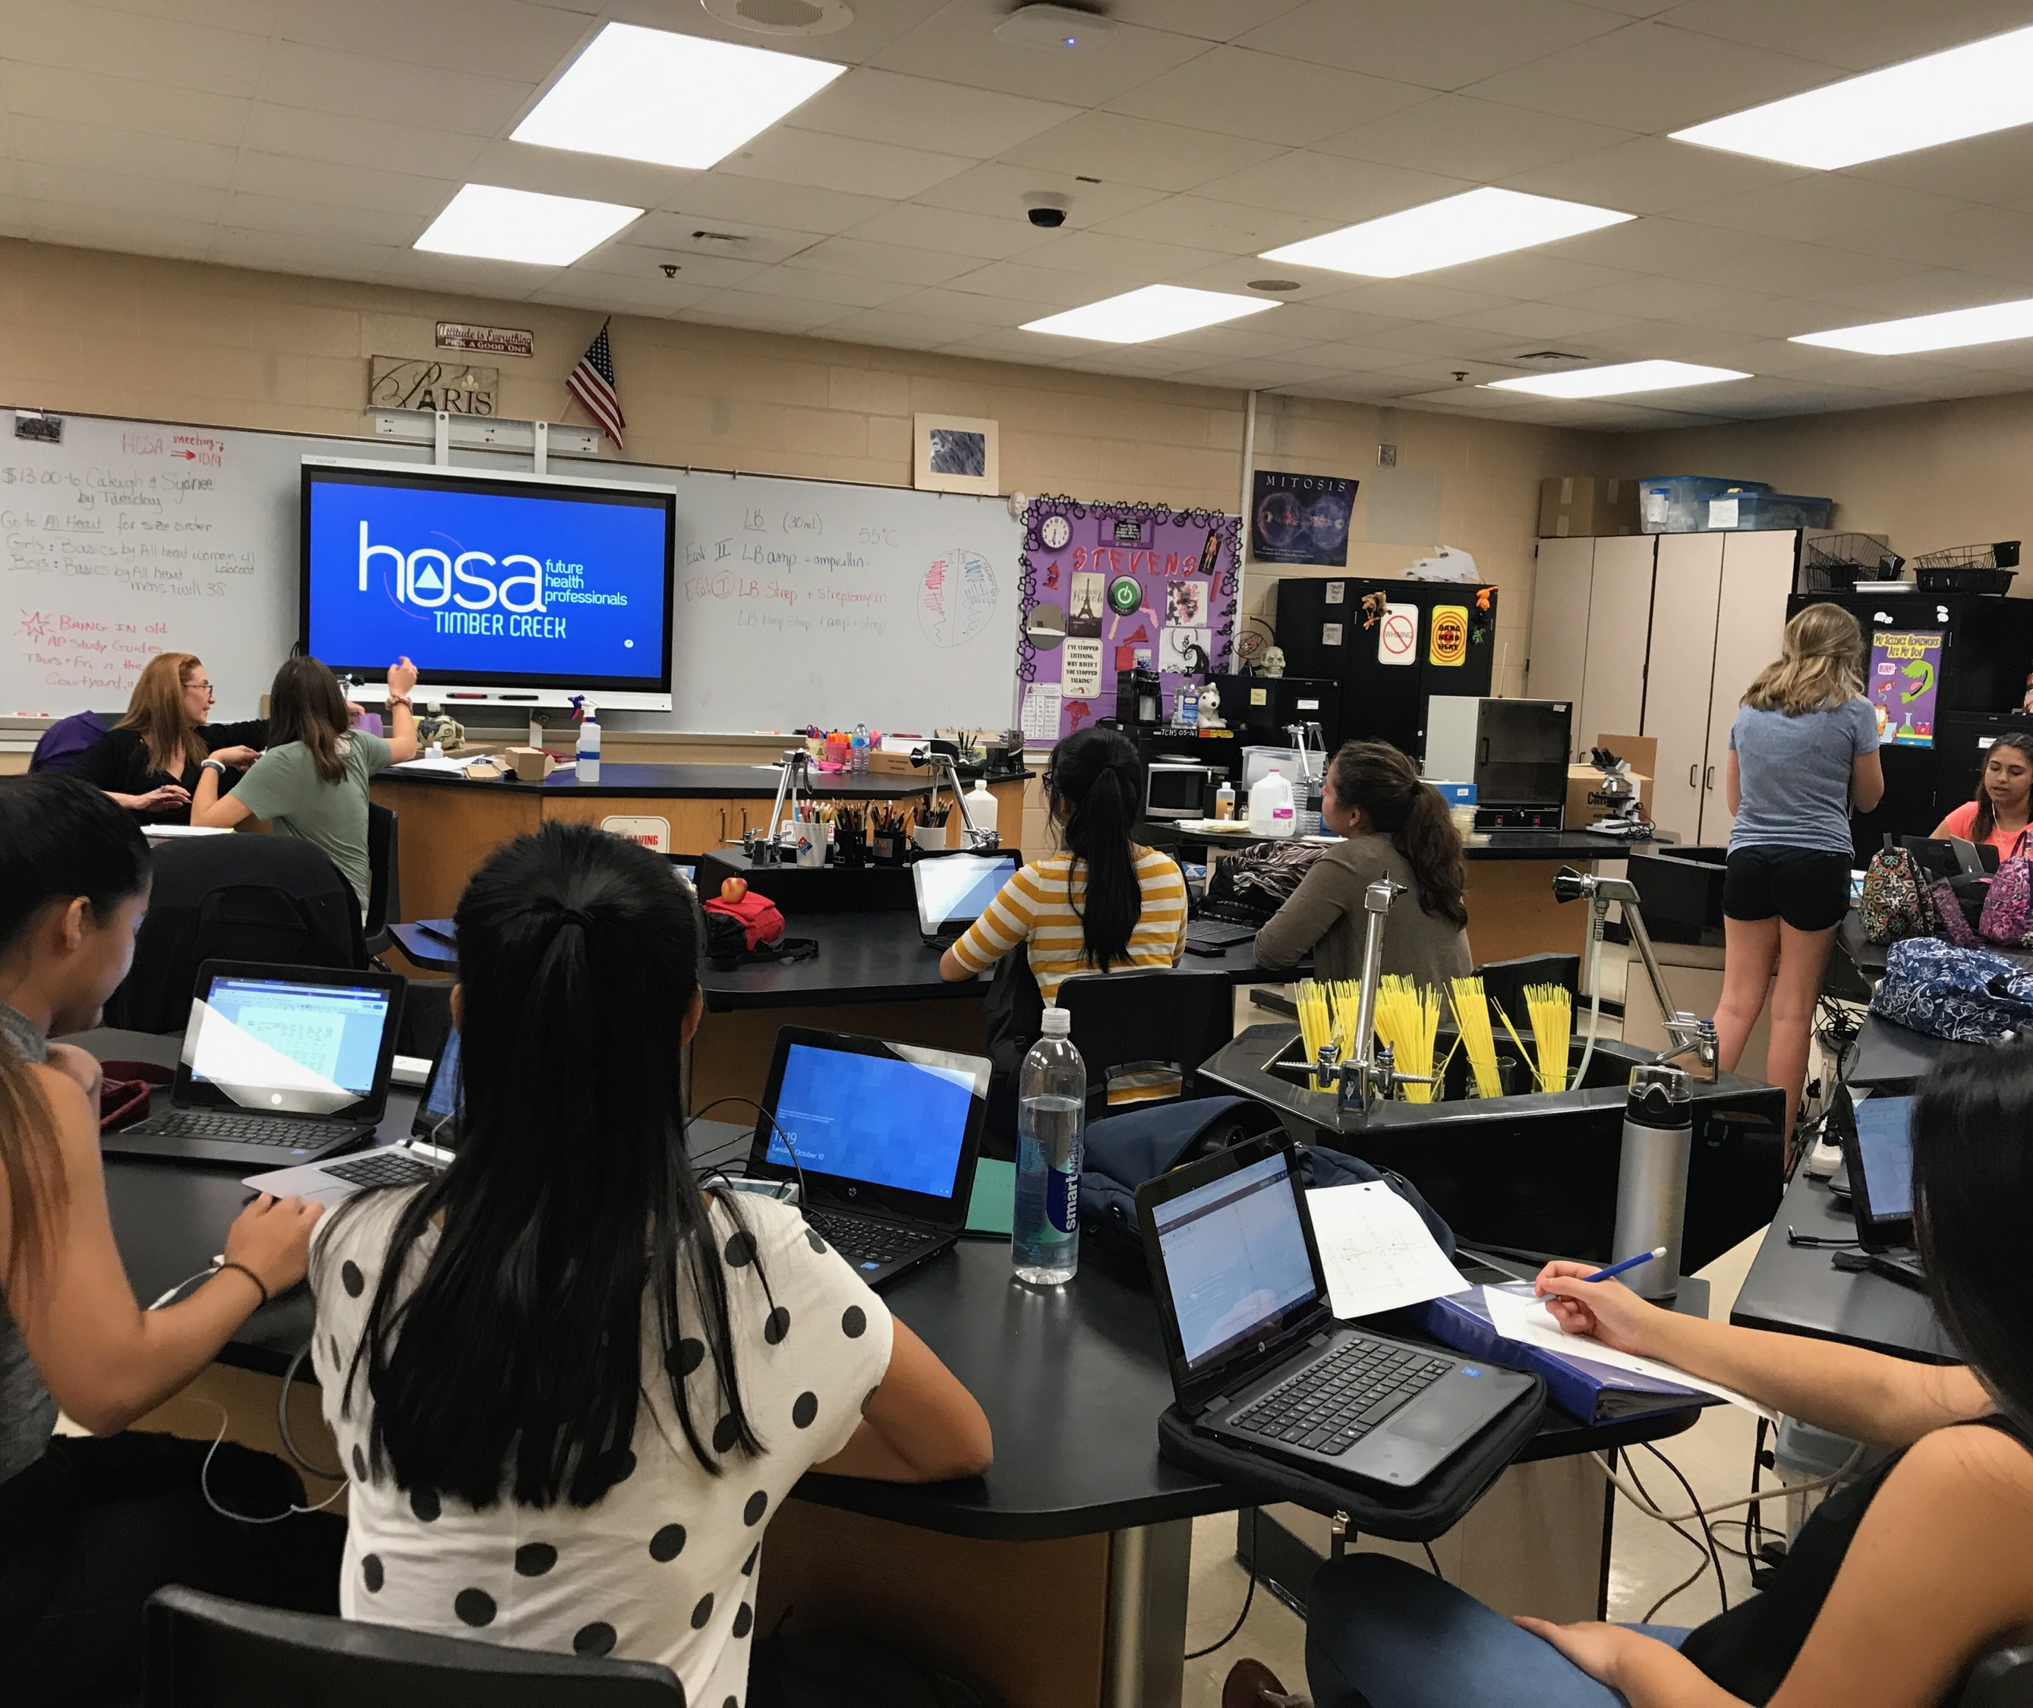
Typical Chapter meeting
General Announcements
Community Service Events
Guidelines on what/how to study
Leadership Conferences/HOSA Activities
Small Study Groups
20-30 Minutes of group studying or practicing of skills assessments
Reflections
Open discussion about the learning and plans to improve for the future
Notes:
Slides 9-how many you two ladies need to tell your stories.

Slide 7
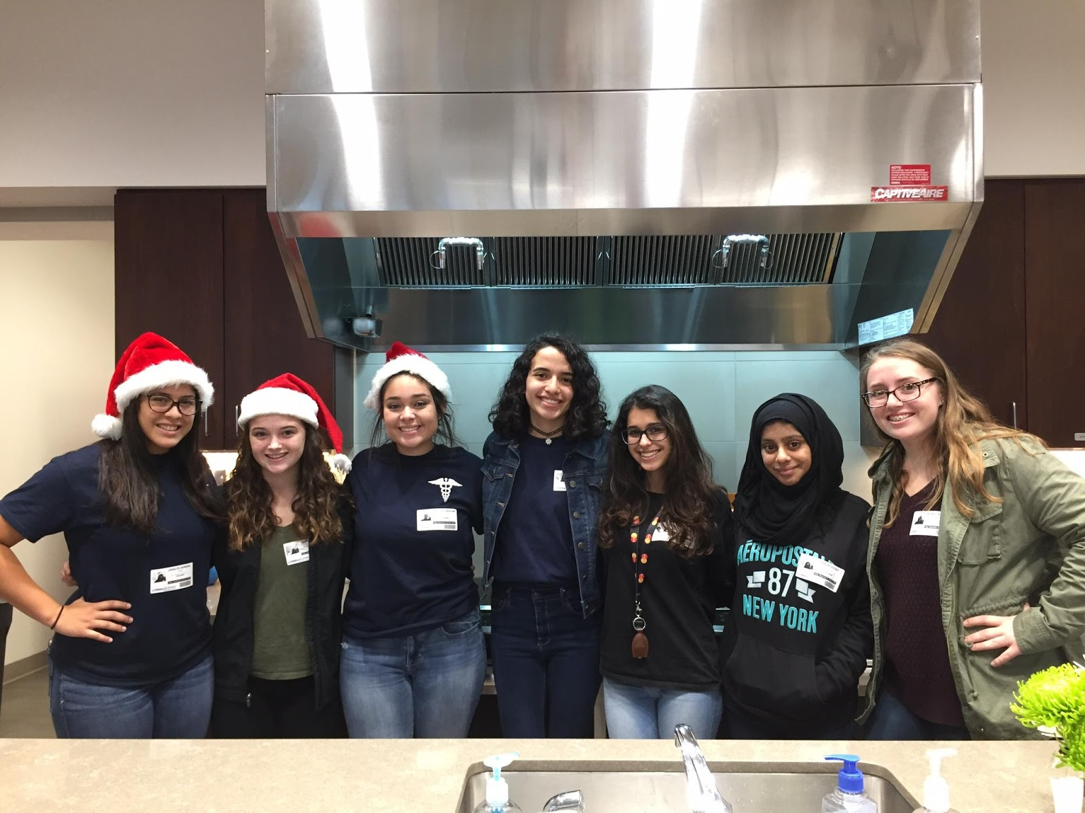


HOSA Week
Local Pre-school about Nutrition and Safety Presentation
Stress Relief Puppy Day
Health Careers Display Fair
Intro to Diabetes Presentation for Principles of Biomedical Science Classes
Ronald McDonald House Volunteers
Chapter Fundraisers

Slide 8


competition

Slide 9
Health Science | Health Professions Events | Emergency Preparedness Events | Leadership Events
Behavioral Health Cultural Diversities & Disparities Dental Terminology Health Informatics Human Growth & Development Medial Law & Ethics Medical Math Medical Reading Medical Spelling Medical Terminology Nutrition Pathophysiology Pharmacology | Biotechnology Clinical Laboratory Science Clinical Nursing Clinical Specialty Dental Science Family Medicine Physician Home Health Aide Medical Assisting Nursing Assisting Personal Care * Pharmacy Science Phlebotomy Physical Therapy Respirator Therapy Sports Medicine Veterinary Science | CERT Skills CPR/First Aid Emergency Medical Technician Epidemiology Life Support Skills * Mental Health Promotion MRC Partnership Public Health | Extemporaneous Writing – Health Policy Health Career Photography Healthy Living Interviewing Skills * Job Seeking Skills Organizational Leadership Prepared Speaking Researched Persuasive Writing & Speaking Research Poster Speaking Skills * IDEA Qualified Event * All Divisions **

Slide 10
Teamwork Events | Middle School Events | National Geographic Learning Academic Testing | Recognition Events
Biomedical Debate Community Awareness Creative Problem Solving Forensic Science Health Career Display Health Education HOSA Bowl Medical Innovation Parliamentary Procedure Public Service Announcement | Dynamic Decisions Exploring Medical Innovation Extemporaneous Health Poster Foundations of Medical Terminology Foundations of Veterinary Science Foundations of HOSA Bowl Health Career Exploration Health Career Display Health Career Preparation Health Education Healthy Living Life Threatening Situations Math for Health Careers Foundations of Medical Reading Foundations of Nutrition Prepared Speaking Public Health Speaking Skills * | AAFP Family Medicine Career Test Allied Health Statistics Anatomy & Physiology Biochemistry Biology Career Development General Chemistry Human Heredity Leadership Math for Health Professionals Microbiology Occupational Safety & Health Organic Chemistry Physics College | America’s Blood Centers & HOSA Blood Drive American Red Cross Volunteer Service Barbara James Service Award** Healthcare Issues Exam Emotional Well-Being Challenge HOSA Happenings** HOSA Service Project** Outstanding HOSA Achievement Outstanding HOSA Leader Outstanding HOSA Alumni IDEA Qualified Event * All Divisions **

Slide 11



Hosa produces Health Professionals Pipeline for future health professionals
Future Health Professional Flow
Schools
Health Employers
Information Flow

Slide 12








Partnerships create opportunity The benefits of HOSTING a hosa Chapter
Partnerships
Knowledge
Linkages
Access
Resources
Dialogue
Cooperation
Planning

Slide 13

Partnership Opportunities
Competitive Events
Event Sponsorships
Topic Selection
Judging
Conference Sponsorships
Financial Sponsors
Workshop Presenters
Keynote Speakers
Exhibitors
Local Support
Network with local leaders
Support conference attendance
Provide internships and job shadowing
Scholarship opportunities

Slide 14
HOSA’s International Leadership Conference
unique learning opportunities about current and relevant trends and ideas in health at educational workshops
educational and classroom instruction resources from publishers, associations and corporate sponsors at the HOSA Expo
100 competitive events that showcase the technical skills and competencies developed through health and biomedical science class instruction
network with 13,000 HOSA members, advisors, health science educators and health professionals from across the country
opportunity to engage and see first hand how 300,000 HOSA members will impact the future of health

Slide 15
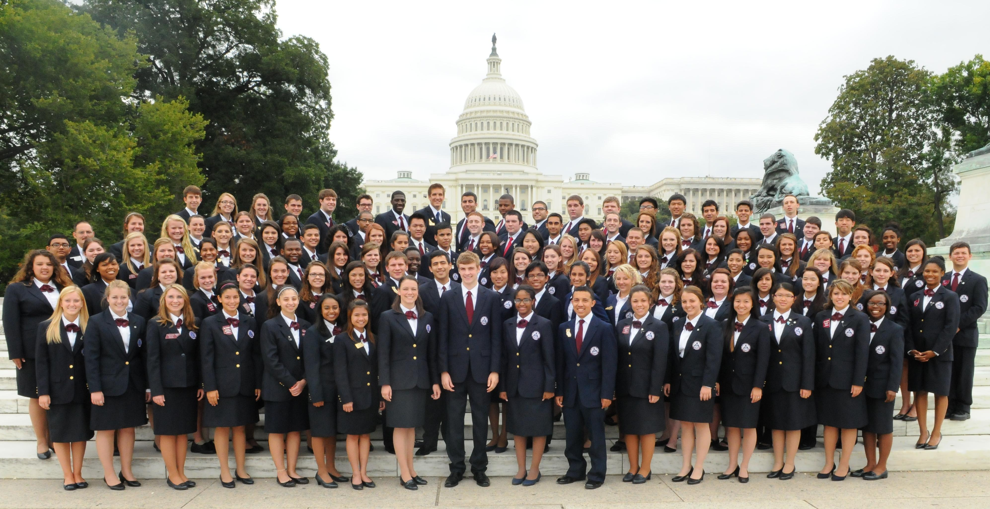
Washington leadership academy and State Advisors Management conference for state and local leaders| September Annually| Washington, DC
Workshops
Leadership Training
Industry Day
Network with key state and local leaders

Slide 16



Continue the conversation Contact information
HOSA-Future Health Professionals
548 Silicon Drive, Suite 101 Southlake, TX 76092
800-321-HOSA
hosa@hosa.org
facebook.com/HOSAFHP
@NationalHOSA
@NationalHOSA

