Slide 1
Did You Say Clinical Laboratory Science?
Wanda Haberer MS, MLS (ASCP) Alexandria Technical and Community College
MLT Program Director  Instructor
HOSA – Future Health Professionals Advisor

Slide 2
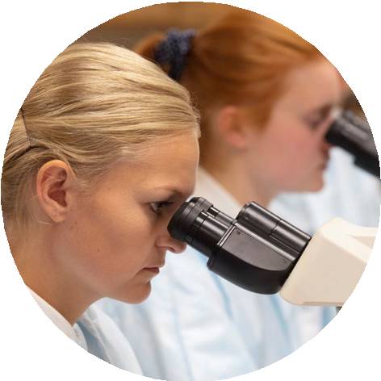
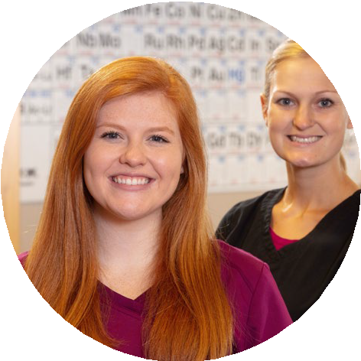
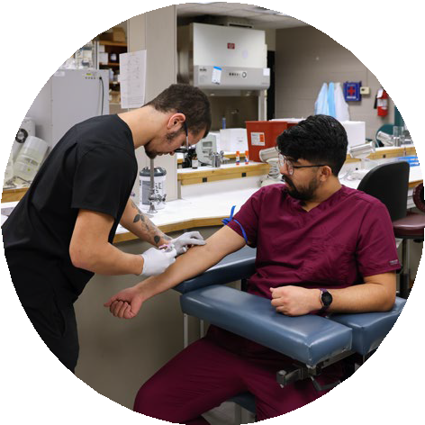
What is Clinical Laboratory Science?
Clinical medical
laboratory professionals include laboratory technicians (MLT) and
medical laboratory scientists (MLS) who are vital members of the healthcare team.
Laboratory professionals are responsible for providing accurate, reliable laboratory test results for monitoring health, diagnosis, and treatment of disease.
Laboratory tests monitor the composition of our blood, urine, and other body fluids and tissues for early warning signs of disease.

Slide 3
Click the link below for a playlist that includes more information on Clinical Laboratory Science.
Clinical Laboratory Science

Slide 4
Check Out Clinical Laboratory Science Careers!

Slide 5
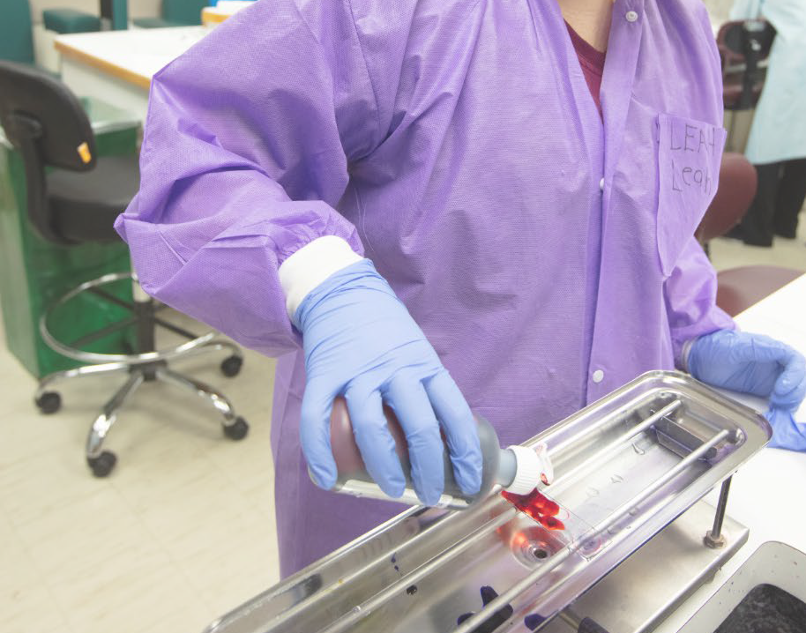
Transferable
Lab Tech skills to Industry Check Out these Careers!
Who’s Who in the Lab - ASCP
Biotech careers
Charles River Laboratories – Clinical Research

Slide 6
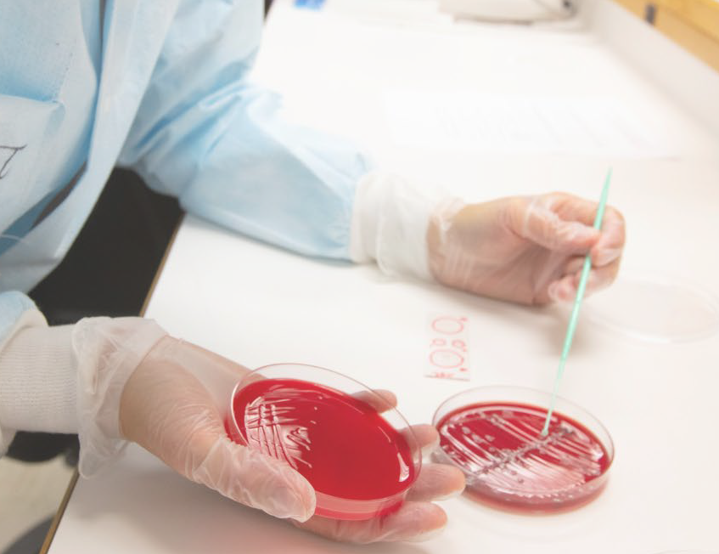
Develop a Health Career Display for
Clinical Laboratory Science
Health Career Display Guidelines

