Slide 1
Jan Mould, RN, BSN, MEd Deputy Director of Competitive Events HOSA – Future Health Professionals

Slide 2
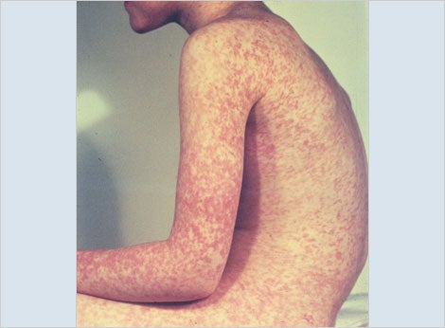
MEASLES
It is back!

Slide 3
WEB MD on the measle comeback
CLICK HERE

Slide 4
Measles history
2000 = no cases of measles in the United States
December, 2023 & January, 2024 = 23 cases in the U.S. alone
Europe 2023 = thirtyfold increase of measles

Slide 5
THE VIRUS
One infected individual who comes in close contact with an incomplete vaccinated or immunocompromised individuals will spread it to 90% of those individuals
To prevent outbreaks – 95% of community needs to be vaccinated

Slide 6
Why Now?
COVID 19 pandemic led to decrease in access to primary & preventative care
Vaccine hesitancy
Misinformation & Disinformation
Exemptions – medical & religious exemptions with new addition of “personal” exemptions

Slide 7
You are to share with your state legislatures if support or oppose your state’s position on vaccine exemptions. Click HERE for states exemptions.
You are to use the Extemporaneous Writing – Health Policy rubric for writing the letter.

