Slide 1
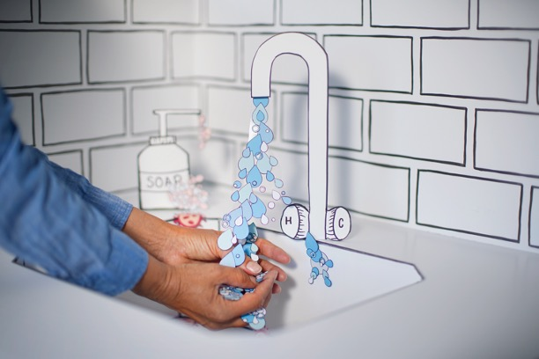
Handwashing – The Essential Skill
Jan Mould, RN, BSN, MEd
HOSA - Future Health Professionals
Notes:
It has been said that the single most important thing you can do for your patients is wash your hands. Let’s see what the CDC has to say about handwashing.

Slide 2
WHAT THE CDC SAYS YOU NEED TO KNOW HERE
Notes:
The World Health Organization provides a video on how to wash your hands.

Slide 3
World Health Organization -
How to Wash Your Hands
HERE

Slide 4
Your Turn
Using the HOSA Nursing Assisting Guidelines
(Handwashing can be found in many other HOSA Health Professions Events)
Practice Skill I: Handwashing

