Slide 1
Artificial Intelligence/ Biomedical Debate
Jan Mould, RN, BSN, MEd
Deputy Director of Competitive Events
HOSA – Future Health Professionals

Slide 2
DEFINITIONS
Intelligence – ability to learn or understand or to deal with new or trying situations
Artificial Intelligence – the capability of a machine to imitate intelligent human behavior

Slide 3
Quick video on AI HERE

Slide 4
2023 – 2024
Biomedical Debate Topic

Slide 5
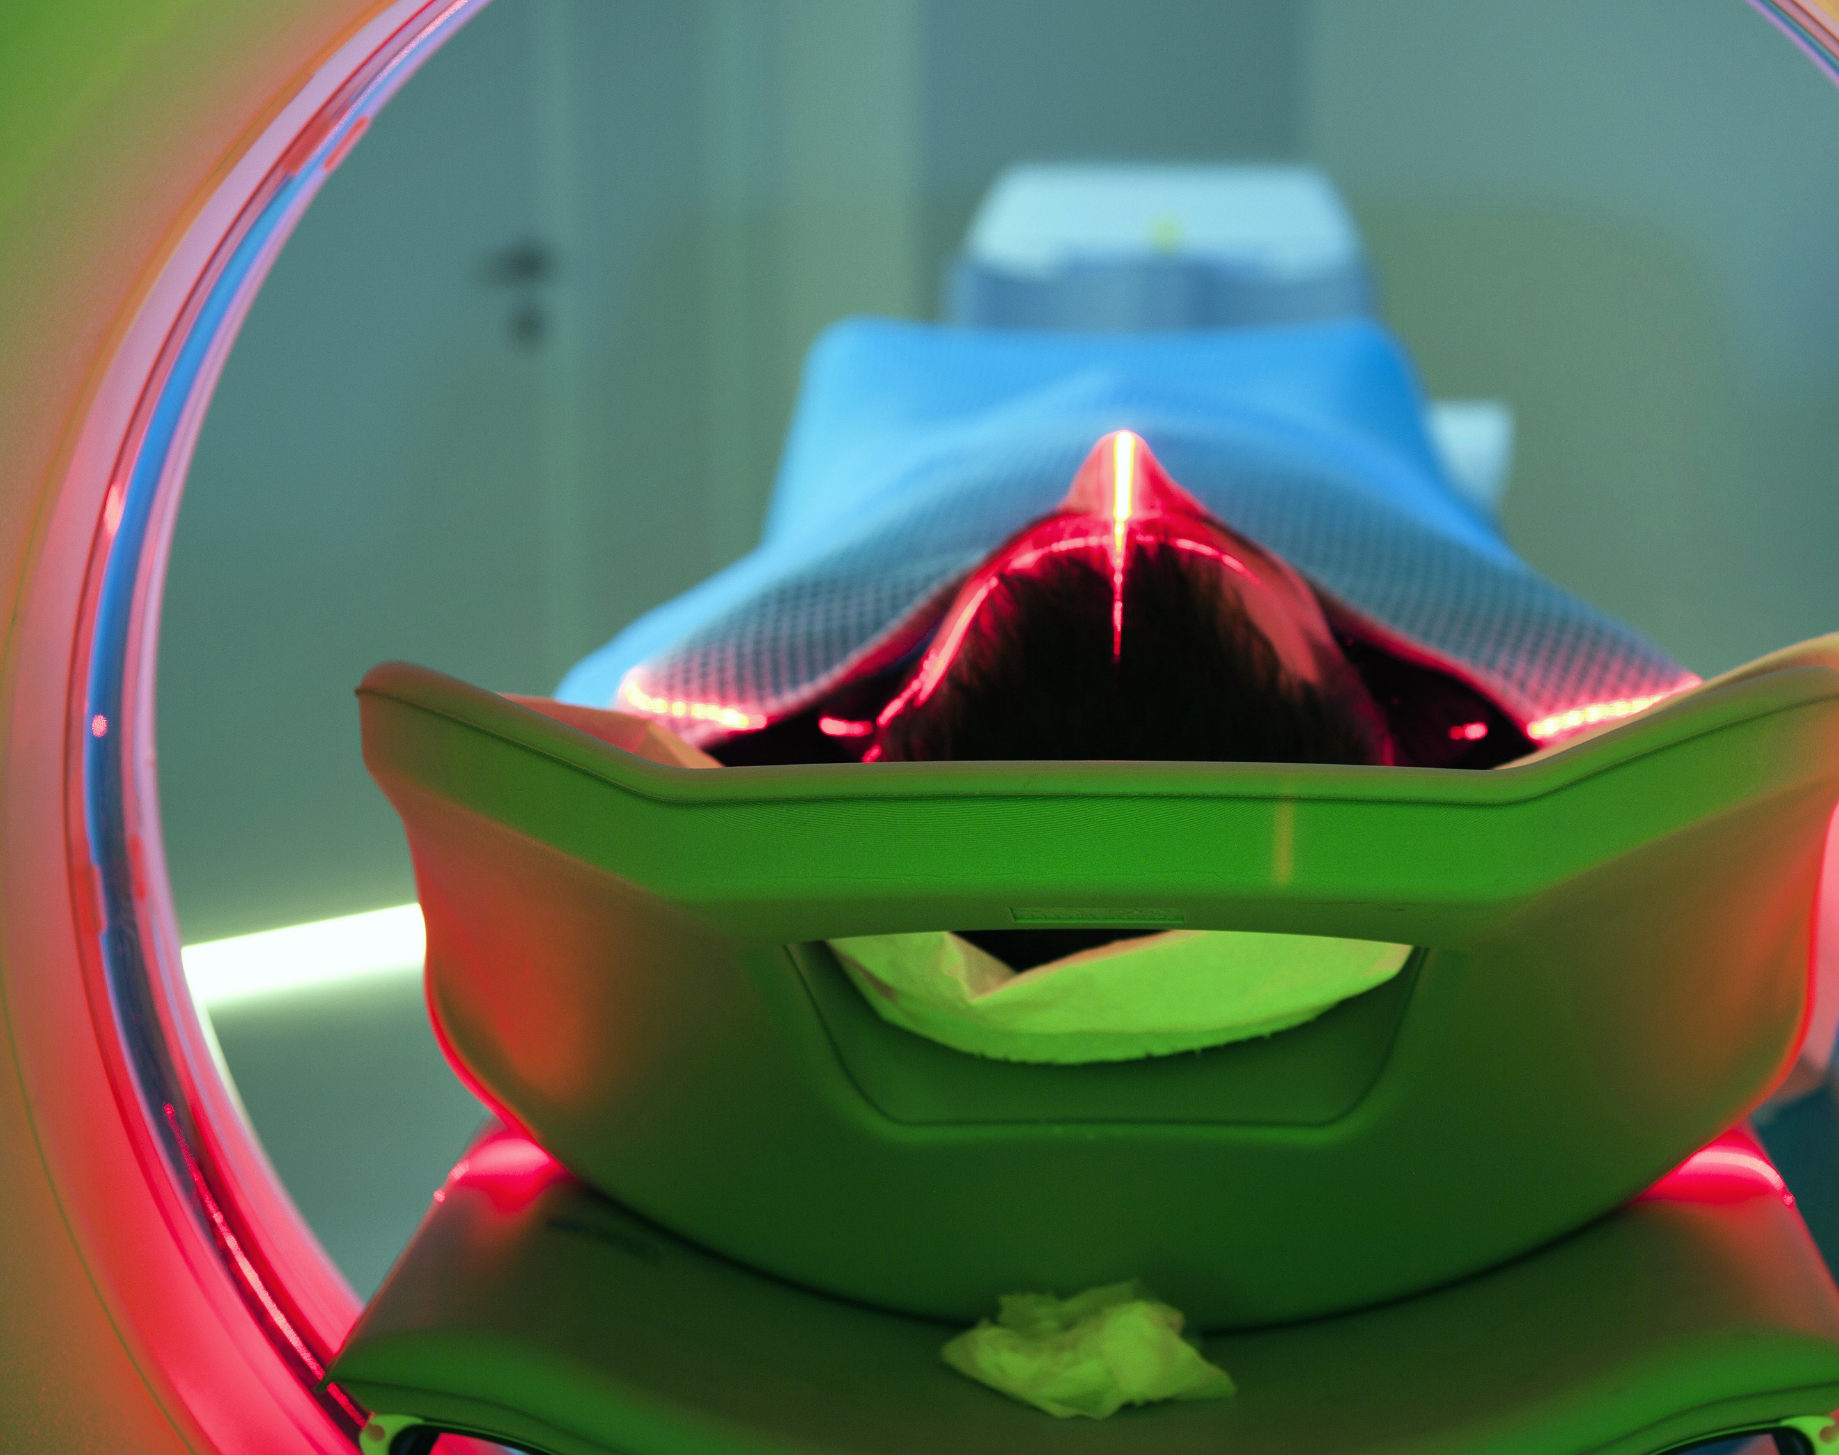
Pros & Cons of Artificial Intelligence in Medicine

Slide 6
AI REVOLUTION IN MEDICINE
Getting diversity in the training of these algorithms is going to be incredibly important, otherwise we will be in some sense pouring concrete over whatever current distortions exist.”
— Isaac Kohane, head of Harvard Medical School’s Department of Biomedical Informatics

Slide 7
Arguing the Pros and Cons of Artificial Intelligence in Healthcare

Slide 8
A great debater:
A good debater knows each side equally well.
Able to predict what their opposition will say.
Be prepared.
Know the topic.

Slide 9
A great debater:
Convinces listeners.

Slide 10
A great debater:
Sharpens their listening skills.

Slide 11
A great debater:
Practices.

Slide 12
A great debater:
Stays confident.

Slide 13
A great debater:
Use your voice, tone, posture & facial expressions.
Takes advantage of non-verbal cues.

Slide 14
A great debater:
Closes strong!

Slide 15
Be sure to check the guidelines for the rubrics for your speech!
You will be divided in teams of 3-4 members. You are to develop either an affirmative or negative speech stating your arguments on the current topic, Should Artificial Intelligence in Healthcare be Welcomed or Feared?

