Slide 1
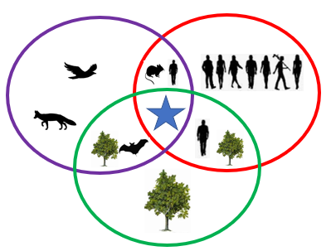
Discovering
One Health
© 2023 Thomson Publishing LLC
All Rights Reserved
Notes:
This lesson addresses:
United Nations Sustainable Development Goals: (these are addressed throughout the lesson but highlighted slides are listed)
Good Health and Well-being (slides 21-23)
Quality Education (slides 1-27)
Clean Water and Sanitation (slides 5-9)
Affordable and Clean Energy (slides 5-9- deforestation)
Sustainable Cities and Communities (slides 5-9- deforestation)
Responsible Consumption and Production (slides 5-9- deforestation)
Climate Action (slides 5-9)
Life on Land (slides 5-9)
Partnerships for the Goals (slides 22-25)
U.S. Next Generation Science Standards: (these are addressed throughout the lesson but highlighted slides are listed)
High School: LS2: Ecosystems: Interactions, Energy, and Dynamics (slides 5-9)
High School: LS3: Heredity: Inheritance and Variation of Traits (slides 12-21)
High School: LS 4: Biological Evolution: Unity and Diversity (slides 5-9, 12-19)
High School: ESS3: Earth and Human Activity (slides 5-9)
Overview:
Have you ever thought about how disease outbreaks start? A germ finds the ideal environment and runs out of control! The germ jumps between species and onto you. How can we prevent this? Find out more with Discovering One Health!
Lesson Objectives:
1. Students will understand that the health of people is dependent on the health of animals and the environment (slides 3-11)
2. Students will understand the need for vaccines (slide 21-23)
3. Students will better understand the importance of protecting our environment (slides 3, 5-9, 23)
4. Students will better understand disease transmission and mutations (slides 4-20)
5. Students will understand what health professionals are combating (slides 11, 20-24)
6. Students will understand the importance of good communication between different professions (slides 24-25)

Slide 2
We will review:
One Health Concept
Zoonotic Disease
Mutation
Vaccine
One Health Approach
FIRST HALF
SECOND
HALF
Notes:
Each keyword is covered in order throughout the lesson. If the class meets for 30-45 minutes, then cover the first half of the lesson and teach the second half another time. This lesson can be taught in 1.5-2 hours (depending on the amount of interaction with the students and if they do the final activity).

Slide 3
What is the “One Health” Concept?
The connection between:
Human Health
Environmental Health
Animal Health
Notes:
Emphasize: “A sick environment leads to sick people and animals. Sick animals can make people sick. Sick people can make animals sick. We are all connected.”
Review: This Venn Diagram is simplified. Reality is more complicated.
Also note here that some people in 2023 call this connection “Planetary Health”. “Planetary Health” has traditionally emphasized the interaction between the environment and people’s health but advocates of “Planetary Health” are starting to include the effect of animals’ health on the planet. More information about Planetary Health can be found at: https://www.planetaryhealthalliance.org/planetary-health
The One Health Approach will be covered in the second half of the lesson. As a preview:
From the US CDC website (https://www.cdc.gov/media/releases/2019/s0506-zoonotic-diseases-shared.html):
One Health is an approach that recognizes the connection between people, animals, plants, and their shared environment and calls for experts in human, animal, and environmental health to work together to achieve the best health outcomes for all.

Slide 4
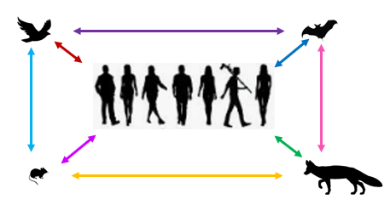
What is a “Zoonotic Disease”?
A disease
that
spreads
between
people and
animals.
Examples:
Rabies, Ebola, Bird Flu, SARS-CoV-2 (virus causing COVID)
Notes:
(Note: This slide requires slideshow view. If you are not already using this method of review, it is best to start now.)
Emphasize that these diseases jump to people.
Ask how many species are represented on this slide (answer: 5 because humans are a type of animal species)
Tip for teachers: Emphasize the “zoo” in zoonotic.
Ask if they can guess what “zoo” means in Greek. (It means “animal or living being”.) Challenge the students to think of other words with “zoo” as a root (ex. Zoology, Zooparasite, Zookeeper).
(A fun link for other “zoo-” terms: https://www.thoughtco.com/biology-prefixes-and-suffixes-zoo-or-zo-373875)
From the US CDC website (https://www.cdc.gov/media/releases/2019/s0506-zoonotic-diseases-shared.html):
60% of all infectious diseases in people are zoonotic. This makes it crucial that a nation strengthens its capabilities to prevent and respond to these diseases using a One Health Approach. One Health is an approach that recognizes the connection between people, animals, plants, and their shared environment and calls for experts in human, animal, and environmental health to work together to achieve the best health outcomes for all.

Slide 5
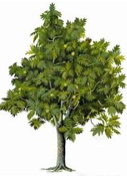
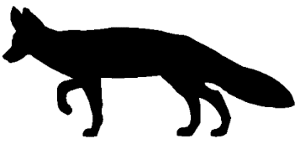
One Health: Part 1-- Environmental health
Notes:
Ask the students: “what are the three parts of One Health?” (Answer: human health, animal health, and environmental health)
Review: this is a picture of a busy and healthy forest. The animals are evenly spread out and there is no stress to any of the animals. The trees look healthy too.
(The teacher can discuss that clean water also plays a role in this forest ecosystem. This slide covers UN Sustainable Development Goals of “Clean Water and Sanitation” and “Life on Land”.)

Slide 6
One Health: Part 2-- Animal health
Notes:
Ask the students:
“Why are there less trees?” (Either from deforestation due to people or because of climate change which makes life for those plants more difficult in that area of the world.)
“Where are the animals going when there are less trees?” (They are starting to crowd together in a smaller area. They are more stressed because they have more competition for food/shelter and have less space to live in. Some animals are even leaving the forest to find food and are now near people).
(The teacher can discuss that water quality also plays a role in this changing ecosystem. If animals drink dirty water that is contaminated by either people or animals then they can get sick. Besides deforestation, the teacher can discuss how Climate Change can alter natural habitats and lead to animals (including insects) move into new territories. This slide would then cover the UN Sustainable Development Goals of “Climate Action”, “Affordable and Clean Energy”, “Sustainable Cities and Communities”, “Responsible Consumption and Production”, “Clean Water and Sanitation” and “Life on Land”.)

Slide 7
One Health: Part 3-- Human health
Notes:
Ask the students:
“What changes do you see with this slide compared to the previous slide?” (there are more people, less trees, more animals near people). Note that there are no actual changes to the number of animals between the slides.
“What is a zoonotic disease?” Review that, in this slide, there are more people in the area where animals have been living. This is an area where zoonotic diseases can easily “spill over” and spread between animals and people.
(The teacher can discuss that water quality also plays a role in this changing ecosystem. If animals drink dirty water that is contaminated by either people or animals then they can get sick. Besides deforestation, the teacher can discuss how Climate Change can alter natural habitats and lead to animals (including insects) move into new territories. This slide would then cover the UN Sustainable Development Goals of “Climate Action”, “Affordable and Clean Energy”, “Sustainable Cities and Communities”, “Responsible Consumption and Production”, “Clean Water and Sanitation” and “Life on Land”.)

Slide 8
One Health
Notes:
Review that the birds are either leaving the smaller forest or they are dying because of the increased competition for food and shelter (trees).
Climate change can further shrink an animal’s habitat and lead to species extinction by changing what plants grow in the area or make the temperature unsuitable for life for that (animal or plant) species. Climate change affects animals, people and plants in this way.
(This slide addresses UN Sustainable Development Goal: “Climate Action”)

Slide 9
One Health
Notes:
Compare and contrast this slide with the previous slide. Slowly go back-and-forth several times.
Ask students if they can name the 5 changes between the two slides. (The answers are in the “notes” section of the next slide.)

Slide 10
What are the five changes in the last picture?
No more birds
Why?
Less trees
Why?
More mice
Why?
More foxes
→Why?
More wild animals in human areas
→ Why?
Notes:
Teacher answers:
No more birds– because too much competition for food and shelter (due to habitat loss)
Less trees– because either people are chopping them down or because some birds are responsible for eating fruits and dispersing seeds and they can serve as pollinators
More mice– because other types of birds eat mice and when there are no longer these birds in the forest, the mouse population increases
More foxes- when the mouse population increases, there are more mice for foxes to eat
More animals in human areas- because the animals have no other choice (their home is gone or it is easier for them to survive/find food near people). Emphasize that this situation can increase the spread of zoonotic diseases.

Slide 11
One Health & Zoonotic Diseases
Environment is damaged because of people’s actions.
2. Animals are stressed out! They need to either compete for food in smaller space or leave the forest. They live closer to other animal neighbors (and people). Just like in people, animals can carry germs that do not make them sick.
3. People are taking up the space where animals were once living. This brings animals closer to people. Sometimes people eat wild animals. Some germs are zoonotic and some viruses can mutate.
Notes:
Ask for the definition of a “zoonotic disease”
Review: Now is a good time to discuss that some people eat wild animals (known as “bush meat”) in some areas of the world. They do this for several reasons. For instance, bush meat can be considered a fancy delicacy, or it is culturally accepted as normal, or the people have no other option for their dietary protein. Regardless of the reason, eating bush meat increases the chance of a person getting sick from the animal’s germs. Live animal “wet markets” are known to have animals in cages sitting next to (or on top of) other animals that they are not naturally exposed to. This unnatural environment increases an animal’s stress level and makes it susceptible to showing signs of sickness. If one animal defecates or urinates into the area of another animal then there is increased risk of disease spread between the two animals (regardless of species differences because mutations are possible).

Slide 12
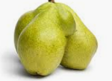
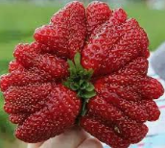
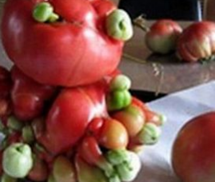
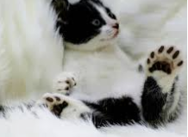
What is a “Mutation”?
A change that affects behavior or development.
Notes:
Emphasize here that viruses and bacteria and parasites and even cells inside people and animals can mutate (ex. some people have an extra finger or toe – just like this cat!)
A good tip here is to have all the students repeat the phrase: “Mutation is Change”. This phrase can be repeated throughout the class. (Later on, the students learn that a mutation can strengthen or weaken a virus’ ability to infect a cell and replicate. Sometimes a mutation does not make much of a difference, it is just a benign change. Other times, the difference is important.)

Slide 13
Mutations can happen by accident
Mutations can happen inside many things: people, animals, plants, viruses, bacteria, and more.
Is a mutation good or bad or neither?
How do mutations happen?
Notes:
Review that “mutation is change”. Explain that mutations ultimately, over many generations lead to adaptation in populations. Sometimes, new subspecies of animals and plants are made from mutations that allowed their ancestors to survive and thrive and reproduce.
The answer to “Is a mutation good or bad or neither?” is that “it depends on the environment”. If the environment has changed and the mutation makes the organism survive better in the new environment, then this is a good thing for the organism. Sometimes mutations do not affect the survival of the organism. Other times the organism with the mutation cannot survive well.
The answer to “How do mutations happen?” is “there are several different ways a mutation can happen but it always involves the most basic form of life within the organism (most of the time this means DNA).” (NOTE: the virus that causes COVID actually has RNA affected, and not DNA, because SARS-CoV-2 is an RNA virus.)

Slide 14
POINT MUTATIONS
Who will NOT mutate the sentence?
Challenge:
Who can say this FIVE times FAST?
A black bug bit a big black bear.
Notes:
Review that “mutation is change”. Ask for 2-3 volunteers to quickly read this bold sentence five times.
This tongue-twister serves as a model for a type of mutation- the simplest kind of mutations (called “point mutations”) - because there are skipped letters in words or added letters to words. Simple small changes like this can occur at the level of DNA and may have drastic consequences if the cell does not correct it by various means.

Slide 15
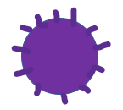
The Mystery Box
Notes:
Explain that another way viruses can mutate is by mixing in an animal (ex. a bird, pig). Review that this “animal” could also be a person!
The first animal example here is a bird. The second is a pig. Swine flu (an influenza virus) can have bits of different viruses inside of it. (A pig virus can mix with a bird virus, human virus or another pig virus! https://www.ncbi.nlm.nih.gov/pubmed/19565018)
Review: this slide models a style of mutation called genetic reassortment (and, more specifically, “antigenic shift”). Through “genetic reassortment”, a new virus can be made.

Slide 16
Let’s see how two viruses can mutate into one!
With another word example
that demonstrates
“Genetic Reassortment”…
Notes:
This next example models another way a virus can mutate, through “genetic reassortment”.

Slide 17
ONCE UPON A TIME…
Once upon a time, there was a
_____ that _____ the _____ ______.
Notes:
This “Once Upon a Time” example models genetic reassortment, more specifically- with “antigenic shift”.
Explain that, like this sentence model, DNA follows a certain template or pattern in order for the cell to work properly. There are special parts of the DNA that never change (just like the phrase “Once upon a time” in this sentence example). However, the “fill in the blank” sections of this sentence allows for variations in the sentence. In some viruses (like the flu virus), there can be a mixing of multiple viruses to create a new virus that is different- either is stronger or weaker or has no change to its strength.

Slide 18
ONCE UPON A TIME…
Once upon a time, there was a
HAUNTED HOUSE that SCARED the LOCAL CHILDREN.
Once upon a time, there was a
SLOW CAR that IRRITATED the OTHER DRIVERS.
Notes:
Review that the red sentence is like the red virus. The blue sentence is like the blue virus. What happens when we combine these two sentences together to make a mutated sentence? (see next slide)

Slide 19
ONCE UPON A TIME…
Once upon a time, there was a
HAUNTED CAR that SCARED the OTHER DRIVERS.
Once upon a time, there was a
SLOW HOUSE that IRRITATED the LOCAL CHILDREN.
Notes:
Review the example of the mutated sentences.
Ask if these mutated sentence are better or worse compared to the original sentences.

Slide 20
Mutations are really hard to predict! Can you guess when?
Notes:
Emphasize that mutations can be difficult to predict.
Do this activity slowly. Explain that the viruses on the left side of the slide are replicating (multiplying) and will either have the original color or will show a mutation (with the purple color).
Have the students guess when the purple virus will show up. They have 3 guesses! (The teacher can say that the purple virus will appear at least once)
Review: The flu virus (called influenza virus) is another example of a virus that mutates a lot. That is why new flu vaccines need to be made each year. Scientists need to look at the flu virus closely (by sequencing it) to see where they think the next mutation will happen so that they can develop the right type of vaccine.

Slide 21
What can scientists do when we know that the flu (influenza) virus mutates often?
Scientists track the mutations!
They closely monitor the mutations and then create a new vaccine each year to try to protect the people who are most at risk of dying from the new or upcoming version of the virus.
But what is a vaccine and what is involved in creating a vaccine?
Notes:
Ask “how would you explain a vaccine to a younger sibling?”

Slide 22
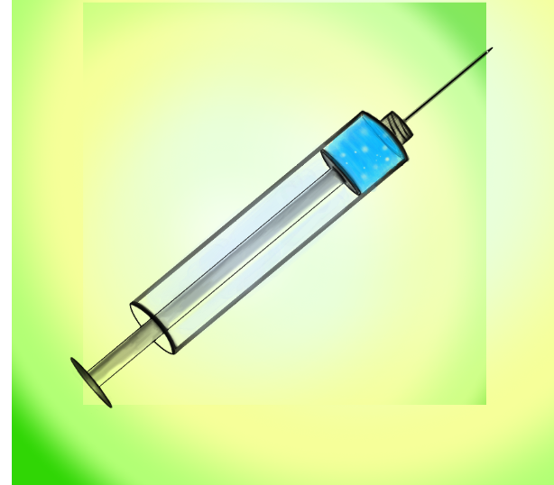
Vaccine
A substance that prepares the immune system to fight a disease.
(like the flu shot)
Notes:
Vaccines are meant to strengthen a body to fight an upcoming germ. Note that a person (or animal) who gets a vaccine does not become invincible against that particular germ/microbe (which the vaccine is developed to fight). A person or animal can still get sick from the germ but, often, not nearly as sick as a person or animal that never received that vaccine.
Review that:
An important point should be made to avoid confusion: a vaccine is NOT a medication. A vaccine is given BEFORE somebody gets exposed to a germ (ex. virus or bacteria) and a medication (ex. antiviral drug or an antibiotic) is only given AFTER somebody gets sick from that germ.
This is a good slide to remind students about antibodies and antigens.
Both veterinarians and physicians and researchers work together to develop the best vaccine to protect people against various germs.
Medications can be developed from plants, microbes and other items found in the environment.
→ Example: Penicillin https://www.kidsdiscover.com/quick-reads/penicillin-found-functional-fungus/
Specialists who work with the environment, people and animals work together to make people better protected against different germs. They must communicate efficiently so that they do not waste any time. This is the One Health approach!
Tip for teachers: use an example from a veterinarian’s point of view—
A dog that receives a vaccine (ex. the rabies vaccine) will not be as sick from the germ it was designed to fight against (ex. the rabies virus) compared to a dog that does NOT get the vaccine. The same general principal is true for people.
(If the students ask, for the rabies example- the unvaccinated dog would likely die from the disease IF it gets infected by the rabies virus—and the dog could bite people and spread it-because it is a zoonotic disease).

Slide 23
How can we protect ourselves in the future?
One Health Concept: Environmental health and Animal health and Human health
Scientists (ex. biochemists, physicians, veterinarians, engineers and other researchers) work together to create and deliver vaccines!
Notes:
Ask: what are the three parts of One Health?
For the first point- Emphasize that veterinarians work closely with other scientists to develop HUMAN and animal vaccines (because animal models are used in a vaccine’s development process). Also, veterinarians and environmental health scientists (like ecologists) have been surveying viruses in wild animals for years. Because of this work, researchers in different parts of the world know what communities are at higher risk of different zoonotic diseases.

Slide 24
Introducing the “One Health” Approach
TEAMWORK!
Notes:
Tip: Spend up to 3 minutes on this slide.
The One Health approach: teamwork between people of different backgrounds, strengths and disciplines to prevent and solve health problems.
Remind students that the earlier slide reviewed the One Health concept and this current slide reviews the One Health Approach.
Also, in 2023, more One Health advocates are talking about the Approach (rather than the concept) when they say the words “One Health”.
Definition from the United States’ CDC website (https://www.cdc.gov/media/releases/2019/s0506-zoonotic-diseases-shared.html) covers the Approach part of the definition: “One Health is an approach that recognizes the connection between people, animals, plants, and their shared environment and calls for experts in human, animal, and environmental health to work together to achieve the best health outcomes for all.”
Emphasize examples here of where teamwork can benefit communities: veterinarians (animal doctors) can work closely with physicians (human doctors) and environmental health scientists to efficiently improve the health of the animals, people and the environment at the same time.
The One Health approach that has been used to address the COVID-19 pandemic involved:
human health care workers- to treat patients and perform research to determine effectiveness of possible new treatment and/or a vaccine
veterinarians - to help to develop possible treatments and/or a vaccine, and determine the risk of transmission between animals and people
public health scientists (can include veterinarians and human health care workers)- to protect the general public against disease spread
pharmaceutical scientists (ex. biochemists)- to develop treatment and/or vaccine
virologists- to identify the virus and help guide human health care workers and pharmaceutical scientists
immunologists- to provide guidance to the human health care workers and the pharmaceutical scientists
ecologists- to determine the degree of environmental changes seen in the area of viral origin
sociologists- to determine the effect of social distancing on the population, guide policy changes and determine what causes an increased interaction between people and animals
economists- to determine how a society can manage through business closures
educators- to teach the public about the importance of One Health
lawmakers- to change or create laws which promote public safety
In short, the One Health Approach means teamwork.

Slide 25
How can the ONE HEALTH APPROACH protect people, animals and the environment?
Who is included? What can they contribute?
Notes:
Emphasize that vaccine development is only one of many ways a One Health Approach can impact the health of people and animals (and plants too!).
Ask about a disease outbreak here: what types of people are important to fix big health problems like a disease outbreak or the loss of biodiversity (decreased variety of different species in an area)? (Any of the student answers will be correct.
Ensure the students understand that people outside of the typical health sciences are needed to protect communities from One Health problems like loss of biodiversity or climate change or contaminated water or contaminated air or deforestation or antimicrobial resistance. Here are some answers and the reasons for them:)
Physicians (human doctors) and nurses- they treat sick people
Veterinarians- they understand germs that can come from animals and spread to people (review the term: zoonotic disease)
Ecologists – they study the interaction between animals and their environment
Sociologists- they understand why people make certain decisions
Politicians- they create laws to protect the environment, people, animals, plants and more
Economists- they help businesses stay open and help livelihoods/income/well-being of families
Researchers- they help develop vaccines (ex .biochemists)- ask the students what other type of researchers can help solve other health problems
Teachers- they help spread awareness and knowledge to protect more people
Engineers- (software, mechanical, etc.)- software engineers can design websites or applications to provide health-focused resources for communities; mechanical engineers to design equipment that is carbon neutral or carbon negative to combat climate change

Slide 26
CONTEST!!
Create a short play (or video) that includes as many of following words:
One Health Concept & Approach
Zoonotic Disease
Mutation
Vaccine
Notes:
Ask: Who can make the BEST 1–2-minute play that uses all of the new terms from this lesson?
Note: This can be done during the lesson (time-permitting) or as homework.

Slide 27
One Health
Notes:
2-minute survey for classroom teacher to complete: https://forms.gle/rvie1WTAMEZ1e4W7A
Other One Health online activities for students:
Game for students to better understand microbes and zoonotic diseases:
http://webadventures.rice.edu/ed/Teacher-Resources/_games/MedMyst-Original/_301/Game-Overview.html
Interactive comic book that shows how a veterinarian can help detect a new virus in New York City.
(Loosely based on real life events with West Nile Virus in New York City in 1999):
https://nysci.org/school/resources/transmissions-gone-viral/
TEDx talk from veterinarian during the West Nile Virus outbreak is here:
https://www.youtube.com/watch?v=qm8NnL582uc) (duration of15:16)—would be appropriate for older students (>15 years old)
Online One Health material that can be used in person or online
Reviews how to live safely with bats around and was developed for communities in Africa:
https://ucdavis.box.com/v/livingsafelywithbats-flipbook
Further information about how the environment and animals play into human health:
https://ensia.com/features/covid-19-coronavirus-biodiversity-planetary-health-zoonoses/
Follow-up material for the curious adult:
https://www.who.int/news/item/27-03-2023-quadripartite-call-to-action-for-one-health-for-a-safer-world
https://www.avma.org/javma-news/2020-04-15/can-veterinarians-prevent-next-pandemic
https://www.newyorker.com/science/elements/from-bats-to-human-lungs-the-evolution-of-a-coronavirus
https://www.theguardian.com/world/2020/mar/25/coronavirus-nature-is-sending-us-a-message-says-un-environment-chief?CMP=share_btn_fb

