Slide 1
Talking About Mental Health Issues
Jan Mould, RN, BSN, MEd
Deputy Director of Competitive Events
HOSA – Future Health Professionals

Slide 2
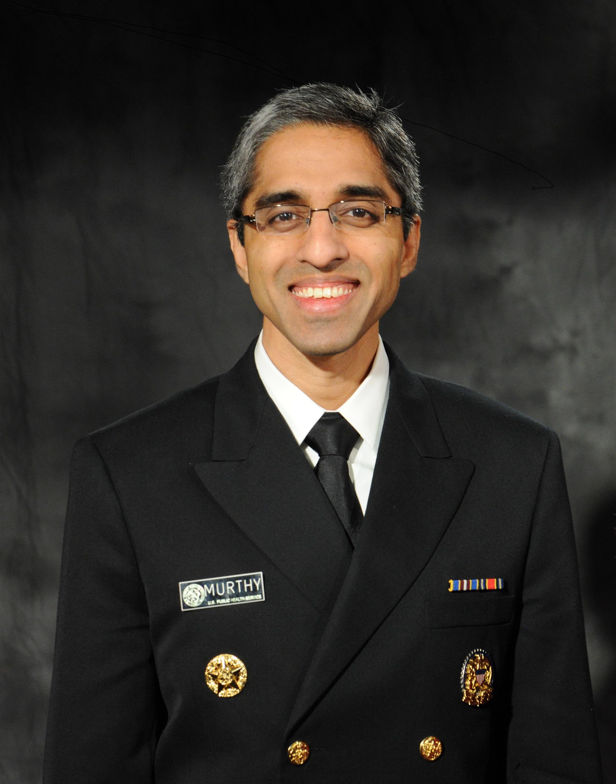
The Surgeon General’s Advisory Report,
Protecting Youth Mental Health
Notes:
The Advisory Report is very eye opening and concerning about the Mental Health of Youth

Slide 3
HOSA’S RESPONSE
HOW TO TALK TO FRIENDS AND
FAMILY ABOUT MENTAL HEALTH
Additions of the Mental Health Promotion and the Emotional Well-Being Challenge Events
Notes:
Two new events and the Public Service Announcement topic

Slide 4
BE THERE CERTIFICATION
BE
THERE
CERTIFICATION
Notes:
Be There Certificate is required for those competing in the Mental Health Promotion Event. It is a free online course that as a mental health professional I highly recommend. The course is self-paced and less than 2 hours, it is available in French, English and Spanish

Slide 5
The Other Side of the Coin
When do you disclose your own mental health issues?

Slide 6
Disclosing to others
Reasons to talk with others
When to tell
Who to tell
At work
Personal Relationships

Slide 7
How and what to talk about
Process talk
Concrete examples
Suggest ways to support you

Slide 8
DOs & DON’Ts
Don’t have to share everything
Do make sure to share the good things
Do set boundaries
Do let them know how they can support you
Do provide them information after you talk to them

Slide 9
NAMI – Disclosing to Others

