Slide 1


Jan Mould
HOSA – Future Health Professionals
Notes:
Fictional disease

Slide 2

OVERVIEW
WEBSITE:
https://www.cdc.gov/scienceambassador/nerdacademy/
Notes:
Empower students to: make informed public health decisions + see themselves in public health careers
All 8 modules can be taught but each can be a stand-alone lesson
Videos are 12 -15 minutes for students; with 2-4 minute video for teacher’s to assist with activities
Seven career spotlights are included in the modules + Module 8 highlights how the 7 careers work together to address public health issues

Slide 3

INTRODUCTION

Slide 4
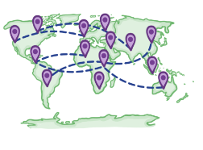
WHAT EXACLTY IS A PANDEMIC?

Slide 5
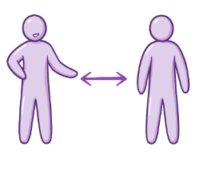
HOW DOES THE DISEASE SPREAD?

Slide 6

WHO IS AT RISK?

Slide 7

WHERE DOES PUBLIC HEALTH DATA COME FROM?

Slide 8
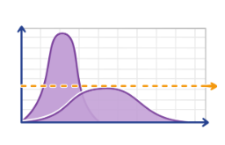
Curriculum
HOW IS PUBLIC HEALTH DATA VISUALIZED?

Slide 9
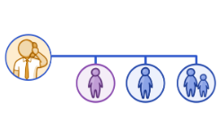
Curriculum
WHY IS CONTACT TRACING SO IMPORTANT?

Slide 10

WHY DO LABORATORY TESTING?

Slide 11

HOSA CONNECTION

