Slide 1
Medical Errors
Jan Mould, RN, BSN, MEd

Slide 2
What???
The study further reports that the CDC does not classify medical errors separately on death certificates.
A significant number of deaths directly related to errors are not recognized.
According to a 2016 study conducted by Johns Hopkins, medical errors are now the third leading cause of death in the U.S.

Slide 3
Common Root Causes of Medical Errors
Organizational Transfer of Knowledge
Staffing Patterns and Workflow
Technical Failure
Inadequate Policies
Communication Problems
Inadequate Information Flow
Human Problems
Patient-related issues

Slide 4
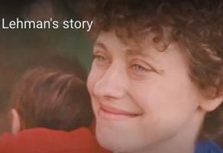
TO ERR IS HUMAN

Slide 5
Research a medical error case that resulted in charges

Slide 6
Should Medical Errors be Considered Criminal Offenses?
Select your position on the above question. Write a 5 paragraph persuasive essay defending and swaying others to your position.

Slide 7
Congratulations you have completed the first steps in the Biomedical Debate event for 2022-23.
BIOMEDICAL DEBATE Guidelines

