Slide 2
Jan Mould, RN, BSN, MEd Deputy Director of Competitive Events HOSA – Future Health Professionals

Slide 3
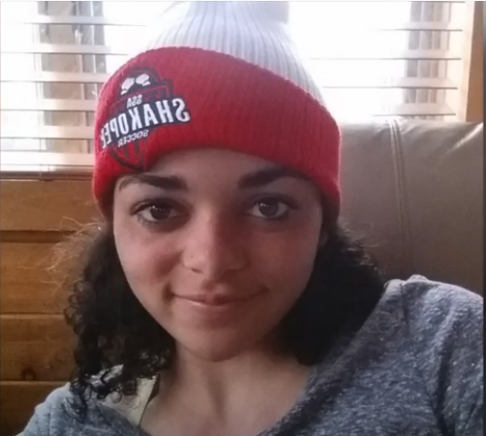
A Fairytale ending
IMANI

Slide 4
LEARN MORE
Resource
Information

Slide 5
HOSA SERVICE PROJECT

