Slide 1
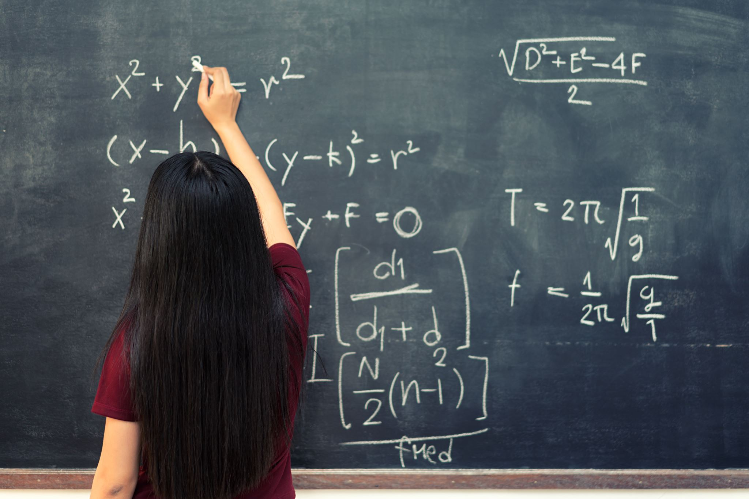
Math for the Health Professions: Basic to Pharmacy
Jan Mould, RN, BSN, MEd
HOSA – Future Health Professionals

Slide 2
I Math

Slide 3
KILO – 1000
CENTI - 100
DECI - 10
Micro –
1,000,000
Milli - 1000

Slide 4
LENGTH: 1 meter(m) = 100 centimeters(cm) = 100 millimeters(mm)

Slide 5
WEIGHT: 1 kilogram(kg) = 1000 grams(g) 1 gram(g) = 1000 milligrams(mg) 1 milligram(mg) = 1000 micrograms(mcg)

Slide 6
VOLUME FOR FLUIDS 1 liter(L) = 1000 milliliters(mL) 10 centiliters(cL) = 1 deciliter(dL) 10 deciliters(dL) = 1 liter(L) 1 cubic centimeters (cc) = 1 milliliter(mL)

Slide 7
Approximate Equivalents Among Systems 240mL = 1 cup = 8 ounces(oz) = 16 tablespoon(tbsp) 30mL = 1 oz = 2tbsp = 6 teaspoons(tsp) 15mL = 1tbsp = 3tsp 5mL = 1tsp 1mL = 15 drops(gtts) 0.0667mL = 1 drop(gtt)

Slide 8
Weight Conversion 1 kilogram (kg) = 2.2 pounds (lbs) 1 pound (lb) = 16 oz

Slide 9
Height Conversion 1 meter(m) = 39.4 inches(in) 2.54 centimeters(cm) = 1in 1foot(ft) = 12in

Slide 10
RATIO: Relative amounts of two quantities PROPORTION: Expression of the equality of two ratios

Slide 11
EXAMPLE: If 2 tablets contain 975 mg of ASA, how many mg would be contained in 12 tablets? 3tablets = 975mg 12 tablets = Xmg Xmg = 12tabs X 975mg 3 tabs

Slide 12
EXAMPLE: If 3 tablets contain 975mg of ASA, how many tablets would contained 3900mg? 3tablets = 975mg X tablets = 3900mg Xtablets = 3tabs X 3900mg = 975mg 12 tabs

Slide 13
Xylocaine liquid contains 1.5gm of lidocaine HCl in 30 mL. What is the final concentration? 1.5gm 30mL 1.5 ÷ 30 = 0.05 0.05 x 100 = 5%

Slide 14
Rogaine is a 5% solution of minoxidil in alcohol. How much active ingredient is in a 60mL bottle? X x 100 = 5% 60mL Xgm = 5 60mL 100 X = 3

Slide 15
CONCENTRATION: wt/volume Active Ingredient Total Quantity Convert to decimal Multiply by 100

Slide 16
DILUTIONS: Q1 = initial quantity or volume Q2 = final, or desired quantity or volume C1 = initial concentration (%) C2 = final or desired concentration (%) Q1 x C1 = Q2 x C2

Slide 17
If you diluted 90mL of an 8% benzocaine lotion to 6%, how much could you produce? Q1 = 90mL C1 = 8% Q2 = X C2 = 6% 90 x 8 = X x 6 720 = 6X 120 = X

Slide 18
IV Flow Rate TV = desired total volume IR = infusion rate X = number of hrs bag will last Ordered 5% in D5W @ 125mL/hr. To provide solution in 1000mL bag. 1000 = X 125 X = 8

Slide 19
IV Drip Total volume in mL x drop factor = drops Infusion time in min min Ordered NS 500mL with 25,000 units of heparin infused over 8 hours. Drop factor of 60 gtts/mL #1 convert hrs to in 8 X 60 = 480 #2 500 = 1.042 480 #3 1.042 x 60 = X #4 X = 62.5 gtts/min

Slide 20
Alligations In what proportion should alcohols of 95% and 50% strengths be mixed to make 1L of 70% alcohol?
20
70
50 25
20 + 25 = 45
95% 1000mL X 20 = 444mL
45
50% 1000mL X 25 = 556mL
45

Slide 21
Math for Health Careers
Medical Math
Math for Health Care Professionals
Pharmacology
Pharmacy Science

