Slide 1
Jan Mould, RN, BSN, MEd Deputy Director of Competitive Events HOSA – Future Health Professionals

Slide 2
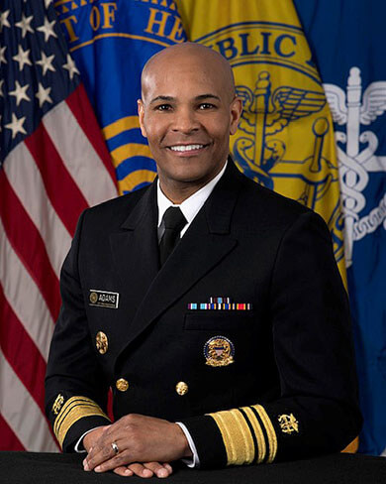
Opioid epidemic
“There is no us and them when it comes to the opioid epidemic and when it comes to health. We are all in this together.”
Dr. Jerome Adams
20th US Surgeon General

Slide 3
What are opioids?
Diminish body’s perception of pain
Examples
Prescription drugs such as:
morphine, codeine, methadone, oxycodone,
hydrocodone, fentanyl
Illegal drugs: heroin

Slide 4
INCIDENCE
According to the 2019 NSDUH Annual Report:
10.1 million people aged 12 or older misused opioids in 2019
70,630 people died from drug overdose in 2019
Notes:
National Survey on Drug Use and Health

Slide 5
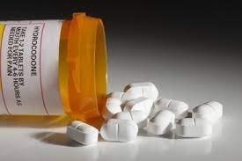
PREVENTION
How to Safely Dispose of Drugs
Rethinking pain treatment
Improving Opioid Prescribing
National Prevention Week
Rx Awareness Campaign

Slide 6
TREATMENT
Finding an opioid treatment program
Treating overdose - Naloxone

Slide 7
HHS 5-Point strategy
Better services for addiction, prevention, treatment & recovery services
Better data
Better pain management
Better targeting of overdose reversing drugs
Better research
Notes:
content used in previous years may not be used again

Slide 8
HOSA Connection
Behavioral Health
Community Awareness
Health Education

Slide 9
Your Turn
Watch Ann Marie’s story
Watch Mike’s Story
Working in groups create a PSA to educate your peers about the dangers of opioid addiction.
PSA

