Slide 1

Notes:
This PowerPoint is intended to introduce students to HOSA. Please modify and update for your school needs!

Slide 2









HOSA – Future Health Professionals is a:
Career and Technical Student Organization (CTSO)
Notes:
HOSA is a CTSO – a Career and Technical Student Organization. Other CTSOs include DECA, FBLA – Future Business Leaders of America (business), HOSA-Future Health Professionals, TSA (Technology Student Association), FFA, SkillsUSA, FCCLA – Family, Career and Community Leaders of America, BPA – Business Professionals of America.
Ask: Have you heard of these organizations before? Stand if you have been involved as a member in one of these organizations.
These CTSOs are leadership organizations for the following subject areas:
DECA – Marketing
Educators Rising – Teaching
FBLA – Business
BPA – Business
FFA – Agriculture
TSA – Technology
SkillsUSA – Skilled Trades
FCCLA – Family and Consumer Sciences
All CTSOs are similar in some ways: There are competitive events, there are leadership conferences, there are local, state and national officers

Slide 3



HOSA is…
100%
Health care!
Notes:
HOSA is an unique CTSO because it is 100% focused on health care

Slide 4
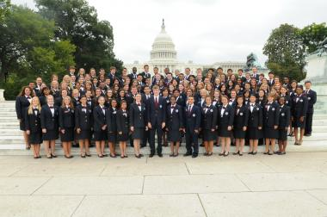

HOSA Membership
Middle School
Secondary
Postsecondary/Collegiate
Alumni
Professional
There are over 2.4 million students that have been involved in HOSA since 1976!
Notes:
There are four membership options in HOSA:
Secondary – for high school students
Postsecondary/Collegiate – for students in postsecondary programs (community college, university, etc)
Alumni – for those students that have graduated from high school – this option is FREE
Professional – for advisors, advisory committee members, other adults in the health profession that want to stay involved
Dues are $10 per year on the national level. How much are your state dues? These differ according to the state.

Slide 5
HOSA Leadership
Chapter Level
  Chapter Advisor: Health Science Teacher
  Chapter Officers:
    Enter Chapter Officer Titles Here
Notes:
HOSA has several leadership opportunities!
At the chapter level, the Health Science teacher (or other adult) serves as the chapter advisor
There are chapter officers
(Insert chapter officer opportunities and pictures here)

Slide 6



HOSA Leadership Opportunities
Regional Officer
State Officer
National Officer
Notes:
HOSA offers leadership opportunities beyond the chapter level – you can be a regional (if applicable), state or national officer!!

Slide 7


HOSA Conferences http://www.hosa.org/stateconferences
Fall Leadership Conference
  Date & Place
State Leadership Conference
  Date & Place
International Leadership Conference http://ilc.hosa.org/
  Date & Place
Notes:
HOSA offers opportunities to meet and network with other students just like you through conferences!
Fall Leadership Conference (if applicable)
State Leadership Conference (add dates and place)
International Leadership Conference in June (details ilc.hosa.org)
If you have students that have attended conferences before, have them stand and talk about their favorite things about the conference(s)

Slide 8
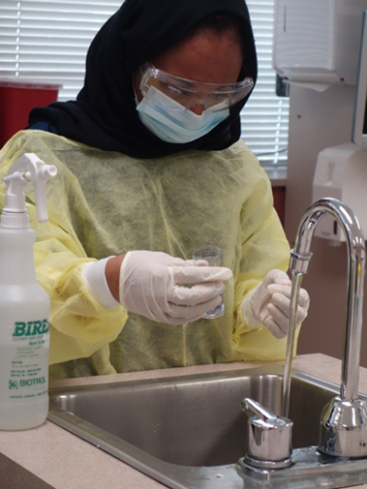
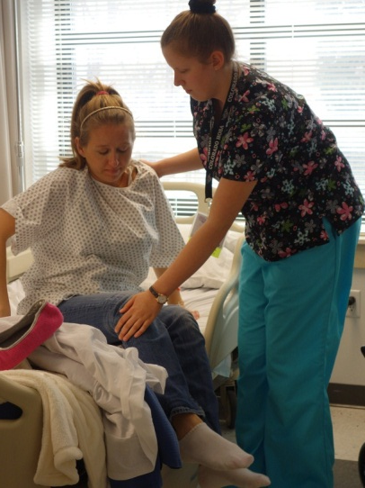
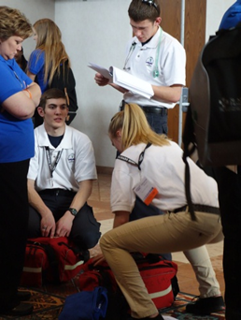

HOSA – Competitive Events
Health Science
Health Professions
Emergency Preparedness
Leadership
Teamwork
Recognition
60 EVENTS!!
Notes:
National HOSA offers 60 Competitive Events in 6 categories:
Health Science
Health Professions
Emergency Preparedness
Leadership
Teamwork
Recognition
To give students a list of Competitive Events, consider printing the “Selecting the Right Competitive Event” tool, found at http://www.hosa.org/Ceresources .

Slide 9



HOSA Online
www.hosa.org
Notes:
Visit the National HOSA website at www.hosa.org
What is your state website?
Don’t forget to like and follow National HOSA and your State HOSA on Facebook, Twitter, Instagram and other social media!

Slide 10
Notes:
This PowerPoint is intended to introduce students to HOSA. Please modify and update for your school needs!

