Slide 1
Connect, Inspire and Engage with
Middle and High School Students—
The Next Generation of Health Professionals!

Slide 2
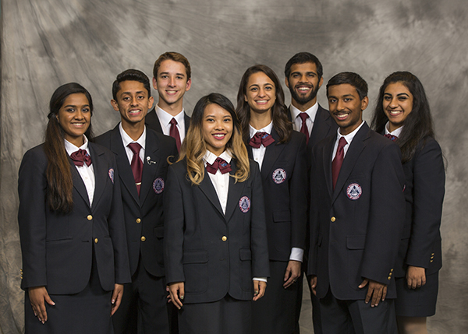
HoSA Provides the Best Prepared people
The mission is to empower
HOSA-Future Health Professionals to become leaders in the global health community through education, collaboration, and experience.
2017-2018 National HOSA Executive Council

Slide 3



hosa by the numbers vital statistics
54 chartered associations in the U.S., Canada, Germany, Mexico, Italy and American Samoa
5,000 chapters representing
middle school, secondary,
postsecondary & collegiate divisions
2.4 million alumni
since 1976
225,000 HOSA Members
80% female, 20% male
46% of HOSA members are racial and ethnic minorities

Slide 4
The number of Hosa chapters is growing
Number of HOSA Chapters over past 5 years
25%
Increase over past 5 years

Slide 5
Hosa membership is steadily increasing
Number of HOSA members over past 5 years
31%
Increase over past 5 years

Slide 6

Chapter Affiliation
www.hosa.org/affiliation
Chapter charter number and password

Slide 7
Available resources www.hosa.org
Guidelines, manuals, photos, posters, publications, tutorials, and videos!

Slide 8
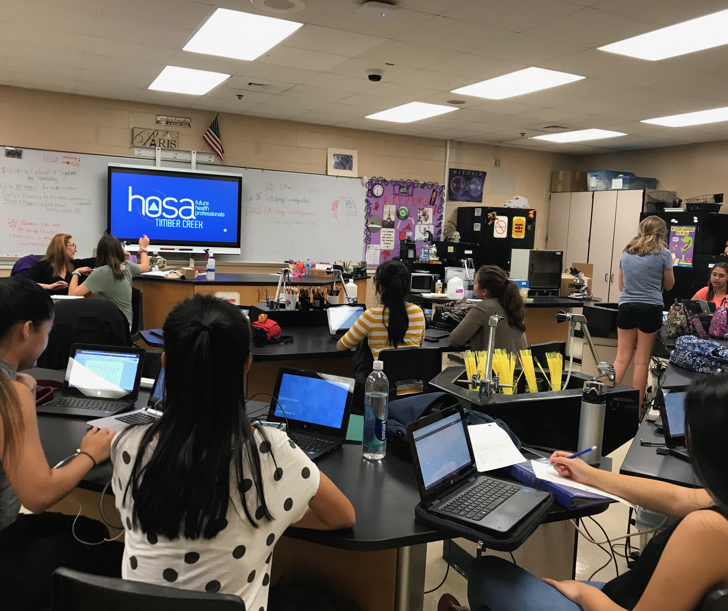
Typical Chapter meeting
General Announcements
  Community Service Events
  Guidelines on what/how to study
  Leadership Conferences/HOSA Activities
Small Study Groups
  20-30 Minutes of group studying or practicing of skills assessments
Reflections
  Open discussion about the learning and plans to improve for the future
Notes:
Slides 9-how many you two ladies need to tell your stories.

Slide 9
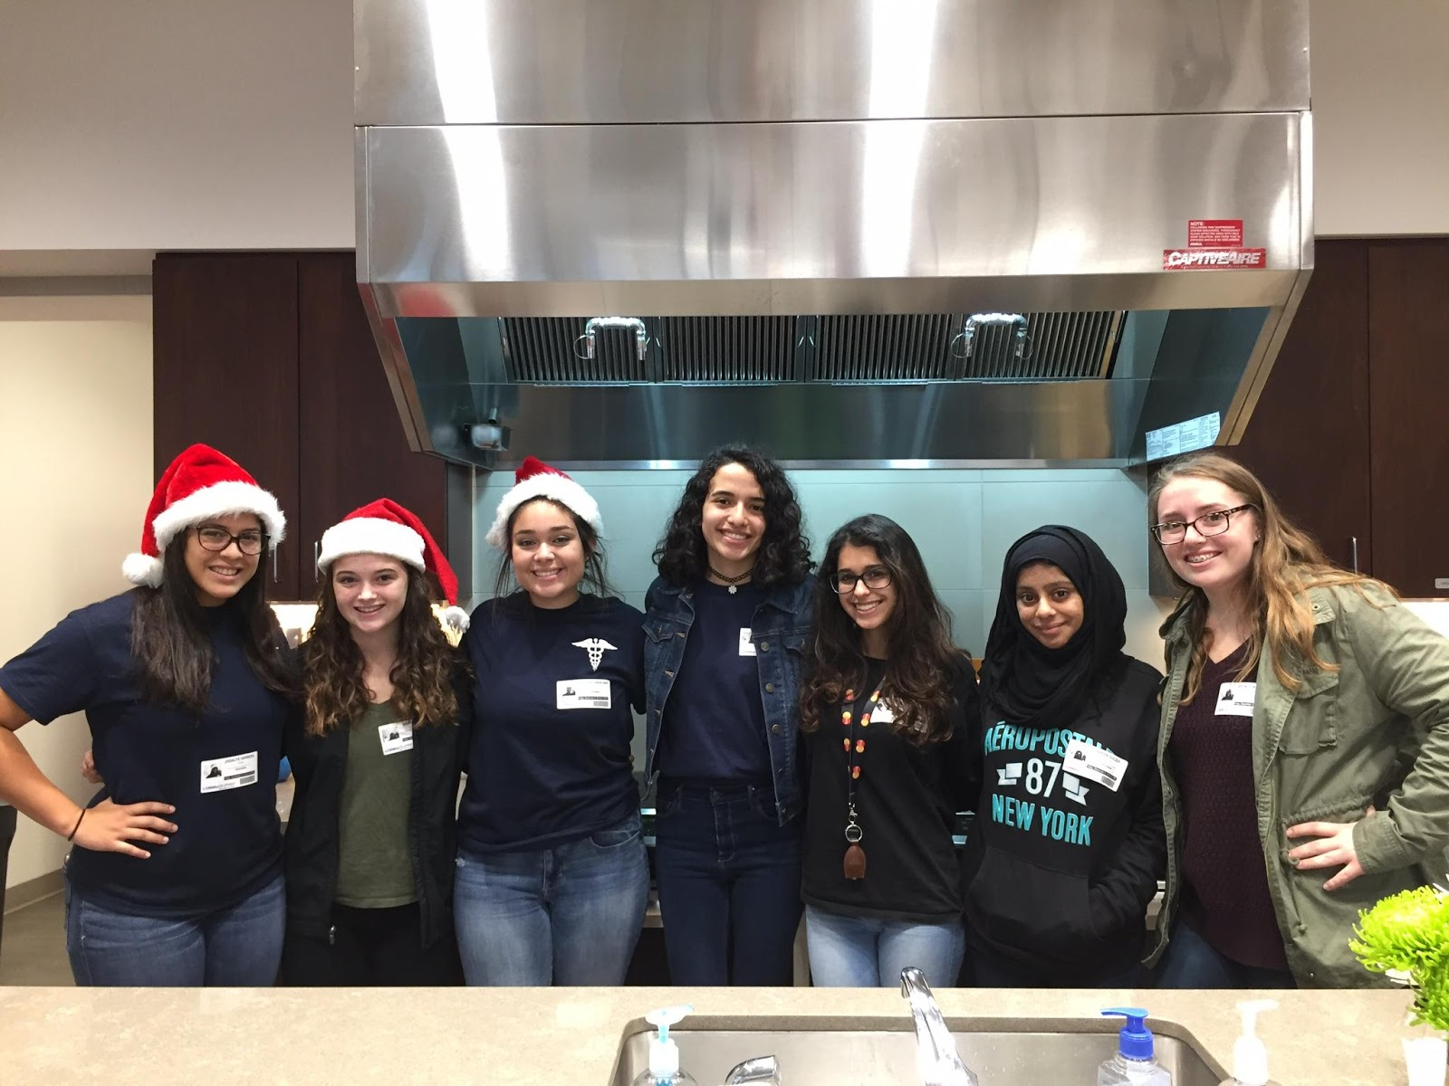
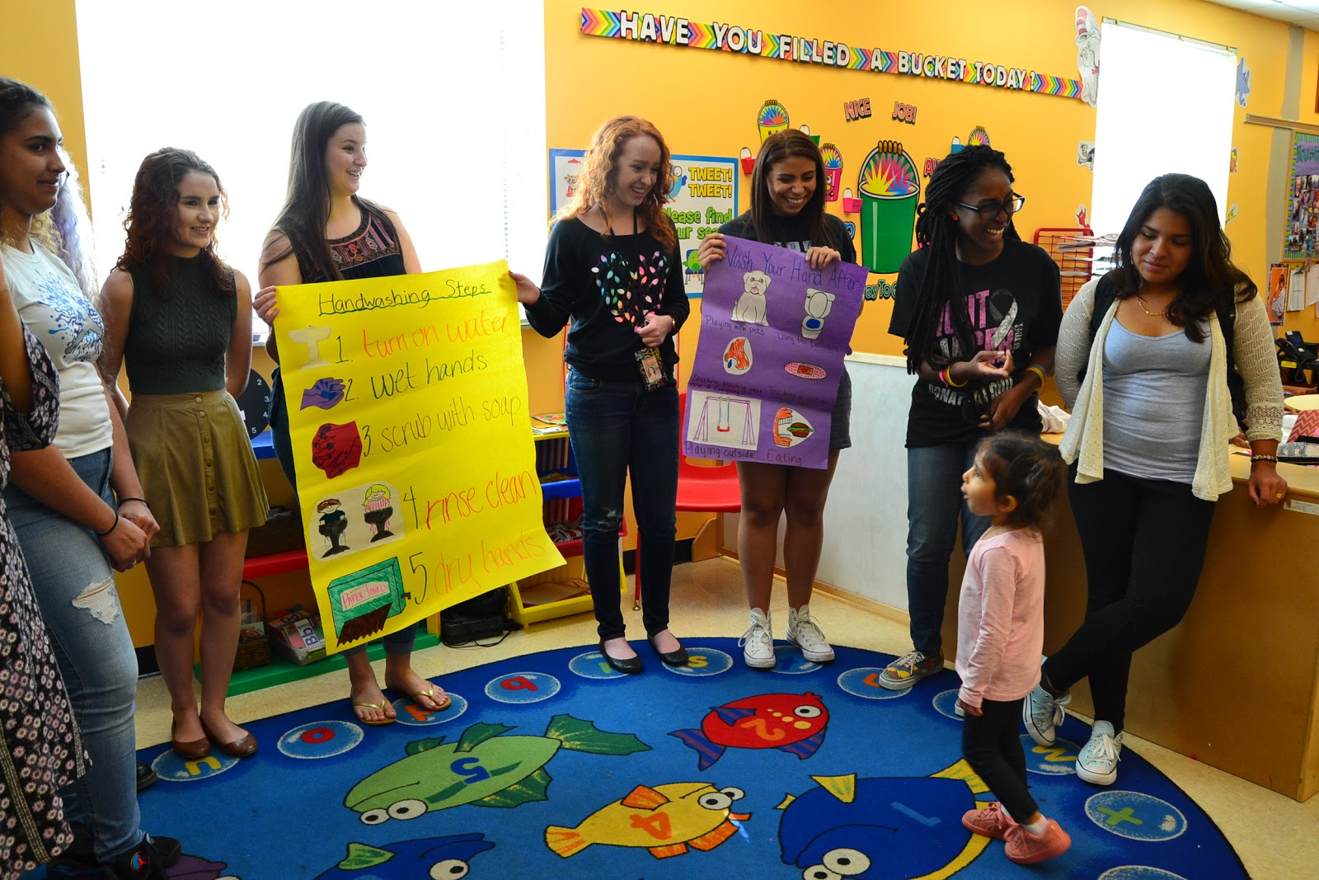

HOSA Week
Local Pre-school about Nutrition and Safety Presentation
Stress Relief Puppy Day
Health Careers Display Fair
Intro to Diabetes Presentation for Principles of Biomedical Science Classes
Ronald McDonald House Volunteers
Chapter Fundraisers

Slide 10

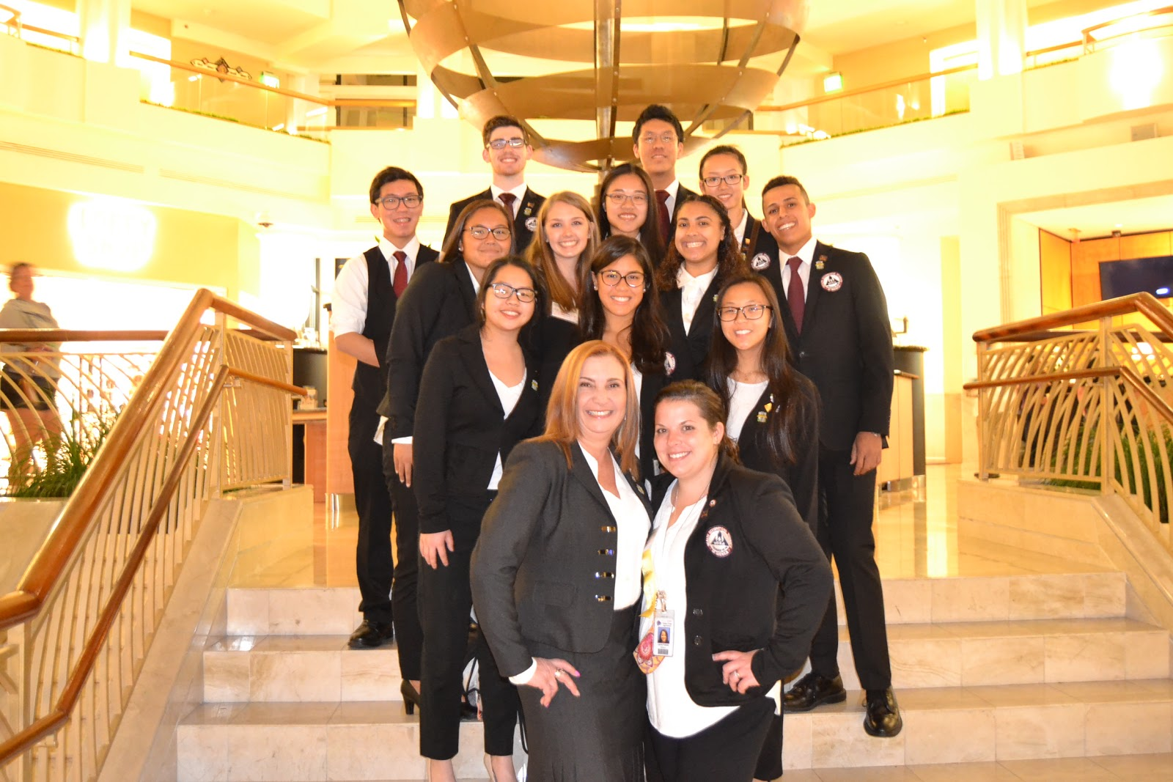
competition

Slide 11
Competitive Events Program
Health Professions Events | Health Science Events | Emergency Preparedness Events | Leadership Events | Teamwork Events | Recognition Events
Biomedical Laboratory Science Clinical Nursing Clinical Specialty Dental Science Home Health Aide Medical Assisting Nursing Assisting Personal Care Physical Therapy Sports Medicine Veterinary Science | Dental Terminology Medical Spelling Medical Terminology Medical Math Medical Reading KT: Human Growth & Development KT: Nutrition KT: Medical Law & Ethics KT: Pathophysiology KT: Pharmacology KT: Behavioral Health KT: Transcultural Health Care | CPR/First Aid Emergency Medical Technician Epidemiology Life Support Skills MRC Partnership CERT Skills Public Health | Extemporaneous Health Poster Health Career Photography Extemporaneous Writing Healthy Lifestyle Job Seeking Skills Prepared Speaking Researched Persuasive Writing and Speaking Interviewing Skills Speaking Skills | Community Awareness Creative Problem Solving HOSA Bowl Parliamentary Procedure Biomedical Debate Health Career Display Health Education Forensic Medicine Public Service Announcement Medical Innovation: Existing Medical Innovation: Original | Outstanding HOSA Chapter Health Care Issues Exam Outstanding State Leader MRC Volunteer Recognition National Service Project Barbara James Service Award HOSA Happenings

Slide 12



Hosa produces Health Professionals
Pipeline for future health professionals
Future Health Professional Flow
Schools
Health Employers
Information Flow

Slide 13








Partnerships create opportunity
The benefits of HOSTING a hosa Chapter
Partnerships
Knowledge
Linkages
Access
Resources
Dialogue
Cooperation
Planning

Slide 14
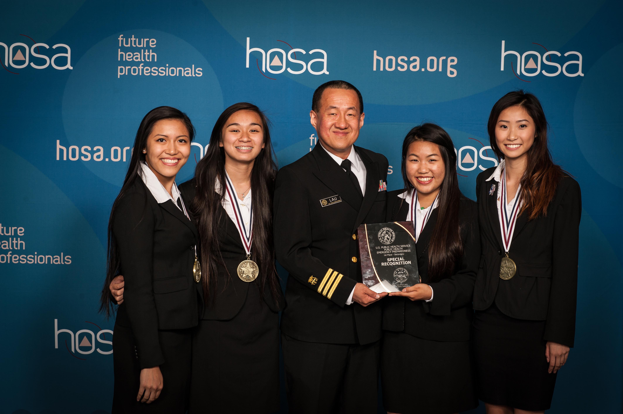
Partnership Opportunities
Competitive Events
  Event Sponsorships
  Topic Selection
  Judging
Conference Sponsorships
  Financial Sponsors
  Workshop Presenters
  Keynote Speakers
  Exhibitors
Local Support
  Network with local leaders
  Support conference attendance
  Provide internships and job shadowing
  Scholarship opportunities

Slide 15
HOSA’s International Leadership Conference
June 27-30, 2018 | Dallas, Texas
unique learning opportunities about current and relevant trends and ideas in health at educational workshops
educational and classroom instruction resources from publishers, associations and corporate sponsors at the HOSA Expo
60 competitive events that showcase the technical skills and competencies developed through health and biomedical science class instruction
network with 10,500 HOSA members, advisors, health science educators and health professionals from across the country
opportunity to engage and see first hand how 225,000 HOSA members will impact the future of health

Slide 16
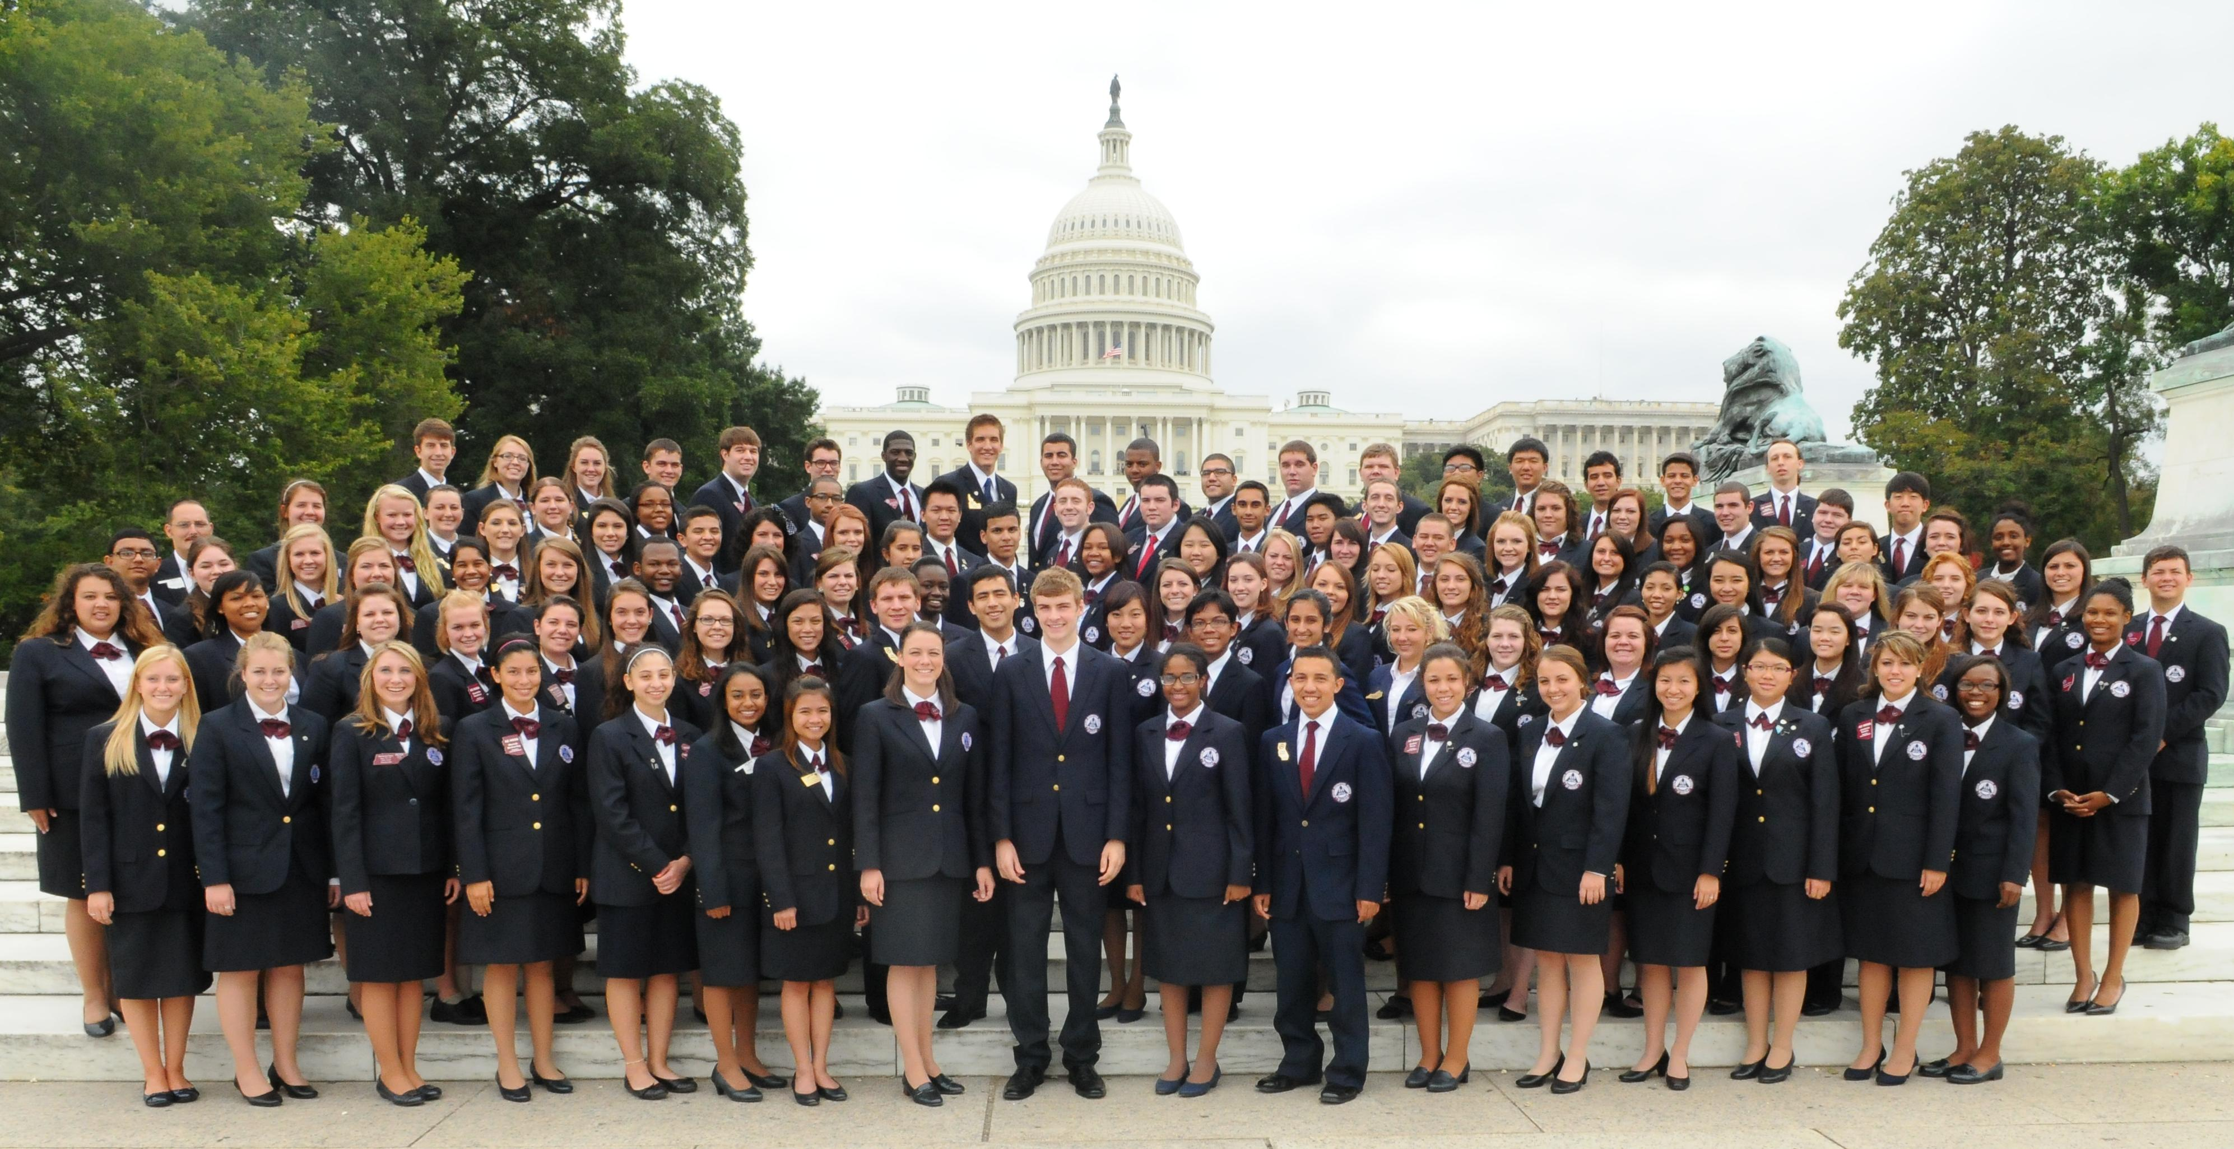
Washington leadership academy and State Advisors Management conference for state and local leaders| September 16-19, 2017| Washington, DC
Workshops
Leadership training
Industry Day
Network with key state and local leaders

Slide 17



Continue the conversation
Contact information
Nancy H. Allen
Associate Director
HOSA-Future Health Professionals
548 Silicon Drive, Suite 101
Southlake, TX 76092
800-321-HOSA
nancy.allen@hosa.org
facebook.com/HOSAFHP
@NationalHOSA
@NationalHOSA

