Slide 1
Tell - Me - Your Story
Grassroots Story Telling: How to Connect with Your Audience
Marquita V. Sanders

Slide 2
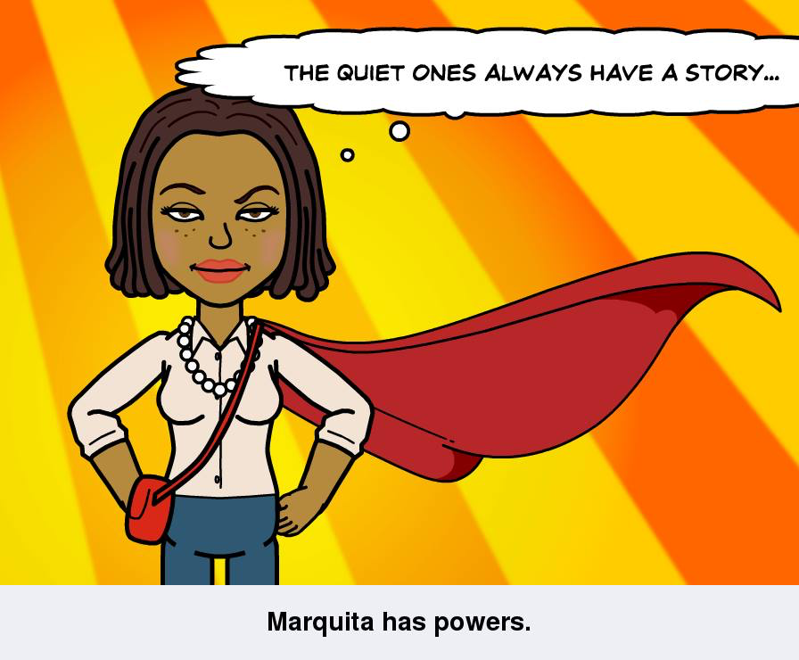
Marquita in a Nut Shell

Slide 3
Why Do We Tell Stories?

Slide 4
Leadership
Taking the responsibility for enabling others, to achieve purpose and direction, in the face of uncertainty.

Slide 5
Public Narrative
Why do we tell stories?

Slide 6




Two Ways Of
Understanding
The World
        Why
Story Motivation
                How Strategy Analysis

Slide 7
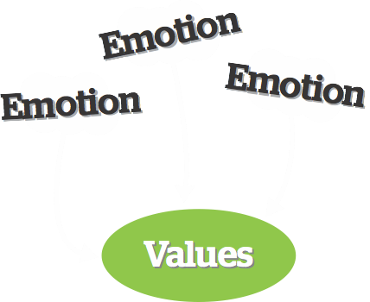
Emotions, Values, & Action
Stories help us
FEEL emotions
that remind of us
of our

Slide 8

URGENCY
Inertia
ANGER
Apathy
STAGNATION
MOTIVATION
Fear
HOPE
Isolation
SOLIDARITY
Self Doubt
YCMD

Slide 9





URGENCY
Inertia
ANGER
Apathy
STAGNATION
MOTIVATION
Fear
HOPE
Isolation
SOLIDARITY
Self Doubt
YCMD

Slide 10





Slide 11


CHALLENGE
OUTCOME
CHOICE
MORAL
PLOT

Slide 12



3 Parts Of
Narrative
SELF

Slide 13
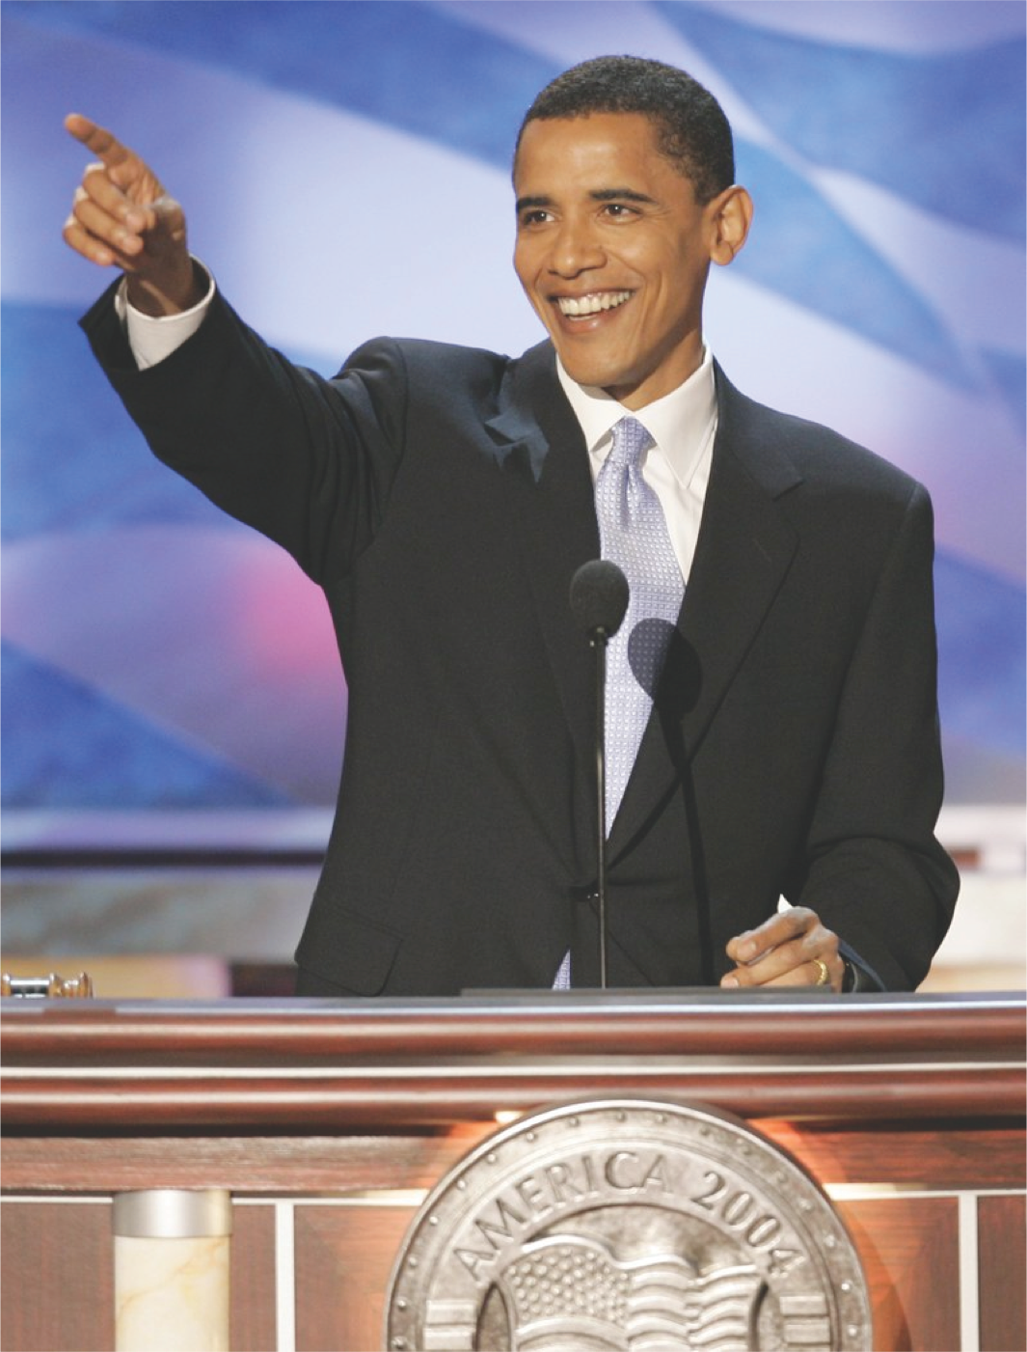
Story of Self- Story of Our Country

Slide 14
Thank You
More organizing and leadership resources?
New Organizing Institute (NOI)
www.neworganizing.com

Slide 15
Affordable Care Act (ACA)
Open Enrollment Begins on November 1st and Ends January 31st
Learn more about health coverage or how to volunteer
Email Marquita.Sanders@HHS.gov
Check out www.Healthcare.gov to learn about Insurance
Or
Marketplace.CMS.gov for engagement resources

