Slide 1
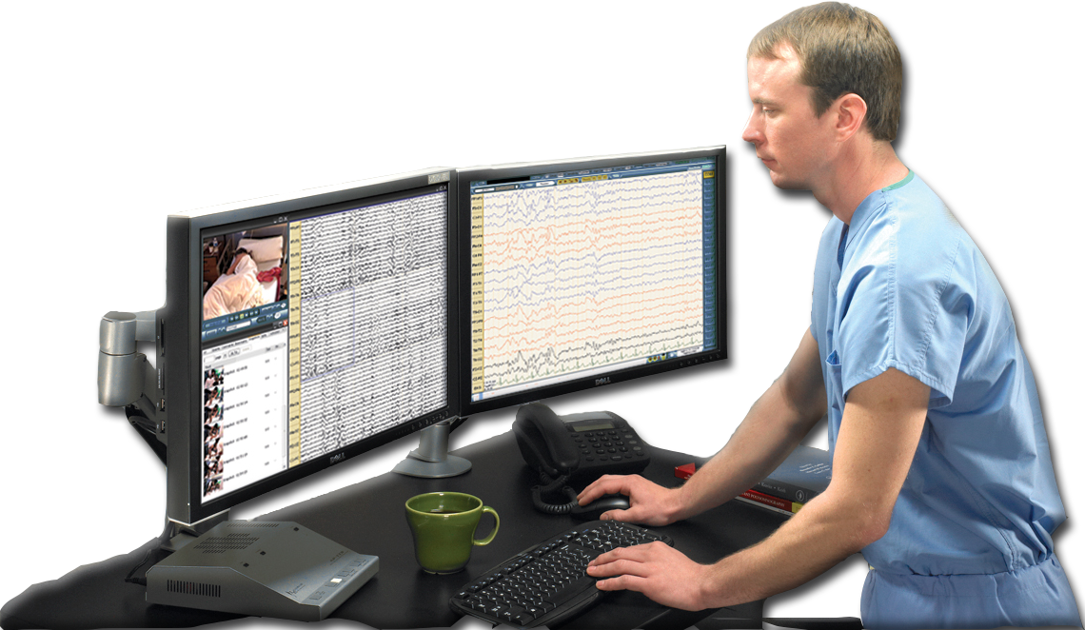
NEURODIAGNOSTIC TECHNOLOGIST
Improving the health of the people we serve
Notes:
We are Neurodiagnostic Technologists, not nurses, not physicians, not “just” techs.
We are here to serve our communities by improving the health of the people we serve. We perform diagnostic tests on the nervous system to complement physician investigations into patients’ health problems.

Slide 2
A Career in Neurodiagnostic Technology
Is in demand
Enables you to impact patients’ lives
Is interesting and challenging
Makes you a vital part of the health care team
Offers opportunities for advancement
Moves with you
MAKE A POSITIVE CHANGE
ASET – The Neurodiagnostic Society
Notes:
Is in demand - According to the U.S. Department of Labor, Neurodiagnostic Technologists have a bright outlook with a projected job growth of 20-28% by 2020.
Enables you to impact patients’ lives - Daily, through diligence to detail and taking thorough histories, we present clear, diagnostic data to physicians to assist in the diagnosis of neurological conditions. We stand beside nurses and physicians in the ICU, monitoring critically ill patients to assist in choosing medications for conditions such as continuous seizures. We hunker down in corners of the operating suite meticulously monitoring nerve and brain function to aide neurosurgeons, vascular surgeons and orthopedic surgeons to improve patient outcomes.
Is Interesting and Challenging - Even the “routine” tests are fascinating, knowing that you are monitoring brain and nerve functions. As we provide stimuli to nerves, we are able to elicit responses and assess the quality of messages from the nervous system.
You are a vital part of the health care team - We are critical to the health care team in the diagnosis of epilepsy, non-epileptic spells, autonomic nervous system dysfunction, vestibular disorders, comatose conditions, sleep disorders and spinal disease.
Offers opportunities for advancement - A career in Neurodiagnostic Technology allows the health care provider to make a positive impact in their community by improving the lives of those we serve. As in many of the allied health careers, a neurodiagnostic technology career offers advancement from a student, to a trainee, to a basic technologist, credentialed technologist in one of five areas and up to a manager or supervisor of a bustling lab.
Moves with you - A career in Neurodiagnostic Technology moves with you, as the credentials are national credentials. There is no need to retest when you move.

Slide 3
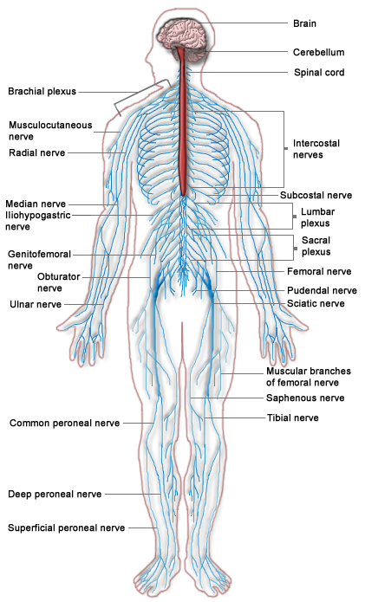
What do Neurodiagnostic Technologists do?
We analyze and monitor nervous system functions to promote the effective treatment of neurological diseases and conditions
Technologists record electrical activity
from the:
Brain
Spinal Cord
Peripheral nervous system
ASET – The Neurodiagnostic Society
Notes:
Neurodiagnostic Technologists perform multiple types of tests including EEG, long term monitoring for EEG, intraoperative monitoring of evoked potentials and nerve conductions; somatosensory evoked potentials, auditory evoked potentials, visual evoked potentials, autonomic nervous system tests, vestibular evaluations, polysomnography and nerve conductions.
These tests evaluate the function of the brain, spinal cord, peripheral nerves and autonomic nervous systems. They work in collaboration with imaging tests.
A careful mechanic looks at the car for physical damage first, then turns the key to watch parts move and listen to the car and then attaches sensors to the car and runs a diagnostic check. This diagnostic check actually talks to the computer components of your vehicle to find out if all manufacturer suggested criteria for the age and mileage of your vehicle are being met. The mechanic should then let you know the findings and ask for your participation in maintaining your vehicle.
Neurodiagnostic Technologists function as the diagnostic computer for your body. We attach sensors, known as electrodes, to the body and either stimulate and record or only record the electrical activity that the body produces. We compare this information to other people your age, gender and size for similarities and problems. We send it to the interpreting physician who puts this together with the imaging and history to determine a maintenance schedule and treatment for problems.

Slide 4
The Alphabet Soup of Neurodiagnostic Procedures
Electroencephalogram (EEG)
Long-Term Monitoring (LTM)
Evoked Potentials (EP)
Intraoperative Neuromonitoring (IONM)
Nerve Conduction Studies (NCS)
Polysomnography/Sleep (PSG)
ASET – The Neurodiagnostic Society
Notes:
Neurodiagnostic Technology is an alphabet soup of acronyms. It includes EEG, LTM, EP, IONM, NCS, PSG and others.

Slide 5
Electroencephalogram (EEG)
Records the electrical activity of the brain. An EEG is used to assist in the diagnosis of epilepsy and a variety of neurological symptoms. EEGs also are used to evaluate the effects of head trauma or the consequences of severe infectious disease.
During an EEG, highly sensitive monitoring equipment records the activity through electrodes that are placed at measured intervals on a patient’s scalp.
ASET – The Neurodiagnostic Society
Notes:
An EEG or electroencephalogram tests the function of the brain between homologous areas of the cortex and can be affected by medications, blood flow, amount of oxygen or other gases, body temperature and other environmental factors.
Some EEGs continue for hours or days, these are long term monitoring studies and are typically done to assess spells or seizures types.
EEGs help to diagnose seizures, non-epileptic spells, coma prognosis, head trauma, and changes in mental status.
EEGs typically involve 20-25 dime sized sensors placed on top of the scalp with a sticky paste. These leads, known as electrodes, pick up electrical signals and transmit them to an amplifier which increases the size of the signal. The EEG instrument, a computer, records these signals. Specialized computer programs aide the visual interpretation of the EEG and enable the physician and technologist to see individual components of the waveforms recorded.
Photic stimulation performed using a strobe light, hyperventilation, sleep and sleep deprivation are used as tools to change the EEG and elicit responses from the brain to further assess for normal or abnormal components.

Slide 6
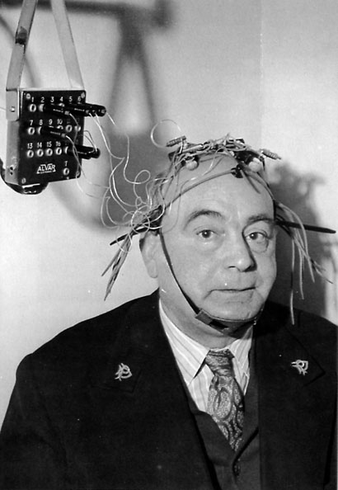
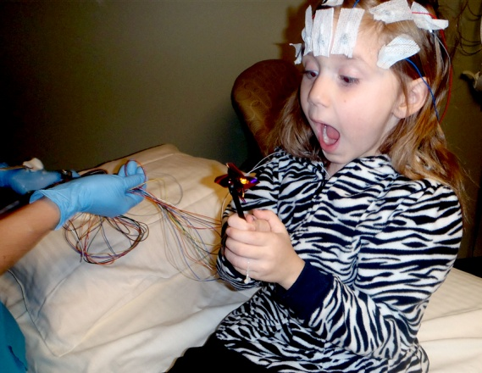
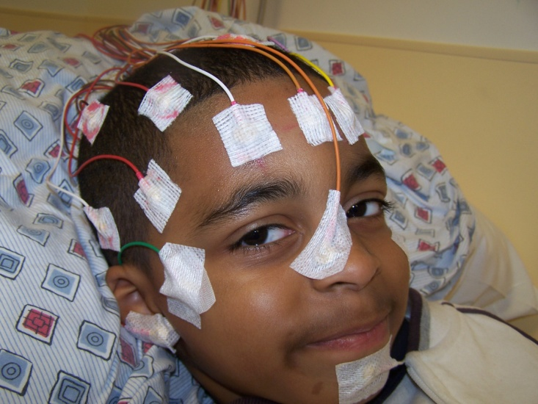
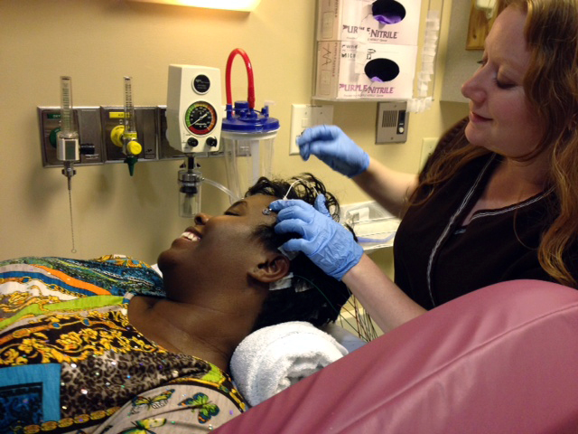
EEG
EEGs in the 21st Century!
An EEG in 1958
ASET – The Neurodiagnostic Society
Notes:
Hans Berger recorded the first human EEG on a patient with an intact skull. That patient was his son. Berger published his findings in 1929. As you can see, EEGs in the 1950s were rather bulky. What you cannot tell by the image is that up until the early 90s, needle electrodes were employed routinely in outpatient EEG labs.
Thankfully, as you can tell by the cute, smiling children on the right, EEGs don’t involve needles any longer. They are tiny metal discs, placed on the surface of the skin.
Glue or other adhesives help hold the sensors in place for extended periods but nothing that hurts.

Slide 7
Long-Term Monitoring (LTM)
The simultaneous recording of EEG and videotaped behavior over extended periods of time.
LTM is useful in diagnosing patients with intermittent or infrequent disturbances as well as in the diagnosis of seizures and other neurological disorders, such as unexplained coma.
Can be performed in:
Intensive Care Units (ICU)
Epilepsy Monitoring Units
ASET – The Neurodiagnostic Society
Notes:
LTM or long term monitoring is an application of EEG. It requires knowledge of video, and audio equipment, computer networking, data storage, archiving, as well as EEG.
The LTM technologist must employ their people skills to help patients handle being in one room for up to a week at a time. LTM technologists often have to be creative in entertaining young children to help keep little hands off of heads.
These studies are used to evaluate for spells, seizures, epilepsy, determining the focal area of seizure activity, and treatment of continuous seizures.
These tests can be performed in Intensive Care Units, Epilepsy Monitoring Units, Clinics or in homes.
Patients may have the electrodes applied and the recording set-up in their own homes. The technologist is able to monitor the EEG from a remote location.

Slide 8
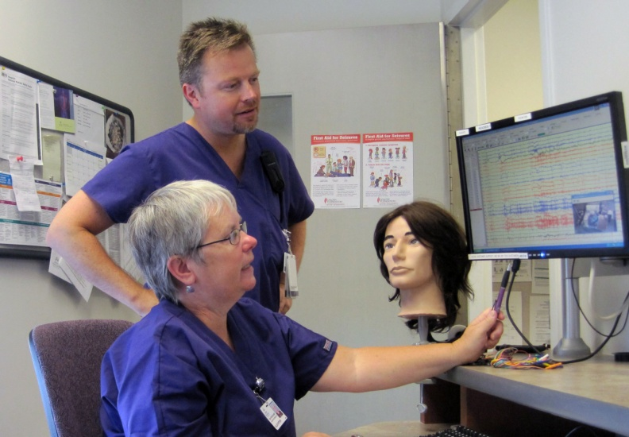
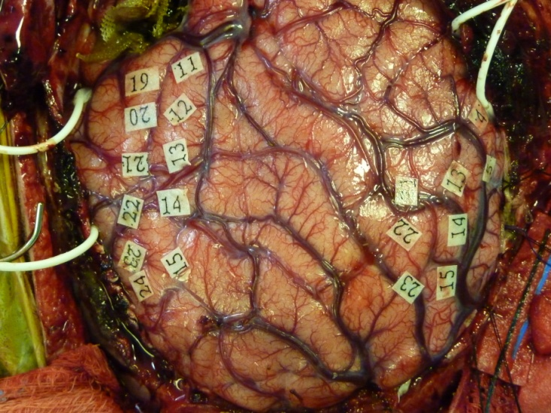
LTM
ASET – The Neurodiagnostic Society
Notes:
Long Term monitoring involves daily review of the EEG, the video, patient notes, and button presses to determine the cause of the patient’s events. It involves communicating with monitoring technologists, nurses and other caregivers to determine if medications were changed or other changes were made to patient care.
Busy EMUs or epilepsy monitoring units, often require a single technologist to review multiple LTM studies concurrently. Multitasking is a must for the LTM technologist.
Some advanced EMUs can be involved in monitoring patients with grids and strips that are placed directly on the surface of the brain to determine exactly where the seizure is starting. Surgery is planned carefully to only remove the starting location of the seizure, known as the focus.

Slide 9
Evoked Potentials (EP)
Recordings of electrical activity from the brain, spinal nerves, or sensory receptors in response to specific external stimulation.
Evoked potentials are helpful in evaluating a number of different neurological problems, including spinal cord injuries, hearing loss, blurred vision and blind spots.
This test can be performed during surgery on the spine to help the surgeon make sure nerves are not damaged during the operation.
Evoked potentials also are performed in a clinical neurodiagnostic laboratory, using either earphones to stimulate the hearing pathway, a checkerboard pattern on a television screen to stimulate the visual pathway, or a small electrical current to stimulate a nerve in the arm or leg.
ASET – The Neurodiagnostic Society
Notes:
Evoked potentials, here is your chance to shock someone!
Seriously, in somatosensory evoked potentials, small electrodes or sensors are placed at the ankle, wrist , knee or elbow to stimulate a patient’s nerves. These sensors deliver an electrical shock, we call it a small pulse. This impulse should be enough to make the thumb, pinky or toes twitch and not more than that. It is an unusual sensation, some patients report it feels like an electric fence. I thought it felt similar to the small pulse received when an outlet is not properly grounded.
This pulse travels through the nerve and is recorded along a series of points to the scalp. The waveform generated by the pulse is measured and analyzed for shape, latency and amplitude. The location of a delay, reduction in amplitude or a broadening of the waveform can help the physician narrow the diagnosis.

Slide 10
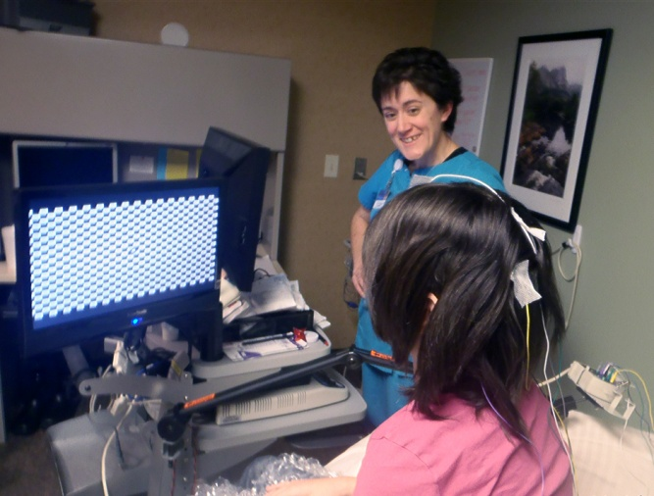
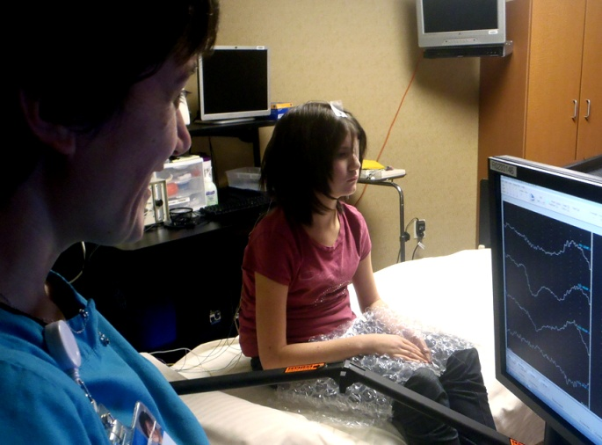
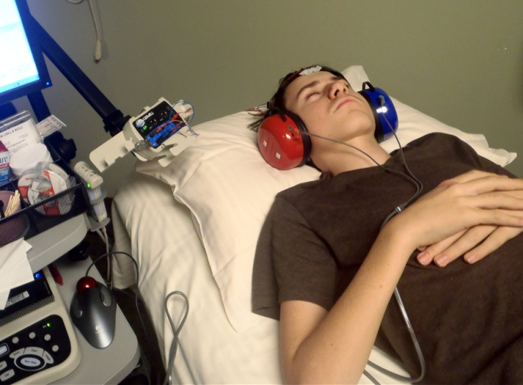
EP
ASET – The Neurodiagnostic Society
Notes:
Visual evoked potentials involve less than five electrodes on the scalp, a pirate eye patch and a checkerboard. The optic nerve is stimulated by simply watching a set pattern from a set distance. Typically this test is performed to evaluate for multiple sclerosis as the first symptom is most often vision changes.
Auditory evoked potentials involve only three electrodes, headphones and a monotonous tone. The auditory nerve is stimulated by the monotonous tone and the resultant waveform is measured for five separate points which correlate with very specific portions of the auditory pathway. Typically this test is performed to look for tumors on the auditory nerve.

Slide 11
Intraoperative Neuromonitoring (IONM)
The use of neurophysiological monitoring techniques during surgery to provide information to the surgeon about nervous system integrity.
The use of IONM guards against neurological complications during surgery and helps reduce the risk of negative surgical outcomes such as paralysis or stroke.
IONM is used to monitor neurosurgical, vascular, and orthopedic procedures, including spinal surgery for scoliosis, tumor removal, and aneurysms.
ASET – The Neurodiagnostic Society
Notes:
Intraoperative Neuromonitoring is only for those who can stand cold, sometimes hostile environments, play by play stories, multitasking and blood and internal body structures. The IONM technologist must be willing to stand or sit for hours, climb under tables, contort their body in odd positions to reach electrodes and be confident in their skills enough to speak up in the OR.
IONM helps to protect the patient’s nervous system during neurological, vascular and orthopedic procedures. IONM involves a wide variety of neurophysiological testing procedures running concurrently.
The IONM technologist must be skilled at communications with a wide variety of staff as they must keep in constant contact with surgeons, anesthesiologists, nurses, OR technologists and interpreting neurologists.
IONM is hands on, live protection to patients.
An IONM technologist can be employed by a hospital, private monitoring company or self employed.
Some IONM technologists have left the practical field to serve as educators, sales persons, trainers for equipment companies or medical school.

Slide 12
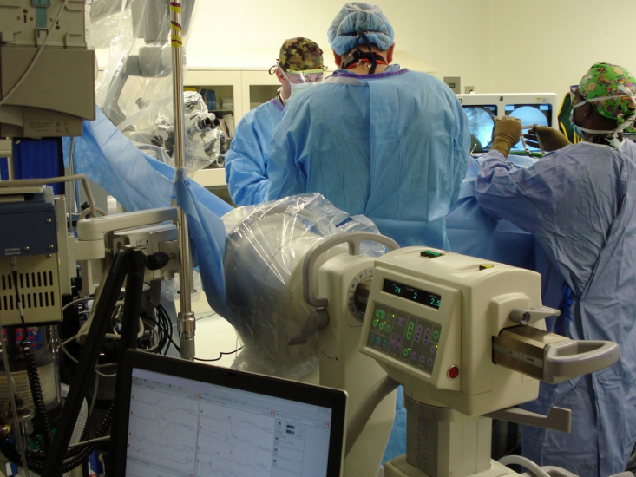
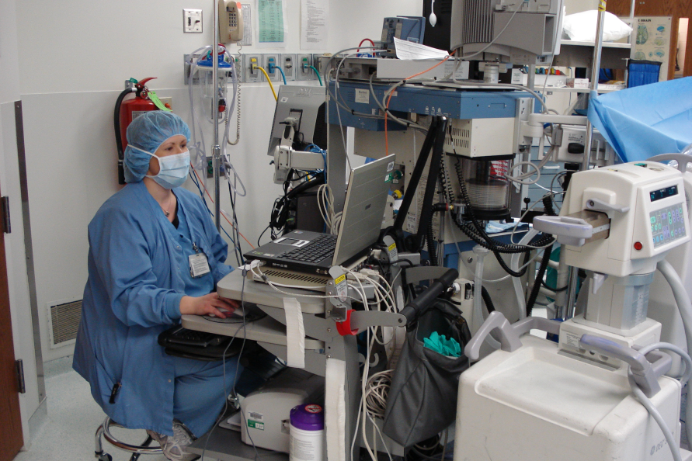
IONM
ASET – The Neurodiagnostic Society
Notes:
The carotid arteries in the neck carry blood flow to the brain. When these arteries become clogged, blood flow to the brain is decreased. During surgery to clean these arteries, monitoring helps to determine if collateral blood flow is maintained. If the EEG activity decreases and the SSEPs are reduced or eliminated, the clamp must be removed and the process stopped to prevent stroke.
Upper and lower somatosensory evoked potentials are used during spinal cases to closely monitor the function of the nerves when the spine is manipulated.
Auditory evoked potentials are monitored during tumor resections particularly when the facial nerve is at risk.

Slide 13
Nerve Conduction Studies (NCS)
Evaluate electrical potentials from peripheral nerves.
Technologists stimulate the nerve with an electrical current and then record how long it takes the nerve impulse to reach the muscle.
Patients can suffer from nerve conditions which produce numbness, tingling, muscle pain, muscle weakness, muscle cramping, abnormal movements, pain or loss of sensation, or neurological diseases affecting primarily the feet, legs, hands, arms, back, and neck.
ASET – The Neurodiagnostic Society
Notes:
Nerve conduction studies evaluate peripheral nerve function by calculating the speed of the impulses traveling along a nerve.
Nerve conduction studies can occur on limbs, chest walls, faces and other locations on the body. These studies can be used in the operating room to monitor neural pathways during surgery as well.
Lou Gehrig’s disease, carpal tunnel syndrome, neuropathies, and other nerve disorders are diagnosed through nerve conduction studies.

Slide 14
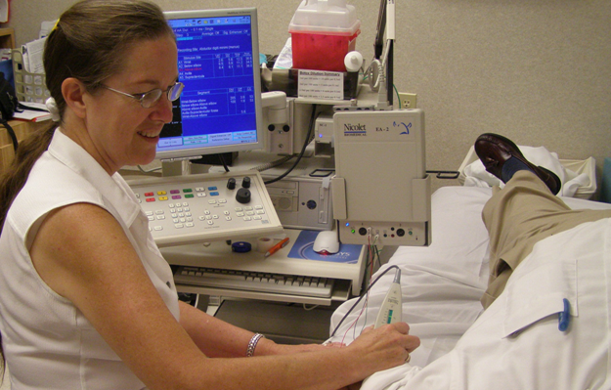
NCS
ASET – The Neurodiagnostic Society
Notes:
Nerve conduction technologists can perform these in a clinic setting, hospital or operating room. Typically these tests are performed in conjunction with the muscle tests known as EMG.
A meticulous nerve conduction technologist will review the patient’s chart prior to their arrival, determine which nerve conduction tests need to be performed and develop a preliminary idea about possible diagnoses. They will gather a thorough history from the patient and assess the patient’s body temperature, medication list and complaints prior to beginning the test.
Similar to the other neurodiagnostic tests, the nerve conduction technologist performs the test and writes a technologist report. The technologist presents this information to the interpreting physician for a final diagnosis.
In the operating room, the neurophysiology technologist must do the set up and monitoring for both nerve conductions and EMG.

Slide 15
Polysomnography/Sleep (PSG)
A recording during sleep that uses EEG and other physiologic monitors to evaluate sleep and sleep disorders
loud snoring,
difficulty staying awake during the day,
falling asleep at inappropriate times,
insomnia
Physicians use polysomnograms to identify dysfunction in sleep/wake cycles, to diagnose breathing disorders during sleep, and to evaluate treatment of these disorders.
ASET – The Neurodiagnostic Society
Notes:
Polysomnography or PSG is a diagnostic test that employs EEG, EKG, respiratory monitoring, EMG monitoring (no needles), video and audio to determine the causes of sleep disorders.
Patients can be recorded at home or sent to a clinic, sleep lab or hospital. Reasons for referral to a sleep study include: snoring, difficulty staying awake during the day, falling asleep during conversations or while driving or insomnia.
Diagnoses that result from PSGs include: sleep apnea, REM behavior disorder, insomnia, narcolepsy, periodic limb movements during sleep and restless legs syndrome.
Some sleep labs have developed support groups for their patients.

Slide 16
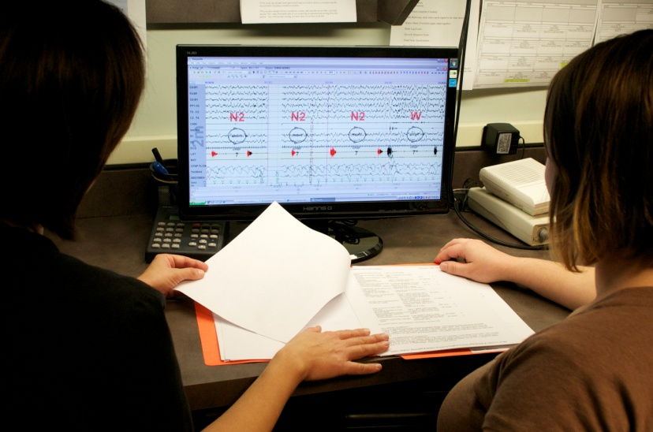
PSG
ASET – The Neurodiagnostic Society
Notes:
Polysomnography technologists work overnight shifts, apply multiple types of physiologic monitors to the patient, review video, audio, EEG and many other physiological channels to assess their patient’s sleep.
Seizures have been discovered through PSG studies.
PSG studies sometimes reveal lack of sleep due to poor sleep hygiene.

Slide 17
We answer the age old question: Who is taking care of your brain?
ASET – The Neurodiagnostic Society
Notes:
Your mechanic must be certified. Your physician must be a graduate of a medical school. Even your nurse must be registered.
Your technologist should be registered or working toward their registry. Who is taking care of your brain?
PLAY VIDEO

Slide 18
Places of Employment for Neurodiagnostic Technologists
Hospitals
Operating Rooms
Intensive Care Units
Neurodiagnostic Labs
Research
Outpatient Clinics
Private Doctor’s Offices
Equipment Vendors
ASET – The Neurodiagnostic Society
Notes:
We are versatile.
We can be employed in clinics, hospitals, operating rooms, specialty labs, research, private offices, universities and colleges, equipment vendors, sales, development, legislation, management, self employed, monitoring from home, traveling companies for variety and the military.
As a hospital employee, you have daily variety but may have to take part in a call rotation and will have to work some holidays.
As an IONM technologist, you can work for a hospital or private monitoring company.
Equipment vendors need technologists to train technologists on their equipment, to test and help develop equipment and to sell their equipment.
Home based monitoring companies need technologists to monitor from home, to visit patients at home to set up the recording, to be online support and to process data.
Don’t forget, technologists can work for equipment manufacturers as tech support.

Slide 19
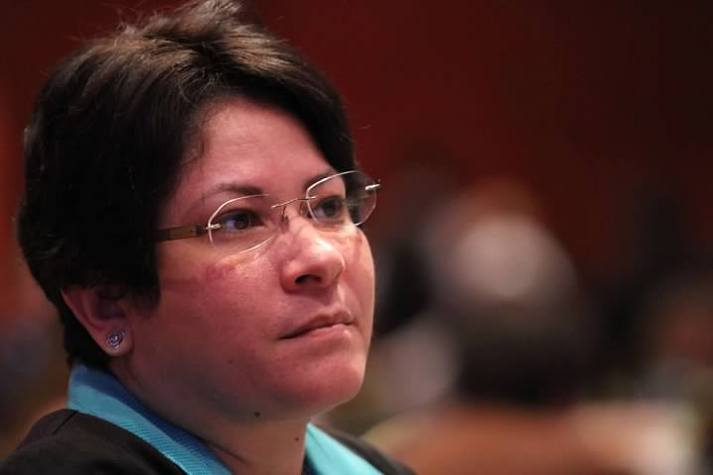
We asked: What do you enjoy most about being a Neurodiagnostic Technologist?
“The neurodiagnostic profession has given me the opportunity to share my knowledge and, most important, change people’s lives. We as technologists change people’s lives in many ways! This gives me a sense of accomplishment and such a rewarding feeling.”
Susan Agostini, R. EEG/EP T., CLTM, FASET
Neurodiagnostics/Epilepsy Monitoring Unit Manager
Banner Good Samaritan Medical Center
Phoenix, AZ
ASET – The Neurodiagnostic Society
Notes:
Susan emphatically shares what she enjoys most about being a neurodiagnostic technologist.
I can guarantee that Susan’s feelings about this field are echoed by many others in the profession.

Slide 20
Who are Our Patients?
Quite simply… Everyone!
We make a difference for patients of all ages from newborns to the elderly
We help patients with neurological disorders and diseases, including:
Epilepsy
Strokes
Traumatic Brain Injury
Etc…
ASET – The Neurodiagnostic Society
Notes:
Our patients are everyone. Our patients range from premature babies to the centurions. Neurological disorders do not discriminate against age, gender, social or economic status. They are reflected in famous personalities, movies and books, and affect us all.
Some of us have joined the field because we or a loved one suffers from a neurological disorder.

Slide 21
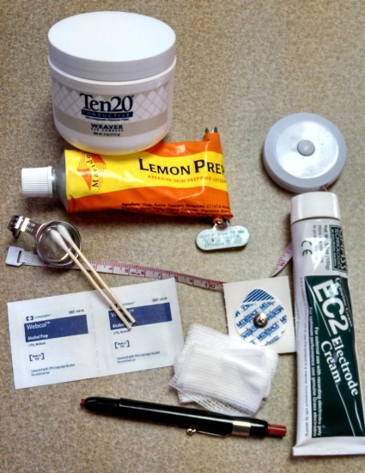
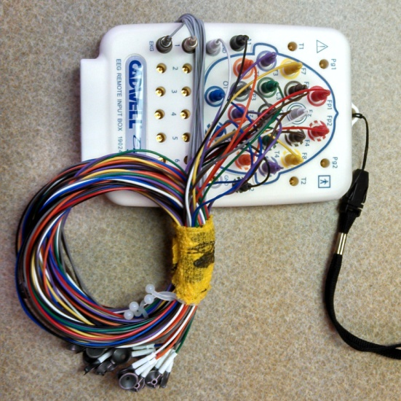
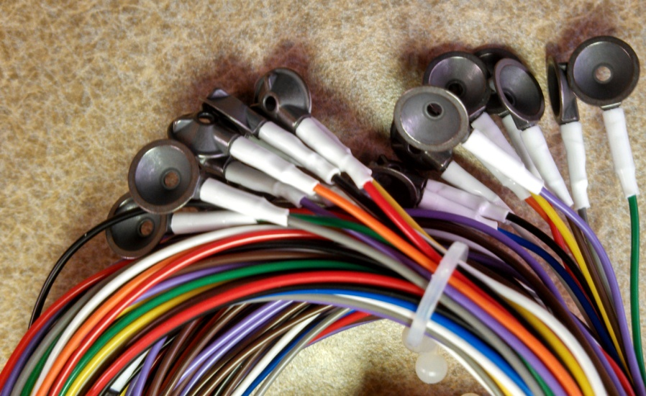
What Tools & Equipment Do We Use?
We use electrodes, gels, pastes, and tape measures on the patient
We color, paste, play with flashing lights and occasionally give small shocks
No drawing blood, catheters, IVs, or bed pans
ASET – The Neurodiagnostic Society
Notes:
In every area of neurodiagnostics, we employ a wide variety of tools and specialized equipment. We use colored pencils, tape measures, cotton tip applicators, tongue depressors, gauze head wraps, alcohol prep pads, abrasive facial cleansers, sticky paste, electrodes, cables, video cameras, flashing lights and stimulators that deliver shocks.
We only use needles in sedated patients. We do not use catheters, IVs or bed pans. We provide tissues to grieving or scared patients and family members.

Slide 22
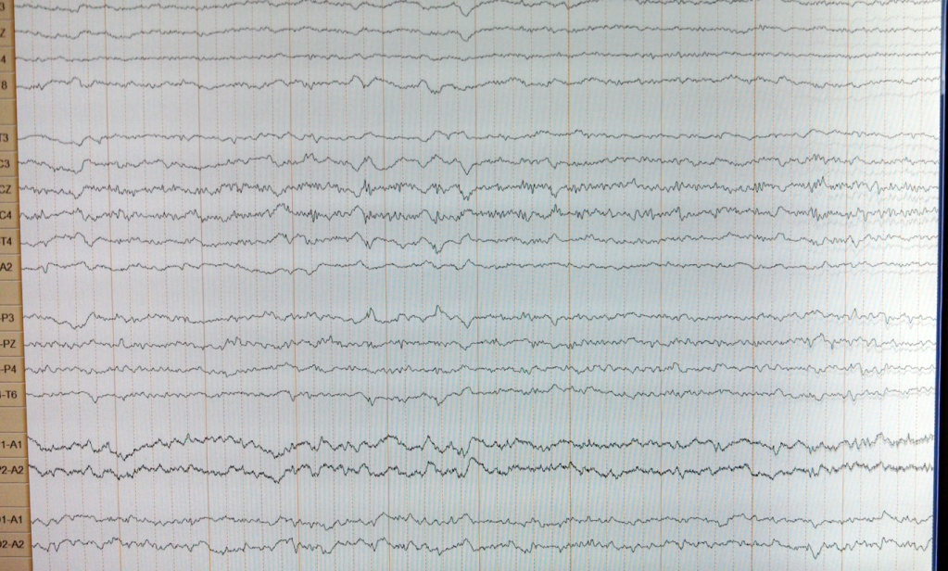
Equipment
ASET – The Neurodiagnostic Society
Notes:
We use computers to record data, to stimulate nerves, and to monitor patients. We employ theories developed by the founders of neurophysiology to assess nervous system function.

Slide 23
Bright Outlook
According to the U.S. Department of Labor, Neurodiagnostic Technologists have been listed as an occupation with a “Bright Outlook”
We are listed as a new and emerging occupation in a high growth industry http://www.onetonline.org/help/bright/29-2099.01
The average annual salary is $44,200 for a recent neurodiagnostic program graduate just entering the field to over $112,333 per year for full-time, self-employed neurodiagnostic professionals. The average annual salary for all neurodiagnostic technologists across the country is $65,226 based on data collected in 2011.
ASET – The Neurodiagnostic Society
Notes:
We have a bright outlook, which means that job growth is expected to continue through 2020. There are more job openings, than people to fill them.

Slide 24
Neurodiagnostics – What Does It Take
If you are good in science, math, English and communications – you would love Neurodiagnostics.
If you like to solve problems, figure out puzzles, study patterns and what they mean – you may thoroughly enjoy this field.
If you strive to be part of a team of professionals across the world that actively participate in educating others, this profession is for you!
Be a part of a growing field that tests the central, peripheral and autonomic nervous system; the only system of the body that cannot be replaced, substituted, or transplanted!
ASET – The Neurodiagnostic Society
Notes:
Neurodiagnostics takes a caring person. A person who employs curiosity of scientific methods and medical processes to solve problems. Only team players need apply as the neurodiagnostic technologist must work with others constantly, nurses, physicians, other technologists, aides, schedulers, billers, salesman and CEOs.
People who love the challenge of piecing together a puzzle are great at recognizing patterns and will make excellent neurodiagnostic technologists.
Neurodiagnostic technologists must maintain a learning attitude as the body is a constant learning process, that is why it is called ”practicing medicine”.

Slide 25
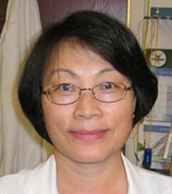
We asked: What prompted or motivated you to enter the Neurodiagnostic Profession?
“I entered the neurodiagnostic profession out of both a curiosity and a desire to understand how the brain works. I am so proud that my work has helped improve the lives of my patients. Today, my profession serves as a source of confidence, knowledge, and passion in my life.”
Jie Zhang, BS, R. EEG/EP T., CNIM, CLTM, FASET
Clinical Neurophysiology Supervisor
Medical University of South Carolina
Charleston, SC
ASET – The Neurodiagnostic Society
Notes:
Jie entered the field of Neurodiagnostics because of her curiosity of the brain. Some of us came on board by having had the test performed on ourselves. Others joined the field by accident, just looking for a job and it was available.
So many ways to engage in this opportunity. Now is the time.

Slide 26
Neurodiagnostic Technology Programs
Contact information, degree specifications, and program length are available online at www.aset.org/ndschools
ASET – The Neurodiagnostic Society
Notes:
Neurodiagnostic schools are spread across our nation. Many of them have online programs. Most of them have affordable options and can work with motivated students to obtain a rewarding education.
Most schools offer a Certificate or Associate Degree program. Bachelor Degree programs for Neurodiagnostic Technology are being developed.
Schools are located in Arizona, California, Colorado, Florida, Illinois, Indiana, Iowa, Maryland, Massachusetts, Michigan, Minnesota, New Jersey, North Carolina, Ohio, Pennsylvania, South Dakota, Tennessee, Texas, Washington and Canada.
Maryland, Massachusetts, North Carolina and Pennsylvania offer online programs.

Slide 27
For More Information about a Career in Neurodiagnostic Technology:
ASET - The Neurodiagnostic Society
Contact us at:
Phone: 816.931.1120
Email: info@aset.org
Visit our website:
www.aset.org
ASET – The Neurodiagnostic Society
Notes:
ASET – The Neurodiagnostic Society brings together technologists across the nation for education, legislation, empowerment and friendships.
Contact us to learn more about the profession.

